Slide 1
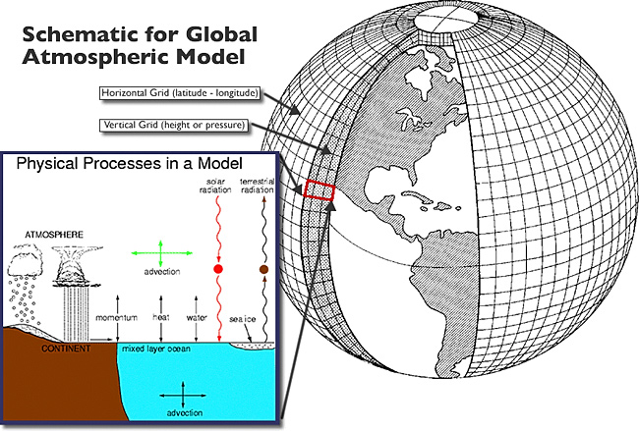

The CCAM as operational seasonal forecast system
Willem A. Landman
Francois Engelbrecht
Ruth Park

Slide 2
Building an optimized CCAM seasonal forecast system
Objective: to produce skilful seasonal forecasts at lead-times up to 6 months
Operational seasonal forecast development is a function of the ability of the next “best” system to outscore the current base-line skill
  After AGCMs, CGCMs is theoretically the next “best” system (challenge for WG3)
Optimal systems have the best chance to capture important modes of variability and their link to SADC’s seasonal-to-interannual variability
A large AMIP and hindcast data set will be available for this purpose: Challenge for WG1

Slide 3
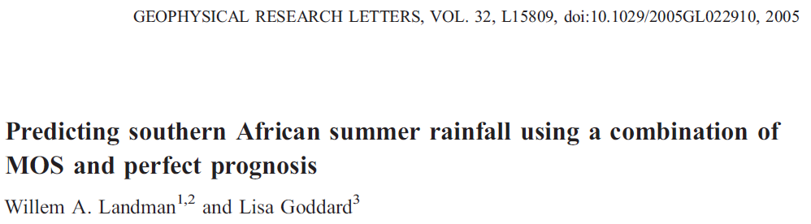
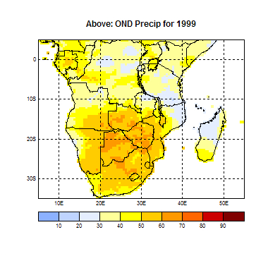
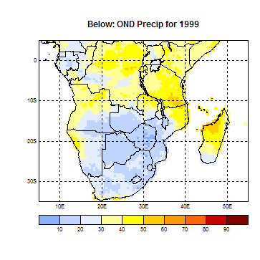
Old operational approach

Slide 4
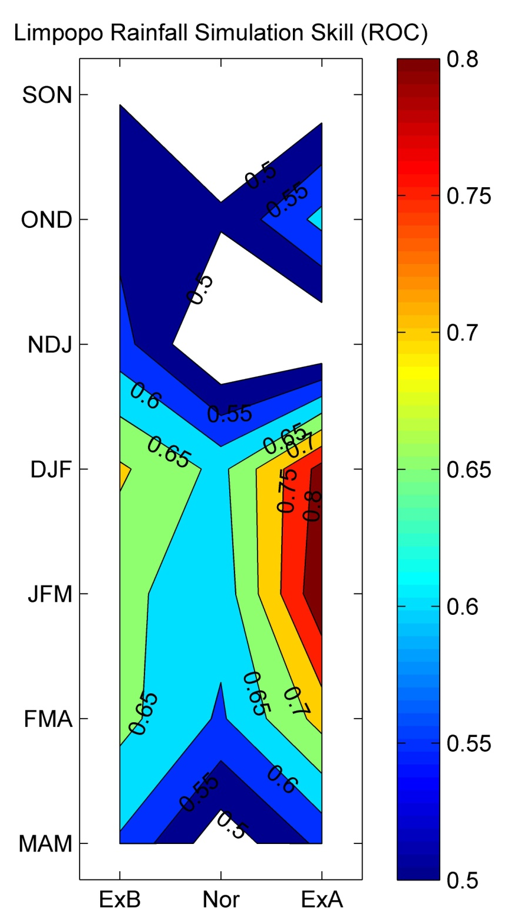
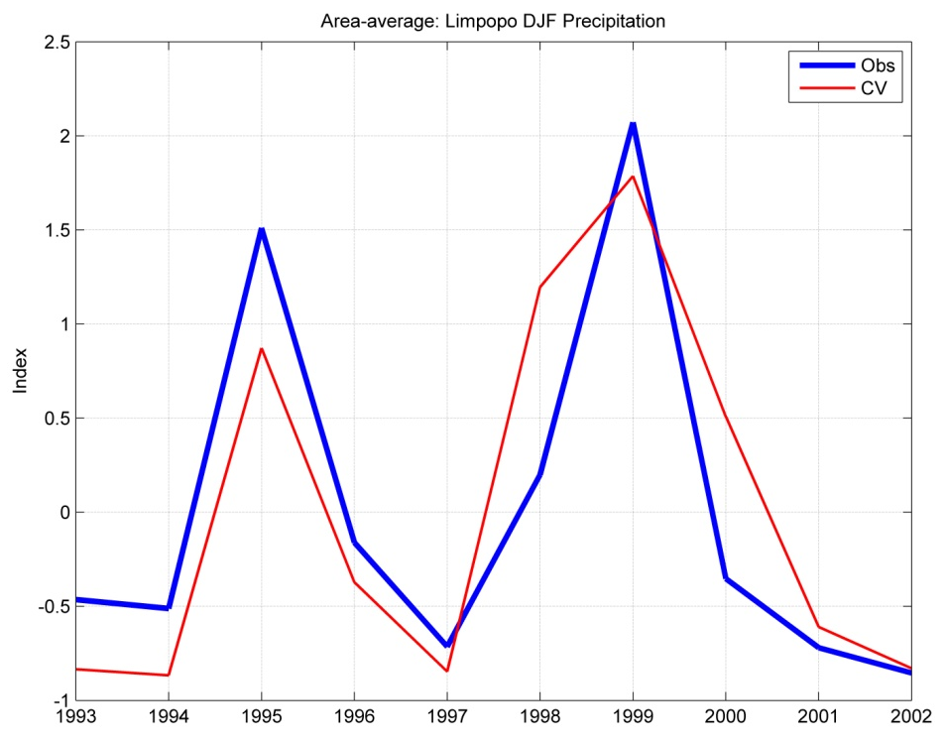
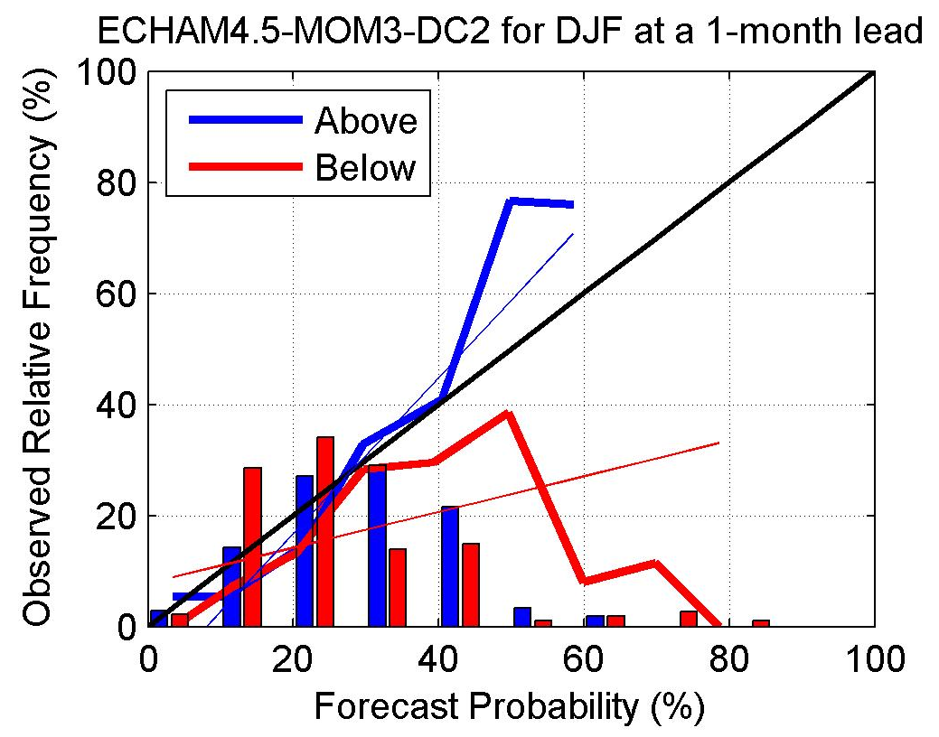
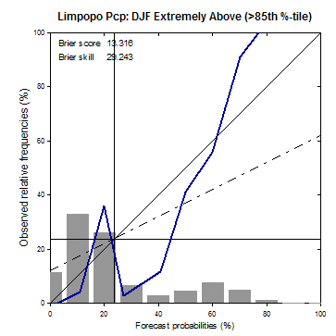
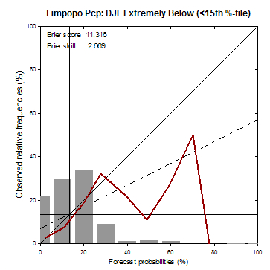
Verification of old system: Limpopo
(also a challenge for WG2)
WG3: To improve on drought forecasting

Slide 5
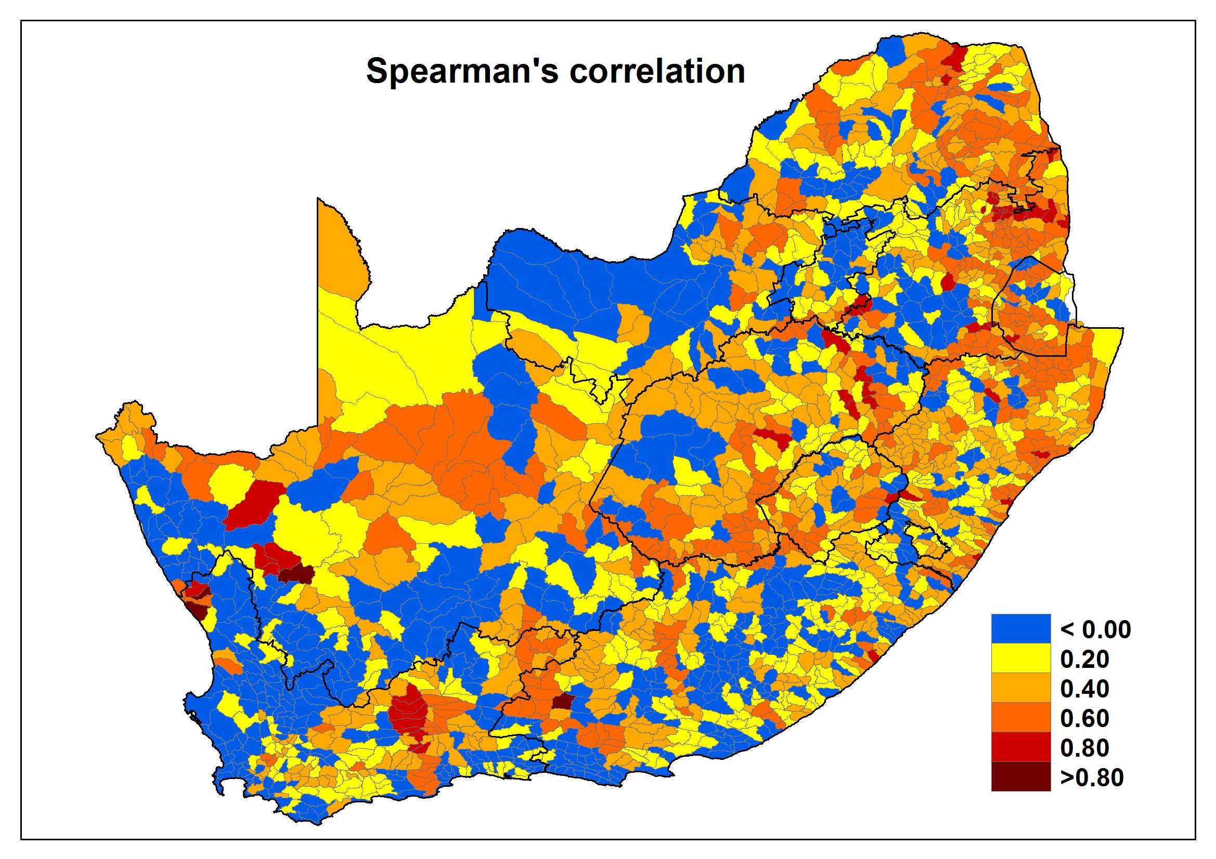
Streamflow forecast skill (DJF)
850 hPa CCAM simulations downscaled to streamflow

Slide 6
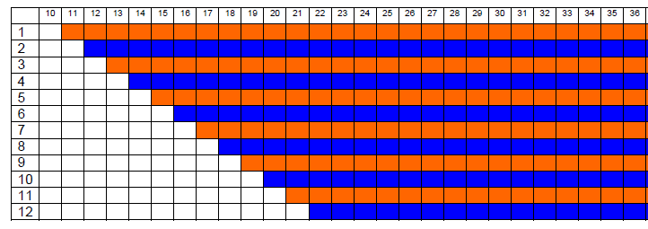
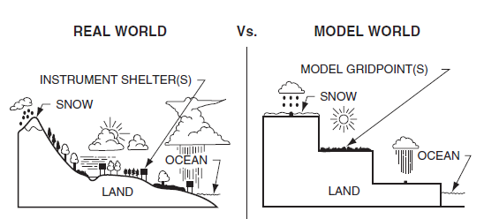
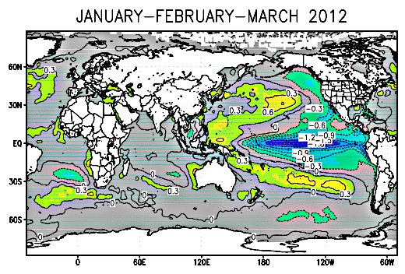
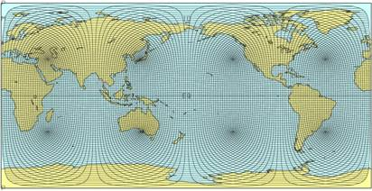
New operational approach
Atmospheric ICs
Model Output Statistics
NCEP/GFS
Boundary Conditions
Resolution ~200km

Slide 7
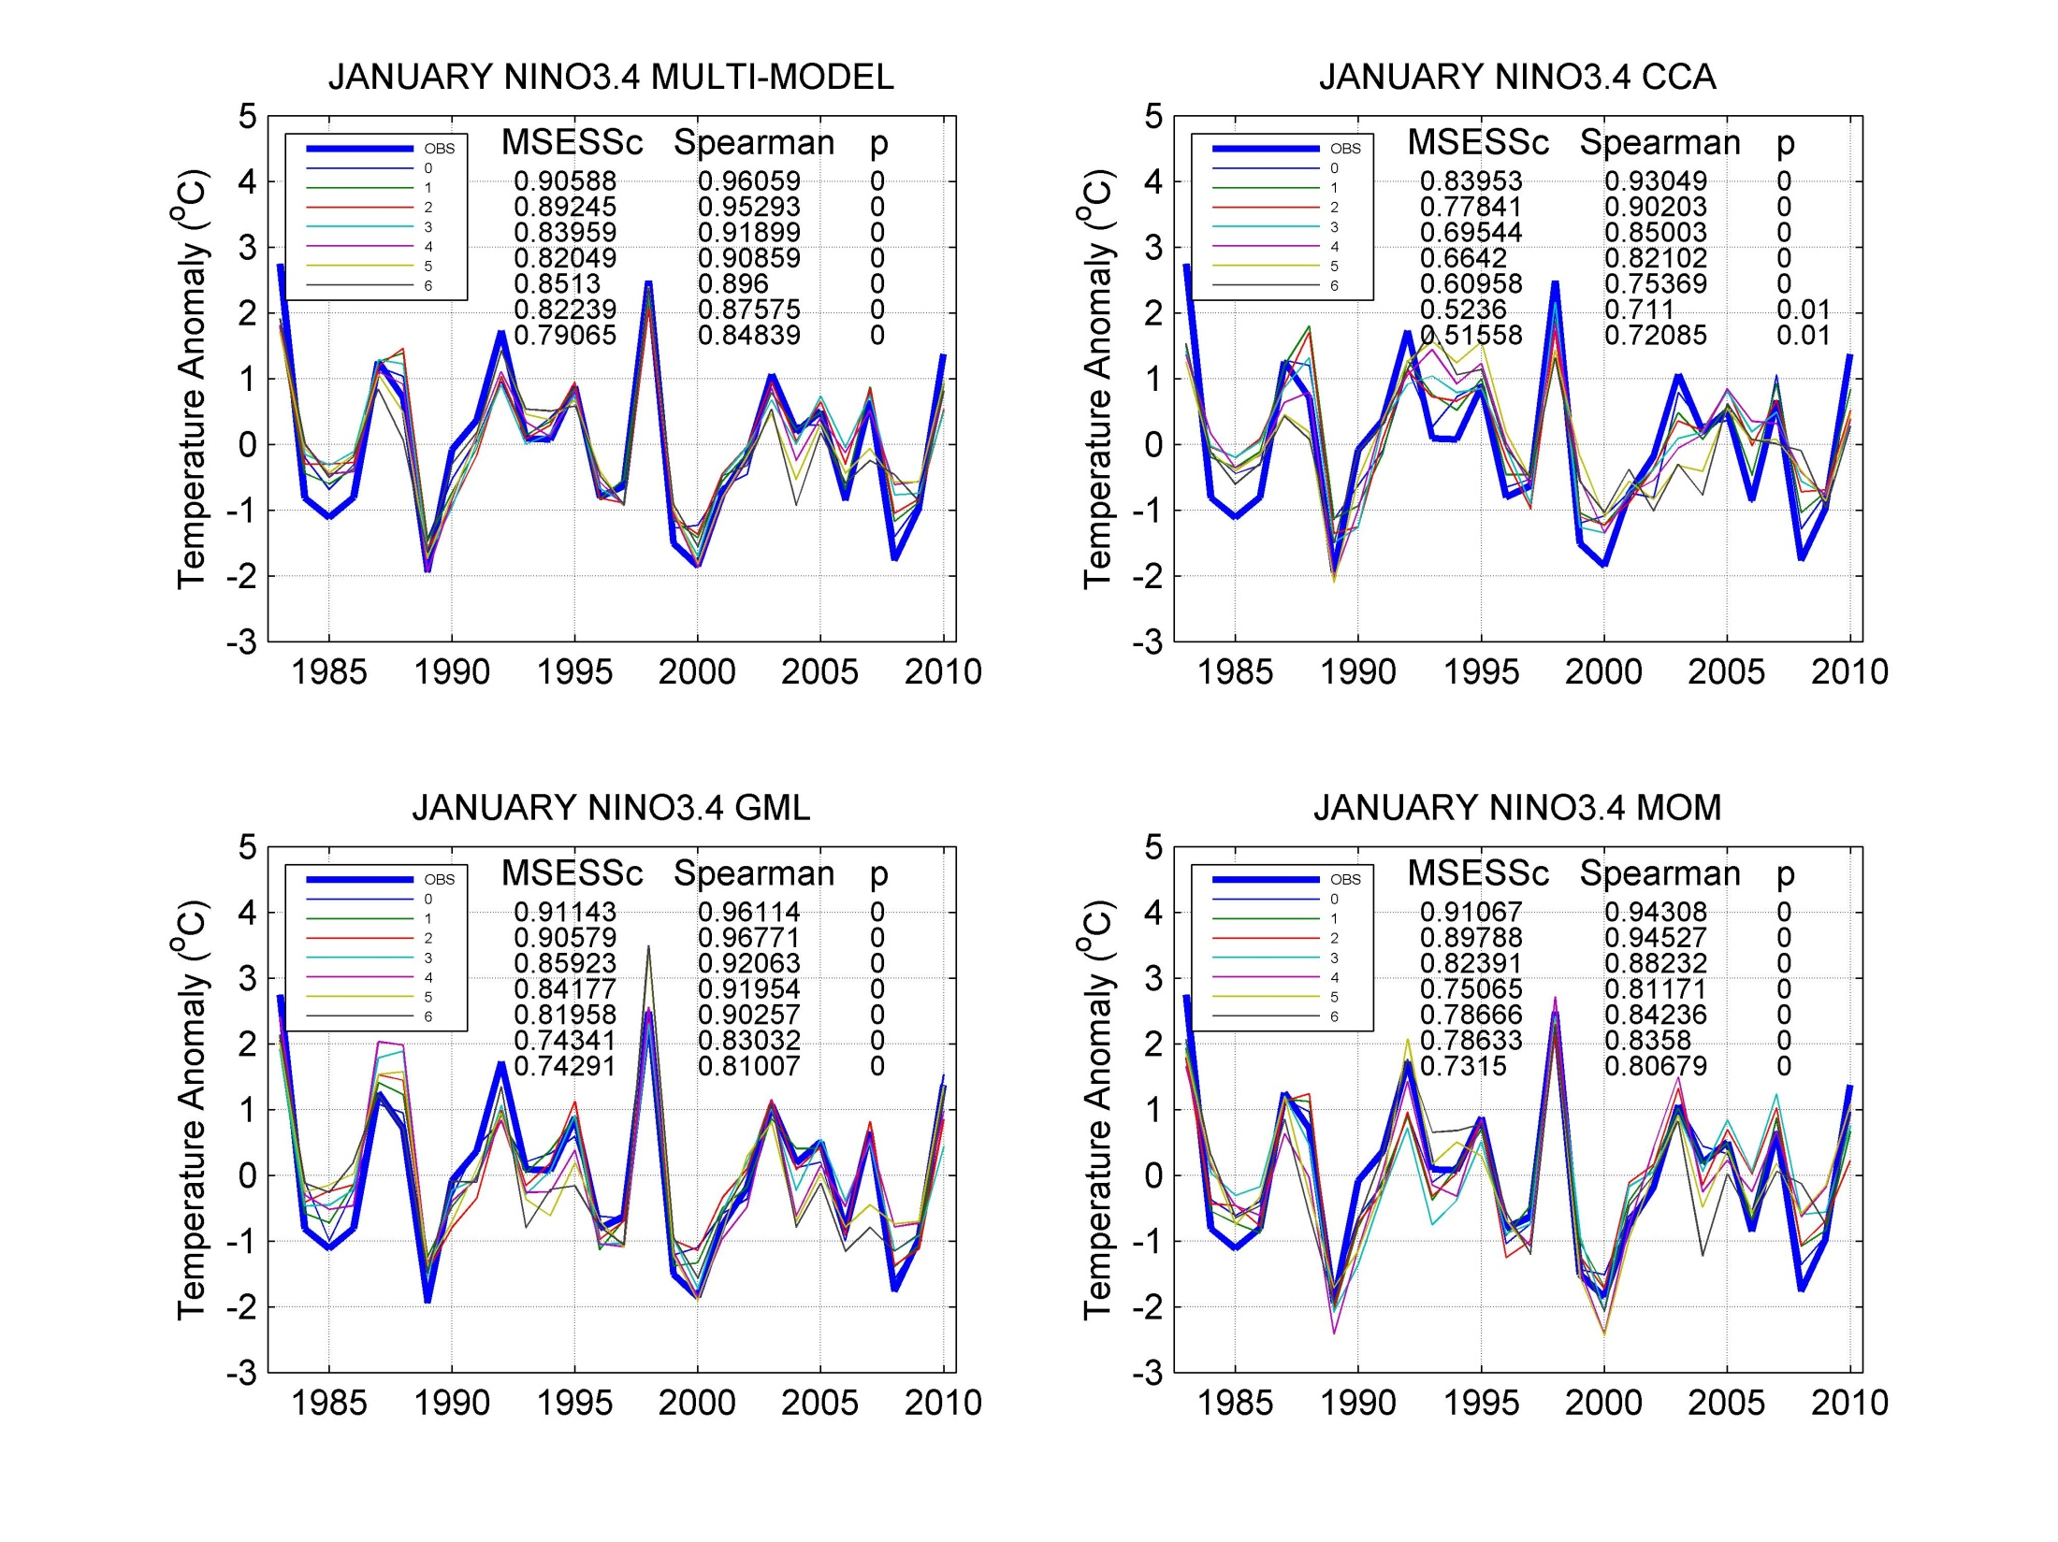

Slide 8
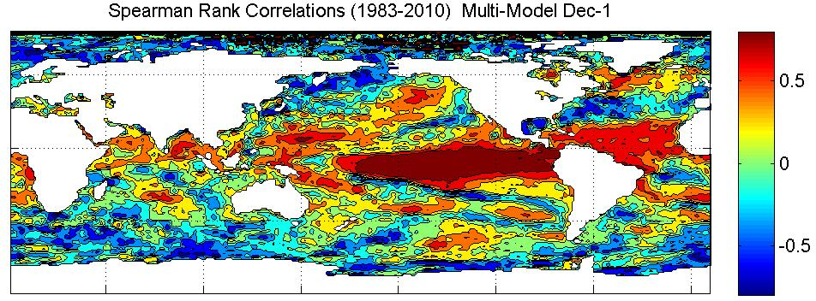
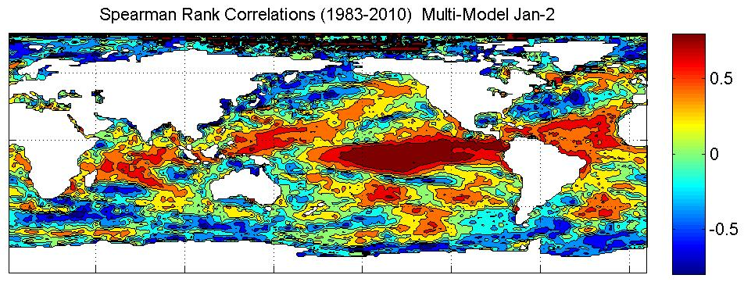
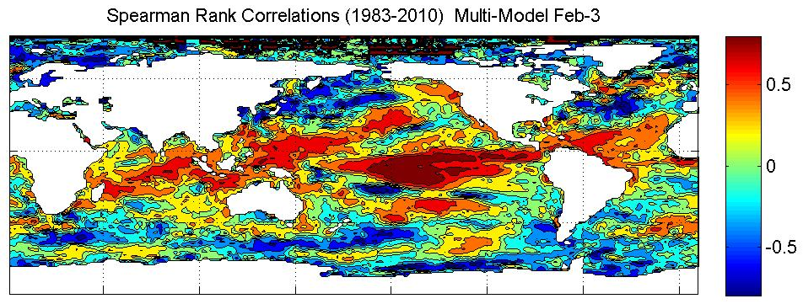
Should we direct (some of) our focus to the southern/mid-latitudinal
ocean?
Challenge for WG3?

Slide 9
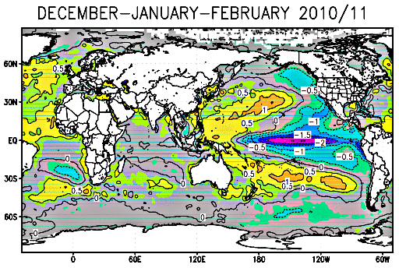
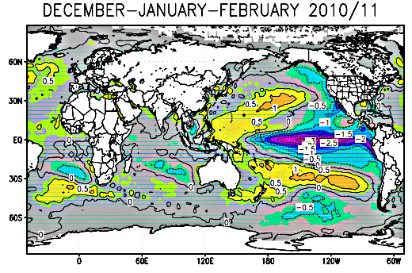

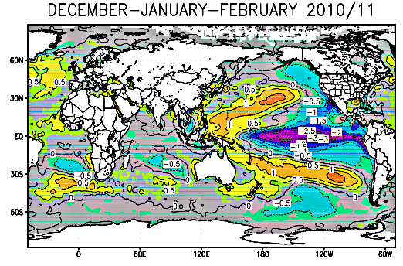
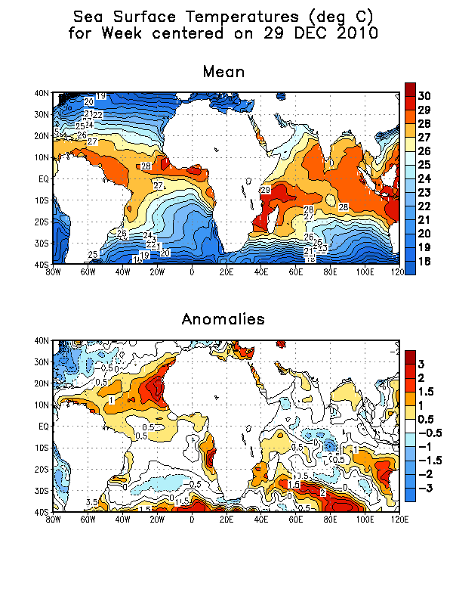
Predicted Subtropical Dipole Modes during 2010/11
AUG ICs
SEP ICs
OCT ICs
Inclusion of SINTEX-F forecasts in the MM should improve skill
NOV ICs

Slide 10
Imminent development
AMIP
  1979 to 2008
  6 ensemble members
Hindcasts with predicted SSTs
  1982 to 2010
  10 ensemble members
Verification statistics
  SVSLRF
Applying forecasts to
  Streamflow
  Maize yield

Slide 11
What about the land?
Land surface conditions may modulate the response of the atmospheric circulation to SST anomalies
Agents of climate memory at the land surface
  Soil moisture
  Snow cover
  State of vegetation
“If the general circulation alone determines local anomalies, and SST determines the general circulation, then there is little hope for enhancing prediction during boreal summer by improved land surface representation”
Is there latent predictability over a land region to be harvested from the land surface state? If so, would it supersede SST influences?
CCAM will be integrated, coupled to the dynamic land-surface model CABLE, in an attempt to investigate the relative role of the land-surface in forcing seasonal rainfall and temperature anomalies over southern Africa

Slide 12
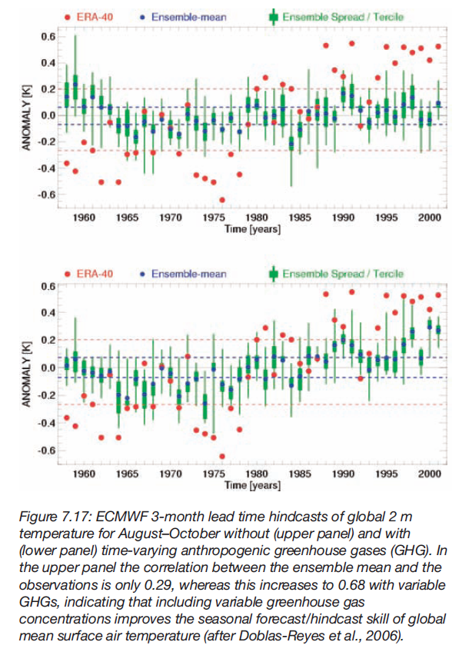
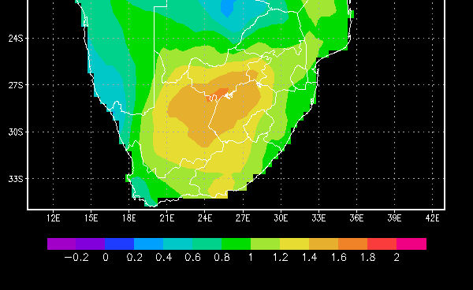
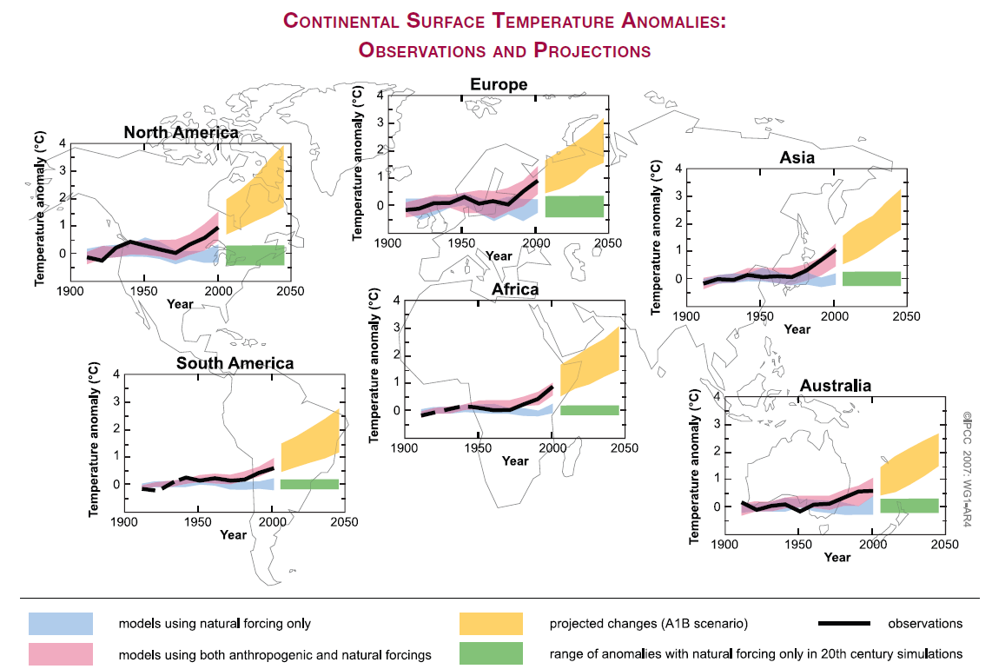
ENSEMBLES
1901-2002
Strong anthropogenically forced warming trends have been observed over southern Africa and are projected to continue to rise, consequently justifying the investigation into how the annual update of greenhouse gas (GHG) concentrations in a global model may affect seasonal forecast performance over the region.

Slide 13
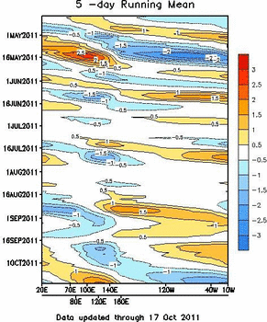
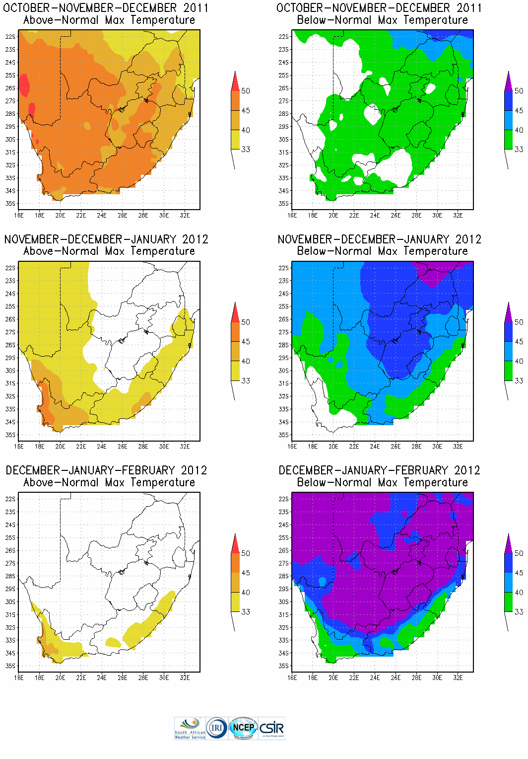
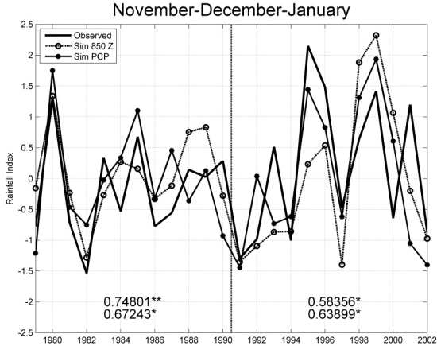
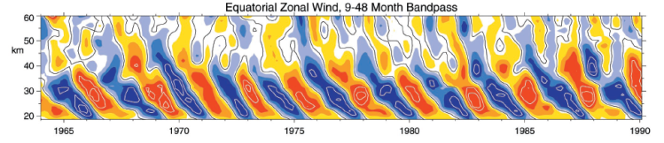
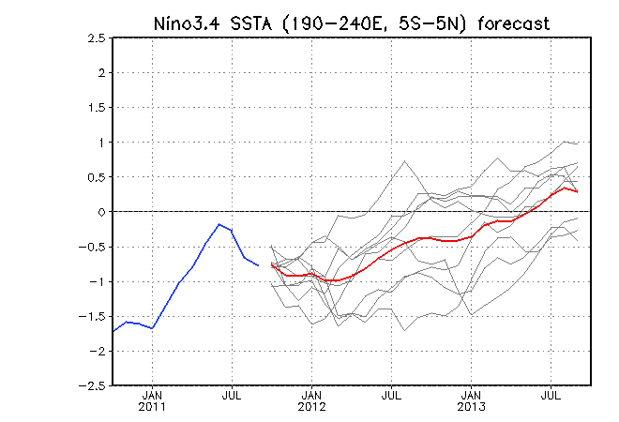
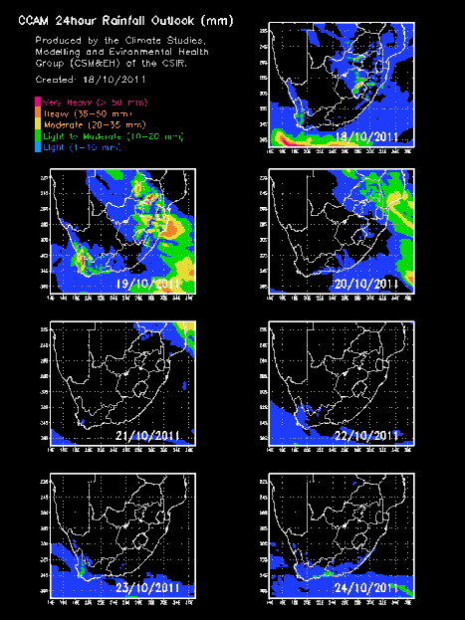

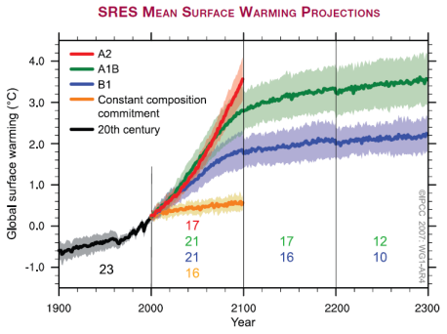
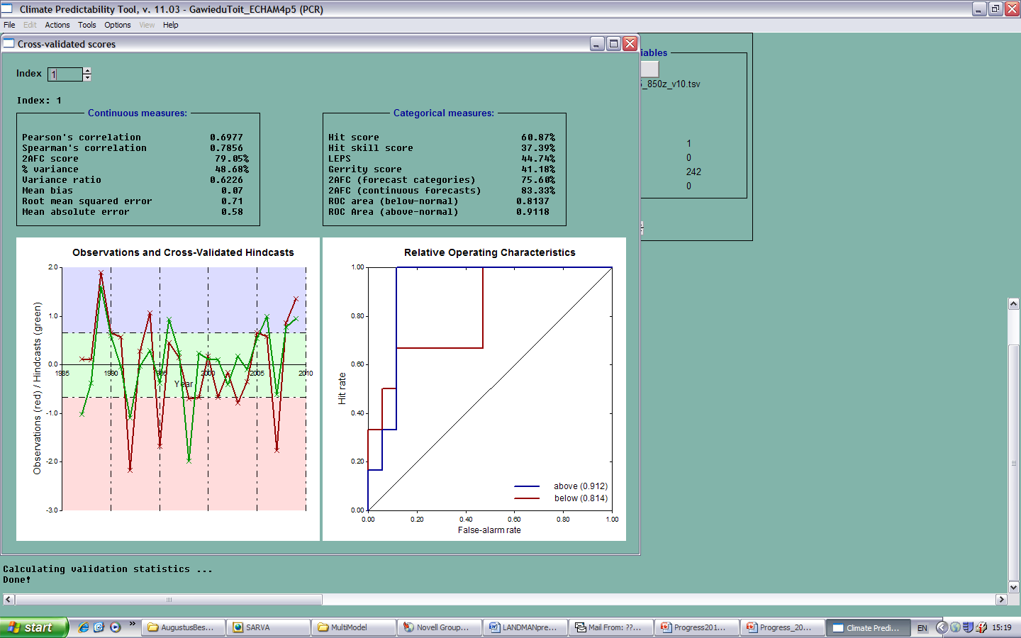
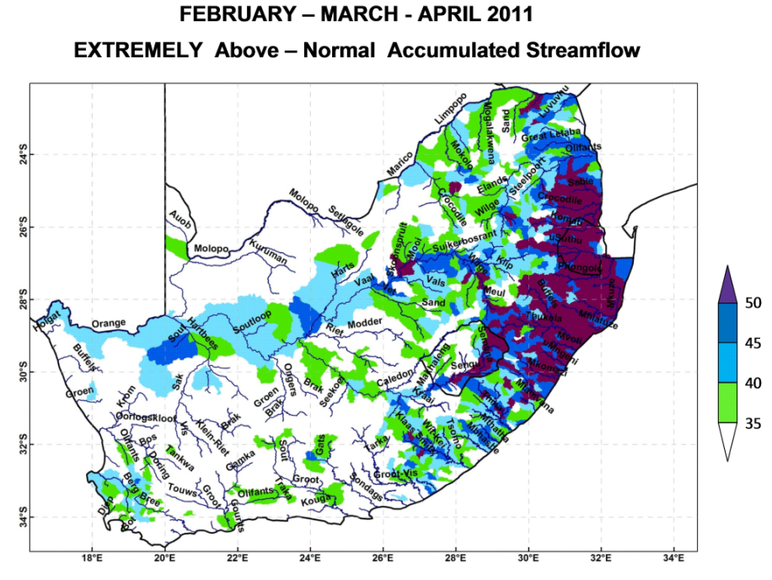
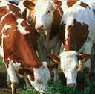
Future plans: SATREPS-2 ??
APPLICATIONS
Medium- to extended-range (beyond 3 days)
Seasonal forecast system (current SATREPS)
1-3 years; decadal
Diseases
Maize yield
River flow
Livestock

Slide 14
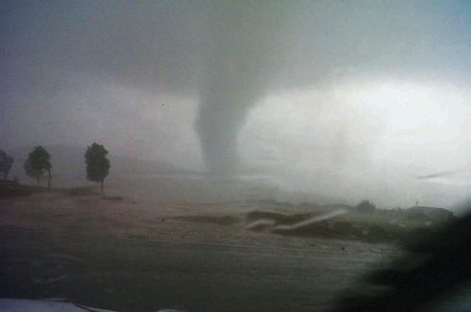
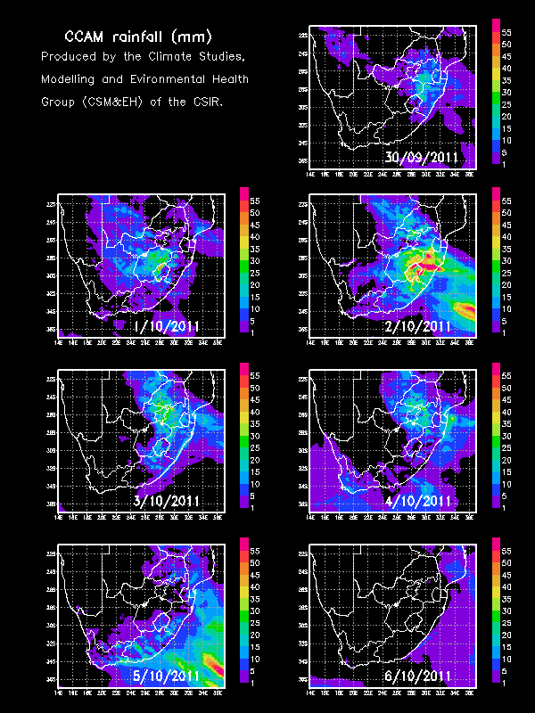
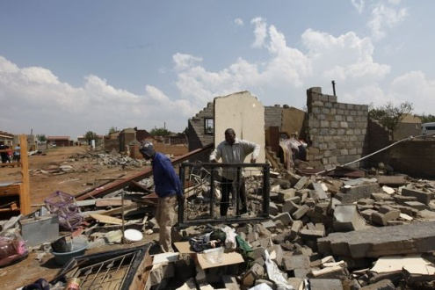
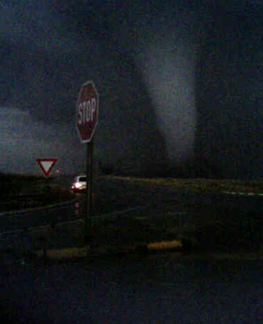
Tornado Sunday
Hundreds of homes were destroyed in Ficksburg in the Free State. Another tornado hit the East Rand and caused extensive damage to Duduza, near Nigel. Two children died.

Slide 15
Final comments…
Optimal AGCM configuration will benefit from sensitivity studies using AMIP (to determine, for example, Cu scheme, etc.) [WG3]
Resources should continue to be directed towards AGCM optimization [WG3]
  about ½ resources required compared to CGCMs – higher resolution, bigger ensemble
  SA modellers focussing on CGCM development/use – must outscore baseline to justify effort
More effort should be directed towards analysing AGCM hindcast/AMIP data to understand processes [WG1]
Hindcast global SST set: 28 years, 6 months lead-time, AND operational SST forecasts available from CSIR FTP site (UCT-CSAG already using it for AGCM predictions, soon at SAWS and at CSIR) [WG3/4]
Strong emphasis on applications modelling [WG4]

