Slide 1



South African Seasonal Rainfall Prediction Performance by a Coupled Ocean-Atmosphere Model
Occam’s razor:
Of two equivalent theories or explanations, all other things being equal, the simpler one is to be preferred
Willem A. Landman¹, Dave DeWitt², Dong-Eun Lee², Asmerom Beraki³ and Daleen Lötter¹
1: Council for Scientific and Industrial Research; WALandman@csir.co.za
2: International Research Institute for Climate and Society
3. South African Weather Service

Slide 2
Research questions
#1: Should available seasonal forecast modelling research and development in South Africa be directed towards coupled ocean-atmosphere models?
#2: Will AGCMs become redundant soon?
#3: With our latest modelling advances, have we reached the forecasting promised land yet? (what is it anyway?)

Slide 3
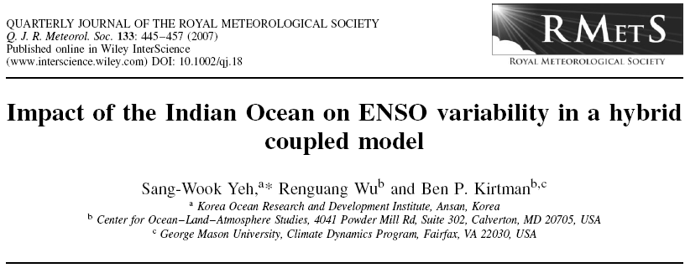
“…air-sea coupling in the Indian Ocean is necessary for simulating the Indian monsoon-ENSO relationship and for studying the influence of the Indian Ocean on the ENSO variability”.

Slide 4
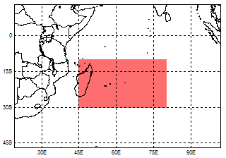
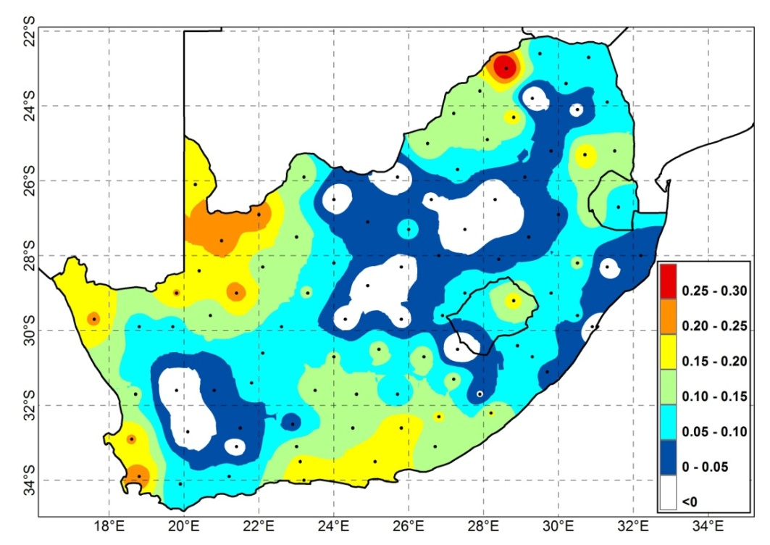
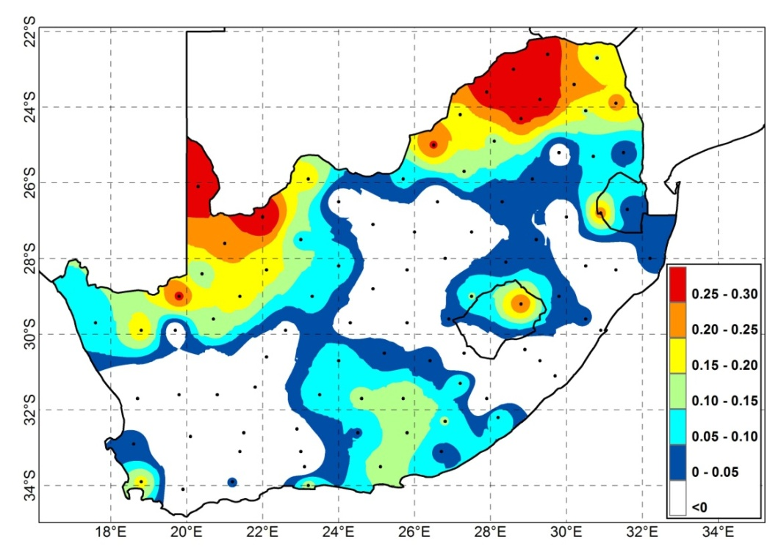
DC2 - cas
SLP
81%
A statistical model used Indian Ocean SLP as PREDICTOR field, forecast (cross-validated over 27 years) by
An AGCM (2-tiered)
Two CGCMs (1-tiered)
at a 1-month lead-time
To predict DJF district rainfall...
The map shows the Kendall’s tau differences:
CGCMs – AGCM
Conclusion:
CGCMs’ IO SLP is a better predictor (larger area covered) of SA’s mid-summer rainfall variability than AGCM IO SLP
GML - cas
63%

Slide 5
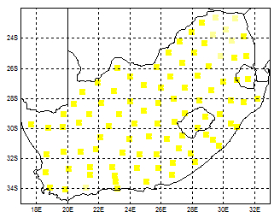
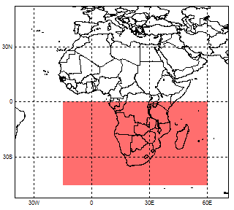
Experimental design
ECHAM4.5
  AGCM1: AMIP (24 members)
  AGCM2: Constructed analogue SST (24 members)
  CGCM1: MOM3-DC2 (12 members)
  CGCM2: GML (slab) (12 members)
850 hPa geopotential height fields downscaled to 93 rainfall districts
Initial training period
  1982/83 – 1995/96 (13 or 14 years)
Retro-active test period
  1996/97 – 2008/09 (14 years)
  SON, OND, NDJ, DJF, JFM and FMA
Climate Predictability Tool

Slide 6
Relative operating characteristics – a measure of discrimination
ROC applied to probabilistic forecasts indicates whether the forecast probability was higher when an event such as a flood season occurred compared to when it did not occur, and therefore identifies whether a set of forecasts has the attribute of discrimination
If forecasts are good, the hit rate will accumulate faster than the FAR, and so the graph will curve towards upper left
ROC = 0.734 for above-normal: There is a greater than 70% probability that the forecasts can successfully discriminate an above-normal season from other seasons

Slide 7
WET
DRY
ROC scores for 6 seasons at various lead-times

Slide 8
WET
DRY
ROC score differences between AMIP and forecasts

Slide 9
Answering the questions... (#1&#2)
In general, the forecast systems that use coupled model forecasts outscore the atmosphere-only system that uses predicted SST
However, for the season of highest predictability (DJF), AMIP-type simulations are the best
  This means that AGCM mid-summer rainfall forecast skill can be further improved by improving the SST forecasts – and to achieve this we are developing MME SST forecasts...

Slide 10
The multi-model sea-surface temperature forecasting system under development through ACCESS
Ensemble 5
SINTEX-F
at JAMSTEC
N₅ members
SA
USA
Brazil*
USA
Ensemble 1
COUPLED models
at CSIR NRE
N₁ members
Ensemble 2
CFS
at NCEP
N₂ members
Ensemble 3
ESM
at CPTEC
N₃ members
Ensemble 4
Two ECHAM4.5 CGCMs at IRI
N₄ members
Japan
VCM+UTCM
SA
MOS post-processing
and
forecast combination
UK
Ensemble 6
Antecedent SSTs
at CSIR NRE
N₆ members
Ensemble 7
GloSEA4
at UK Met Office
N₇ members
In use
Multi-model ensemble
of N₁+N₂+N₃+N₄ +N₅ +N₆ +N₇
members
Near future
Far future
* IBSA-Ocean

Slide 11
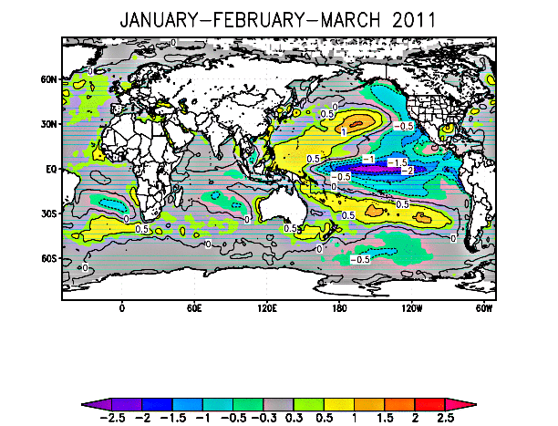
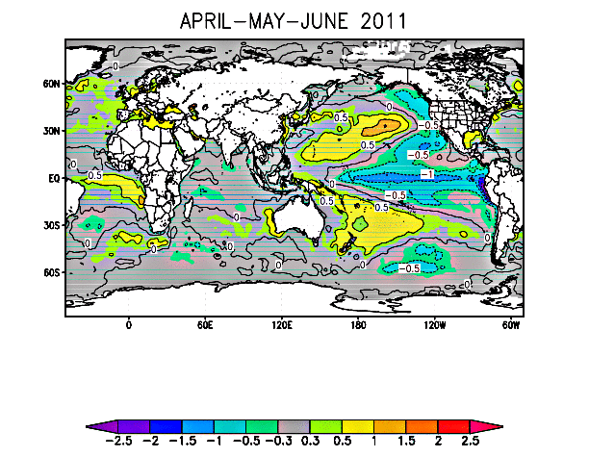
Current global SST anomaly forecasts
With improved SST forecasts, the ECHAM4.5 AGCM could perform just as well as its coupled versions. AGCMs are therefore here to stay for quite a while longer, also because they are cheaper to run than CGCMs and can therefore, by utilizing the same computational resources, be used for higher resolution runs and for the generation of more ensemble members

Slide 12
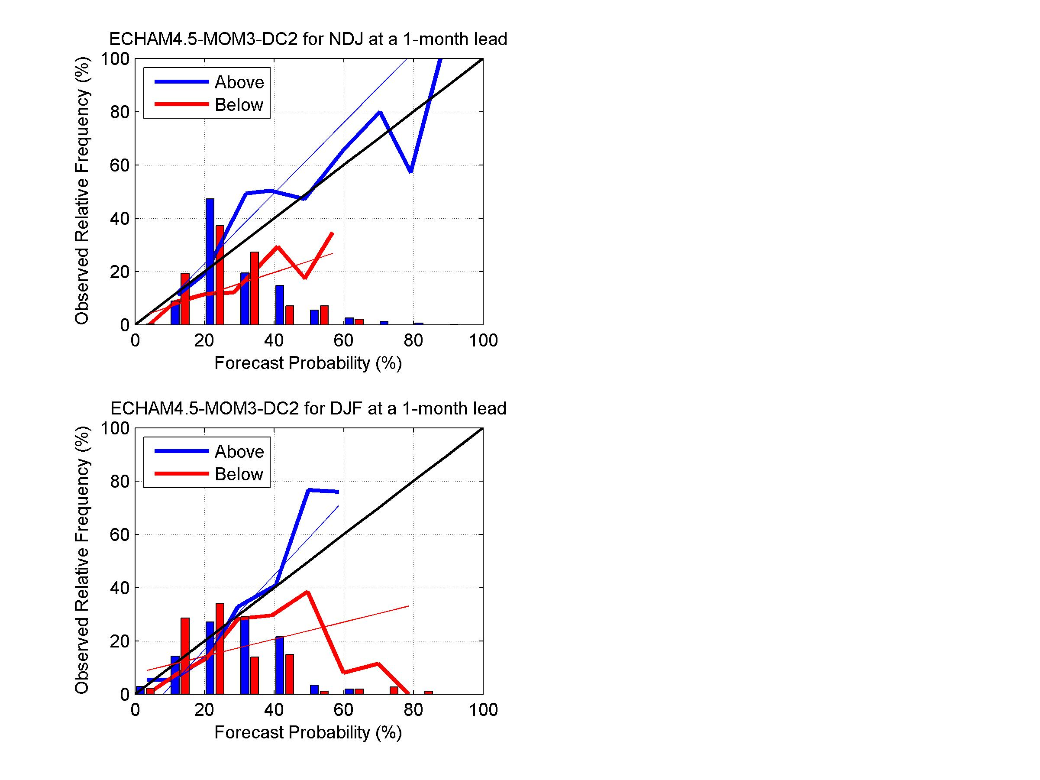
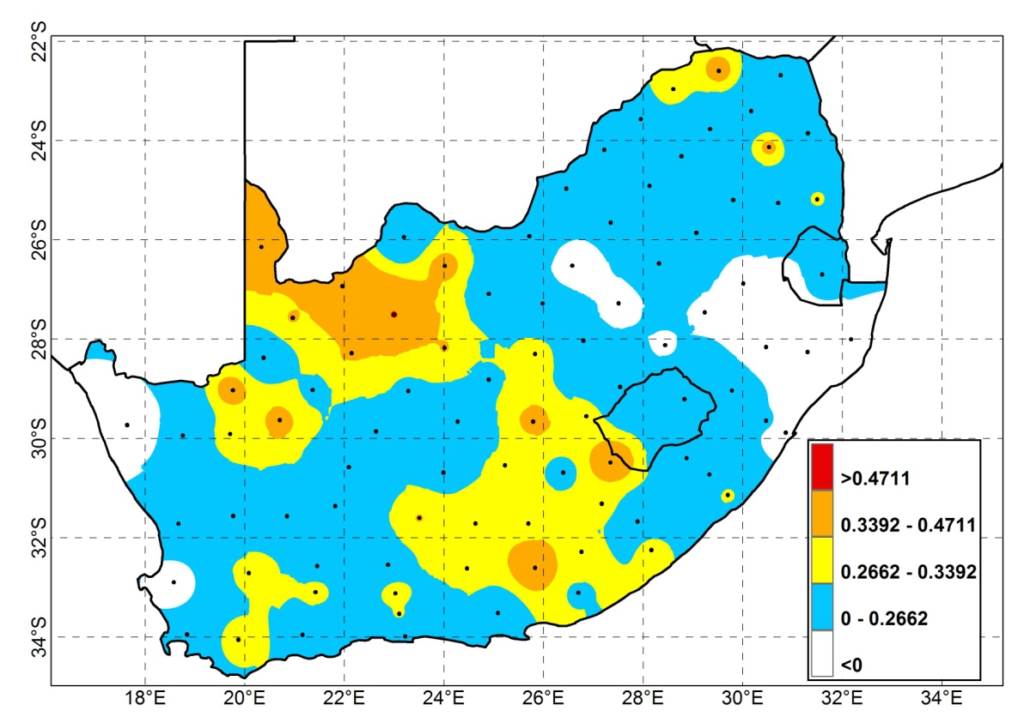
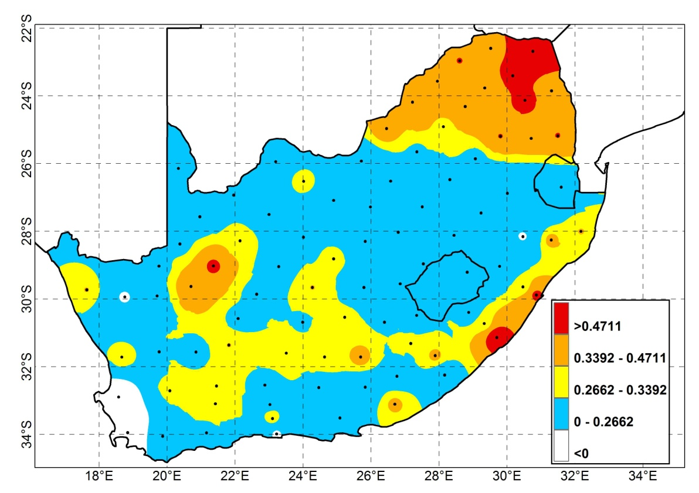
DC2 Sep NDJ
NDJ
DC2 Oct DJF
DJF

Slide 13
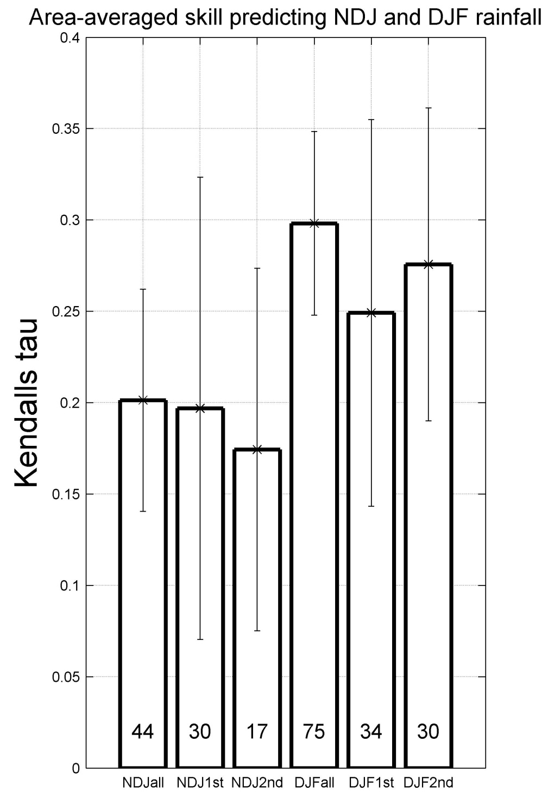

Slide 14
אֶרֶץ יִשְׂרָאֵל eht siht sI?‎
Significant forecast skill most likely to be found only for mid-summer rainfall variability
Large forecast errors are still occurring, notwithstanding
Forecast skill a function of location
Poor predictability during spring and autumn seasons, making seasonal onset and cessation forecasting challenging (to say the least!)
From previous work (Landman & Beraki, 2011 IJoC):
Predictability mostly assoc. with ENSO seasons
With the limitations of seasonal forecasting in mind and the large emphasis on climate change modelling in the region, how can funding agencies be convinced that more funds should be directed towards this time scale?

Slide 15
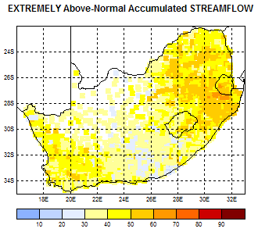
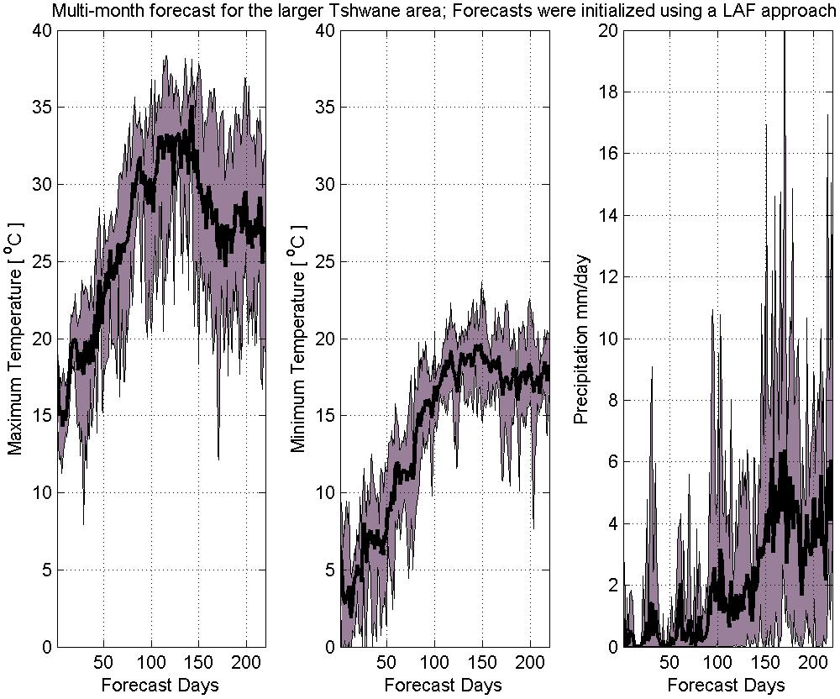
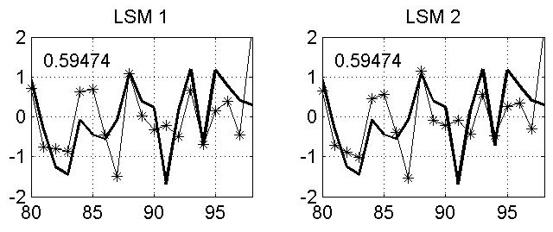
Answering the questions... (#3)
Although further improvements are possible, seasonal forecasts may never be as skilful as weather forecasts, but that should not stop us to use them in order to:
  Predict for intra-seasonal characteristics
  Applications modelling, for example:
    Agricultural production
    Streamflow
Simulated crop production for the growing season
DJF 1999/2000 flooding; ECHAM4.5-MOM3-DC2 fully coupled model forecast late October 1999

Slide 16
The multi-model seasonal rainfall and surface temperature forecasting system for SADC under development through ACCESS
Ensemble 5
SINTEX-F
at JAMSTEC
N₅ members
SA
Brazil*
SA
SA
Ensemble 1
CCAM
at CSIR NRE
N₁ members
Ensemble 2
ESM
at CPTEC
N₂ members
Ensemble 3
ECHAM4.5
at SAWS
N₃ members
Ensemble 4
HadAM3/CAM
at UCT
N₄ members
Japan
SA
Ensemble 6
COUPLED models
at CSIR NRE
N₆ members
MOS post-processing
and
forecast combination
Ensemble 7
Two ECHAM4.5 CGCMs at IRI
N₇ members
VCM+UTCM
Ensemble 8
CFS
at NCEP
N₈ members
Ensemble 9
GloSEA4
at UK Met Office
N₉ members
USA
USA
UK
In use
Multi-model ensemble
of N₁+N₂+N₃+N₄ +N₅ +N₆ +N₇ +N₈ +N₉
members
Near future
Far future
* IBSA-Ocean

