Slide 1
Costs of food waste along the value chain: Evidence from South Africa
Anton Nahman, Willem de Lange
Sustainability Science & Resource Economics Research Group, CSIR, South Africa
1st International Conference on Global Food Security
29/09 – 2/10 2013, Noordwijkerhout, Netherlands

Slide 2
“The world has enough for everyone’s need, but not enough for everyone’s greed”
– Mahatma Gandhi

Slide 3
What is food waste?
Losses that arise before food reaches the end-user + food that is discarded by consumers
Arises throughout food supply/value chain
Focus on edible food losses/waste
30-50% of food produced for human consumption lost/wasted globally (Lundqvist et al., 2008; Gustavsson et al. (for FAO) 2011; IMECHE 2013).
Could have been used to feed the 870 million hungry people worldwide if better managed/distributed
Reducing food waste is key to food security

Slide 4
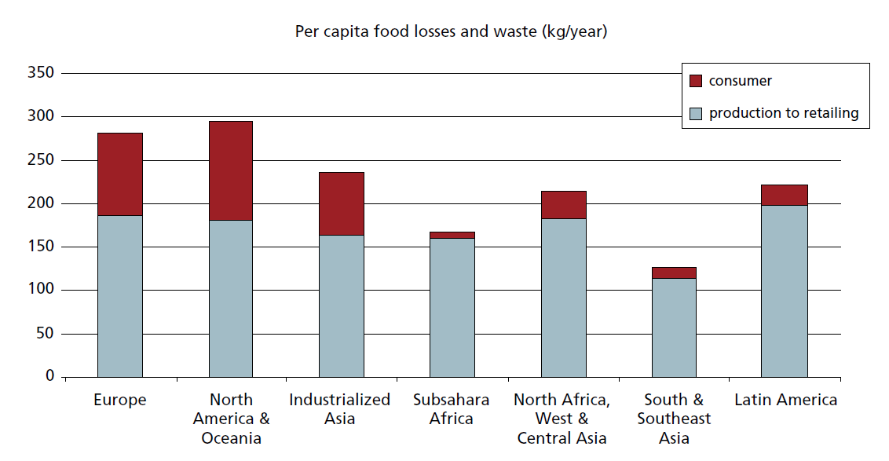
Where does food waste arise?
Source: Gustavsson et al. (for FAO) 2011

Slide 5
Approach
Aim
To estimate the costs of food losses & waste throughout entire value chain in SA
Quantify food waste in tonnes
Estimate representative prices (as proxy of economic costs per tonne)
Estimate total costs (overall & at each point along chain for each food group)

Slide 6
Commodity group | Agric. Produc-tion | Post-harvest handling & storage | Processing & packaging | Distri-bution | Consump-tion
Cereals | 6.0% | 8.0% | 3.5% | 2.0% | 1.0%
Roots and Tubers | 14.0% | 18.0% | 15.0% | 5.0% | 2.0%
Oil seeds & Pulses | 12.0% | 8.0% | 8.0% | 2.0% | 1.0%
Fruit & Veg | 10.0% | 9.0% | 25.0% | 17.0% | 5.0%
Meat | 15.0% | 0.7% | 5.0% | 7.0% | 2.0%
Fish & Seafood | 5.7% | 6.0% | 9.0% | 15.0% | 2.0%
Milk | 6.0% | 11.0% | 0.1% | 10.0% | 0.1%

Slide 7
1000 tonnes Commod-ity group | Agricultural production |  | Post-harvest handling and storage |  | Processing and packaging |  | Distribution |  | Consumption |  | Total food waste (1,000 tons)
 | Food entering | Food Waste | Food entering | Food Waste | Food entering | Food Waste | Food entering | Food Waste | Food entering | Food Waste
Cereals | 13 140 | 788 | 12 352 | 988 | 11 363 | 398 | 14 441 | 289 | 14 152 | 142 | 2 605
Roots and Tubers | 2 015 | 282 | 1 733 | 312 | 1 421 | 213 | 2 144 | 107 | 2 037 | 41 | 955
Oil seeds & Pulses | 1 198 | 144 | 1 054 | 84 | 970 | 78 | 1 340 | 27 | 1 314 | 13 | 346
Fruit & Veg | 8 463 | 846 | 7 616 | 685 | 6 931 | 1 733 | 5 799 | 986 | 4 813 | 241 | 4 491
Meat | 2 549 | 382 | 2 167 | 15 | 2 151 | 108 | 2 802 | 196 | 2 606 | 52 | 753
Fish & Seafood | 673 | 38 | 635 | 38 | 597 | 54 | 568 | 85 | 483 | 10 | 225
Milk | 3 102 | 186 | 2 916 | 321 | 2 595 | 3 | 3 182 | 318 | 2 864 | 3 | 831
Total |  | 2 667 |  | 2 444 |  | 2 585 |  | 2 008 |  | 501 | 10 205

Slide 8
1000 tonnes Commod-ity group | Agricultural production |  | Post-harvest handling and storage |  | Processing and packaging |  | Distribution |  | Consumption |  | Total food waste (1,000 tons)
 | Food entering | Food Waste | Food entering | Food Waste | Food entering | Food Waste | Food entering | Food Waste | Food entering | Food Waste
Cereals | 13 140 | 788 | 12 352 | 988 | 11 363 | 398 | 14 441 | 289 | 14 152 | 142 | 2 605
Roots and Tubers | 2 015 | 282 | 1 733 | 312 | 1 421 | 213 | 2 144 | 107 | 2 037 | 41 | 955
Oil seeds & Pulses | 1 198 | 144 | 1 054 | 84 | 970 | 78 | 1 340 | 27 | 1 314 | 13 | 346
Fruit & Veg | 8 463 | 846 | 7 616 | 685 | 6 931 | 1 733 | 5 799 | 986 | 4 813 | 241 | 4 491
Meat | 2 549 | 382 | 2 167 | 15 | 2 151 | 108 | 2 802 | 196 | 2 606 | 52 | 753
Fish & Seafood | 673 | 38 | 635 | 38 | 597 | 54 | 568 | 85 | 483 | 10 | 225
Milk | 3 102 | 186 | 2 916 | 321 | 2 595 | 3 | 3 182 | 318 | 2 864 | 3 | 831
Total |  | 2 667 |  | 2 444 |  | 2 585 |  | 2 008 |  | 501 | 10 205

Slide 9
1000 tonnes Commod-ity group | Agricultural production |  | Post-harvest handling and storage |  | Processing and packaging |  | Distribution |  | Consumption |  | Total food waste (1,000 tons)
 | Food entering | Food Waste | Food entering | Food Waste | Food entering | Food Waste | Food entering | Food Waste | Food entering | Food Waste
Cereals | 13 140 | 788 | 12 352 | 988 | 11 363 | 398 | 14 441 | 289 | 14 152 | 142 | 2 605
Roots and Tubers | 2 015 | 282 | 1 733 | 312 | 1 421 | 213 | 2 144 | 107 | 2 037 | 41 | 955
Oil seeds & Pulses | 1 198 | 144 | 1 054 | 84 | 970 | 78 | 1 340 | 27 | 1 314 | 13 | 346
Fruit & Veg | 8 463 | 846 | 7 616 | 685 | 6 931 | 1 733 | 5 799 | 986 | 4 813 | 241 | 4 491
Meat | 2 549 | 382 | 2 167 | 15 | 2 151 | 108 | 2 802 | 196 | 2 606 | 52 | 753
Fish & Seafood | 673 | 38 | 635 | 38 | 597 | 54 | 568 | 85 | 483 | 10 | 225
Milk | 3 102 | 186 | 2 916 | 321 | 2 595 | 3 | 3 182 | 318 | 2 864 | 3 | 831
Total |  | 2 667 |  | 2 444 |  | 2 585 |  | 2 008 |  | 501 | 10 205

Slide 10
1000 tonnes Commod-ity group | Agricultural production |  | Post-harvest handling and storage |  | Processing and packaging |  | Distribution |  | Consumption |  | Total food waste (1,000 tons)
 | Food entering | Food Waste | Food entering | Food Waste | Food entering | Food Waste | Food entering | Food Waste | Food entering | Food Waste
Cereals | 13 140 | 788 | 12 352 | 988 | 11 363 | 398 | 14 441 | 289 | 14 152 | 142 | 2 605
Roots and Tubers | 2 015 | 282 | 1 733 | 312 | 1 421 | 213 | 2 144 | 107 | 2 037 | 41 | 955
Oil seeds & Pulses | 1 198 | 144 | 1 054 | 84 | 970 | 78 | 1 340 | 27 | 1 314 | 13 | 346
Fruit & Veg | 8 463 | 846 | 7 616 | 685 | 6 931 | 1 733 | 5 799 | 986 | 4 813 | 241 | 4 491
Meat | 2 549 | 382 | 2 167 | 15 | 2 151 | 108 | 2 802 | 196 | 2 606 | 52 | 753
Fish & Seafood | 673 | 38 | 635 | 38 | 597 | 54 | 568 | 85 | 483 | 10 | 225
Milk | 3 102 | 186 | 2 916 | 321 | 2 595 | 3 | 3 182 | 318 | 2 864 | 3 | 831
Total |  | 2 667 |  | 2 444 |  | 2 585 |  | 2 008 |  | 501 | 10 205
=200kg/p /day

Slide 11
Contribution of each stage to total (by mass)

Slide 12
Contribution of each commodity group to total (by mass)

Slide 13
Commodity group | Represent-ative commodities | Unit | Agric. production | Post-harvest handling & storage | Processing & packaging | Distri-bution | Consump-tion
Cereals | Maize | R/t grain | 1 005 | 1 275 | 1 977 | 2 206 | 3 101
 | Wheat | R/t grain | 1 848 | 2 217 | 2 952 | 3 173 | 3 525
Roots and Tubers | Potatoes | R/t | 2 100 | 2 300 | 3 432 | 3 900 | 8 200
 | Onions | R/t | 2 000 | 2 600 | 3 080 | 3 500 | 7 000
Oil seeds & Pulses | Sunflower | R/t | 5 000 | 6 225 | 18 675 | 19 982 | 21 333
 | Soya beans | R/t | 4 500 | 5 625 | 16 875 | 18 056 | 16 500
Fruit & Veg | Tomatoes | R/t | 3 500 | 4 300 | 8 213 | 9 333 | 14 000
 | Citrus | R/t | 3 708 | 3 708 | 3 708 | 4 100 | 5 916
Meat | Chicken | R/t | 14 000 | 17 000 | 23 000 | 25 000 | 30 000
 | Beef | R/t | 16 000 | 25 000 | 29 000 | 35 000 | 55 000
 | Lamb | R/t | 25 000 | 40 000 | 52 000 | 75 000 | 90 000
 | Pork | R/t | 14 000 | 18 000 | 22 000 | 29 000 | 43 000
Fish & Seafood | Hake | R/t | 25 000 | 30 000 | 35 000 | 40 000 | 45 000
Milk | Milk | R/kl | 3 000 | 3 100 | 4 450 | 6 350 | 7 450

Slide 14
Commodity group | Agricultural production (R/tonne) | Post-harvest handling and storage (R/tonne) | Processing and packaging (R/tonne) | Distribution (R/tonne) | Consump-tion (R/tonne)
Cereals | 1 123 | 1 407 | 2 113 | 2 445 | 3 206
Roots and Tubers | 2 080 | 2 360 | 3 362 | 3 825 | 7 976
Oil seeds & Pulses | 4 804 | 5 990 | 17 970 | 19 310 | 19 646
Fruits and Vegetables | 3 666 | 3 826 | 4 608 | 6 461 | 9 564
Meat | 15 047 | 20 603 | 26 545 | 31 519 | 41 818
Fish and Seafood | 25 000 | 30 000 | 35 000 | 40 000 | 45 000
Milk | 3 000 | 3 100 | 4 450 | 6 350 | 7 450

Slide 15
Commodity group | Agricultural production | Post-harvest handling & storage | Processing & packaging | Distribution | Consumption | Total (1,000 Rands)
Cereals | 885 241 | 1 389 970 | 840 498 | 706 094 | 453 674 | 4 275 477
Roots & Tubers | 586 814 | 735 983 | 716 636 | 410 081 | 324 916 | 2 774 431
Oil seeds & Pulses | 690 445 | 505 045 | 1 393 923 | 517 629 | 258 051 | 3 365 093
Fruit & Veg | 3 102 702 | 2 622 700 | 7 983 722 | 6 370 082 | 2 301 683 | 22 380 890
Meat | 5 753 134 | 312 479 | 2 855 605 | 6 182 060 | 2 179 439 | 17 282 718
Fish & Seafood | 959 025 | 1 142 350 | 1 879 166 | 3 408 000 | 434 520 | 7 823 061
Milk | 558 420 | 994 422 | 11 550 | 2 020 358 | 21 333 | 3 606 083
Total | 12 535 782 | 7 702 949 | 15 681 100 | 19 614 305 | 5 973 616 | 61 507 753
= 788,000 tons x R1123/ton

Slide 16
Commodity group | Agricultural production | Post-harvest handling & storage | Processing & packaging | Distribution | Consumption | Total (1,000 Rands)
Cereals | 885 241 | 1 389 970 | 840 498 | 706 094 | 453 674 | 4 275 477
Roots & Tubers | 586 814 | 735 983 | 716 636 | 410 081 | 324 916 | 2 774 431
Oil seeds & Pulses | 690 445 | 505 045 | 1 393 923 | 517 629 | 258 051 | 3 365 093
Fruit & Veg | 3 102 702 | 2 622 700 | 7 983 722 | 6 370 082 | 2 301 683 | 22 380 890
Meat | 5 753 134 | 312 479 | 2 855 605 | 6 182 060 | 2 179 439 | 17 282 718
Fish & Seafood | 959 025 | 1 142 350 | 1 879 166 | 3 408 000 | 434 520 | 7 823 061
Milk | 558 420 | 994 422 | 11 550 | 2 020 358 | 21 333 | 3 606 083
Total | 12 535 782 | 7 702 949 | 15 681 100 | 19 614 305 | 5 973 616 | 61 507 753

Slide 17
Results and discussion
Total cost of edible food waste throughout the value chain in SA = R61.5 billion (US$6.2 billion or 4.7 billion Euro) per annum
Equates to US$118 per capita, or 2.1% of GDP
By comparison: USA: $285 - $628 per capita; or 0.6% - 1.3% of GDP
Therefore low relative to developed countries in per capita terms, but high as a % of GDP

Slide 18
Contribution of each commodity group to total cost

Slide 19
Contribution of each stage to total cost

Slide 20
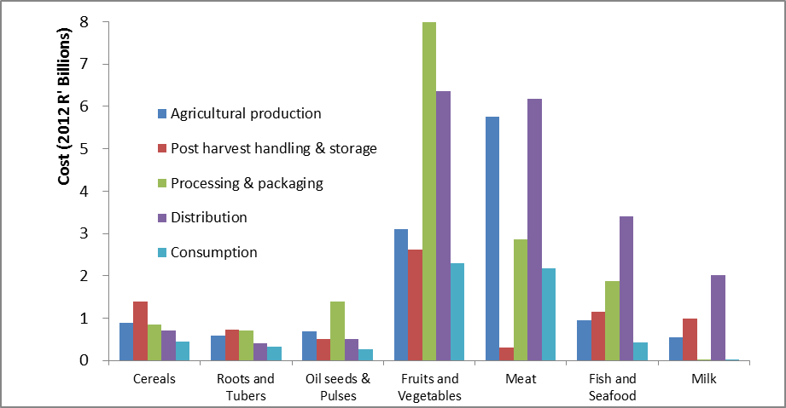

Slide 21
Conclusions and recommendations
Developing countries: Interventions should be targeted at overcoming financial, managerial and technical limitations in supply chain
Developed countries: Address impact of market forces on behaviour, e.g. by ensuring that food prices incorporate full costs, including externalities associated with waste and with other social, environmental and health impacts

Slide 22
Thank you!
Sustainability Science & Resource Economics Research Group
CSIR, South Africa
anahman@csir.co.za
+27 21 888 2403

