Slide 1



“I get all the news I need on the weather report”
Willem A. Landman
Ruth Park
Stephanie Landman
Francois Engelbrecht

Slide 2
“CLIMATE IS WHAT YOU EXPECT…
…WEATHER IS WHAT YOU GET!”

Slide 3
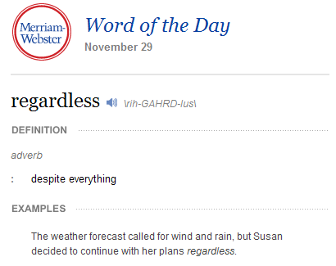

Slide 4
WMO Forecast time ranges
Nowcasting: A description of current weather parameters and 0 to 2 hours’ description of forecast weather parameters
Very short-range weather forecasting: Up to 12 hours’ description of weather parameters
Short-range weather forecasting: Beyond 12 hours’ and up to 72 hours’ description of weather parameters
Medium-range weather forecasting: Beyond 72 hours’ and up to 240 hours’ description of weather parameters
Extended-range weather forecasting: Beyond 10 days’ and up to 30 days’ description of weather parameters. Usually averaged and expressed as a departure from climate values for that period
Long-range forecasting: From 30 days up to two years
  Month forecast: Description of averaged weather parameters expressed as a departure (deviation, variation, anomaly) from climate values for that month at any lead-time
  Seasonal forecast: Description of averaged weather parameters expressed as a departure from climate values for that season at any lead-time
Climate forecasting: Beyond two years
  Climate variability prediction: Description of the expected climate parameters associated with the variation of interannual, decadal and multi-decadal climate anomalies
  Climate prediction: Description of expected future climate including the effects of both natural and human influences

Slide 5
Effects of small errors in the initial conditions
There will always be atmospheric motions whose scales are too small to be properly observed and represented in a model
Thus, there is an unavoidable level of error in the determination of the initial state
The nonlinearity and instability of the atmospheric flow will inevitably cause the small inherent errors in the initial data to grow and gradually affect the larger scales of motion so that the forecast flow field will eventually evolve differently from the actual flow

Slide 6
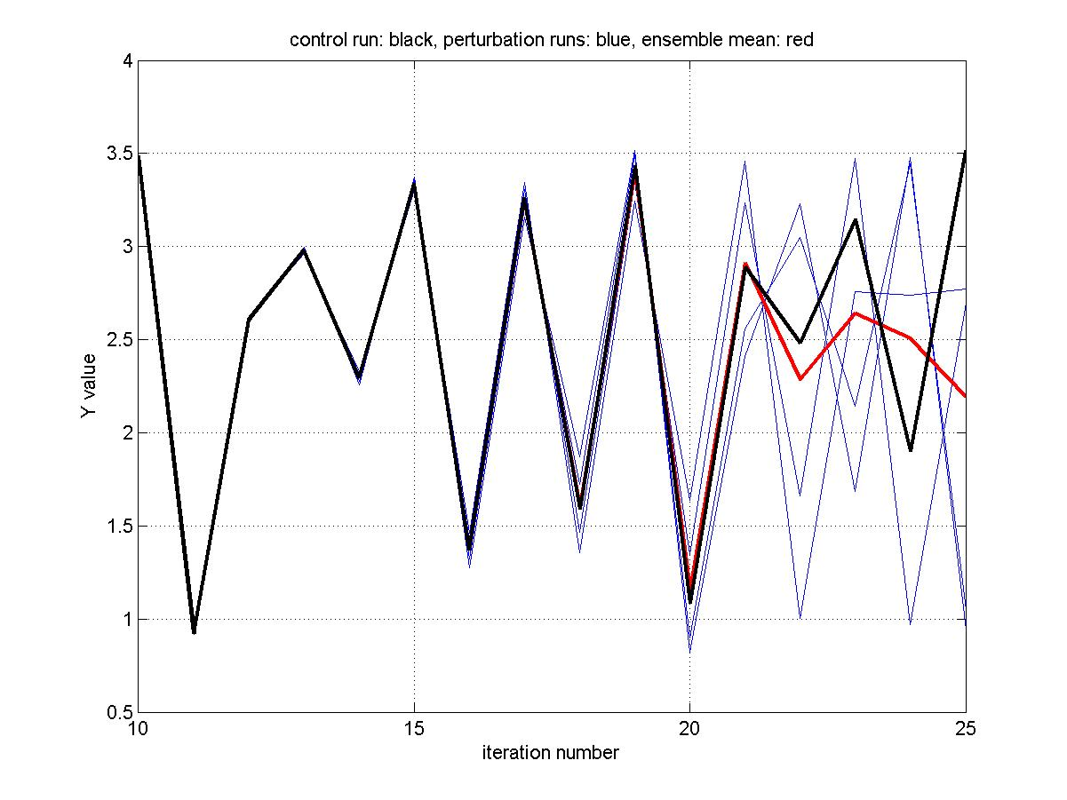
First-order quadratic difference equation
Lorenz illustrated the general problem of predictability by considering the first-order quadratic difference equations:
Y_{s+1} = aY_{s} – Y_{s}²
Figure is for Y(0) = 1.5; a = 3.75
Black: control run or “observations”
Initial value perturbed by 0.001

Slide 7
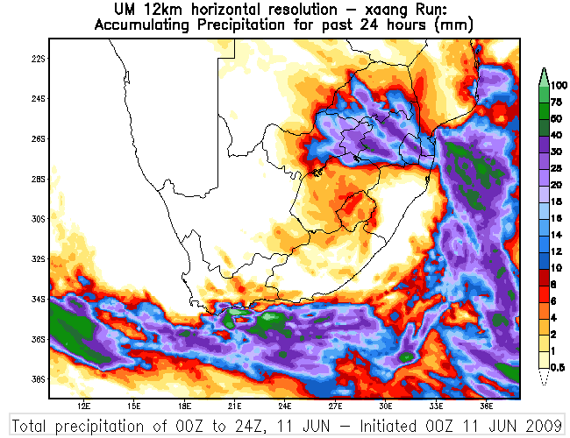
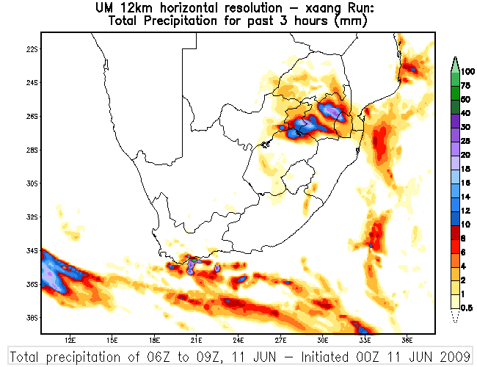
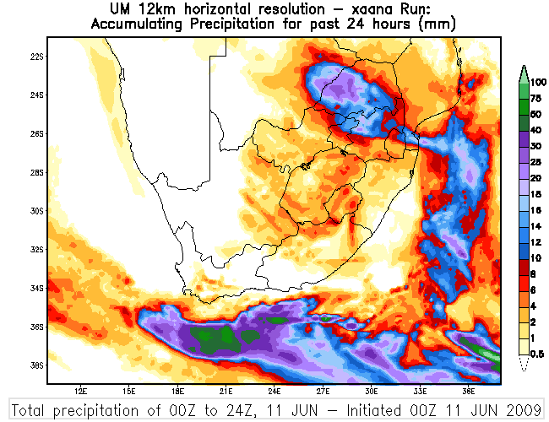
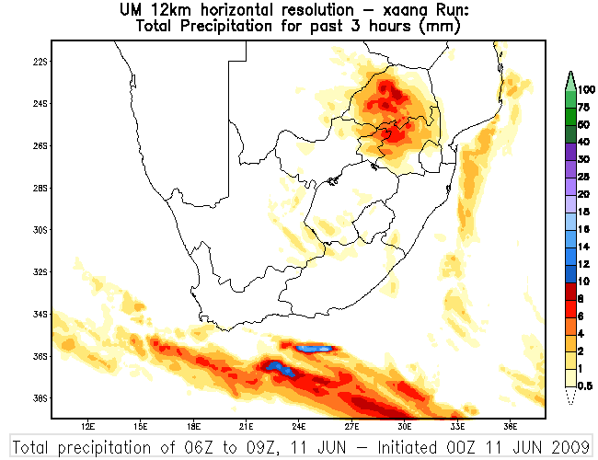

Slide 8
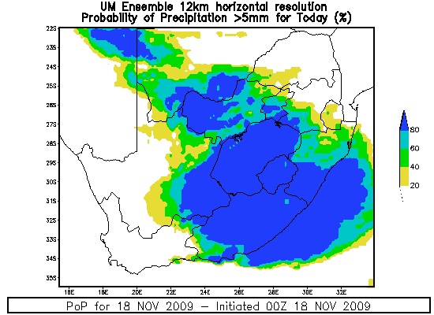
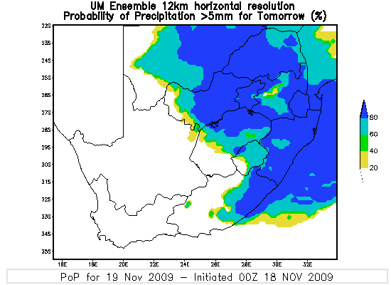
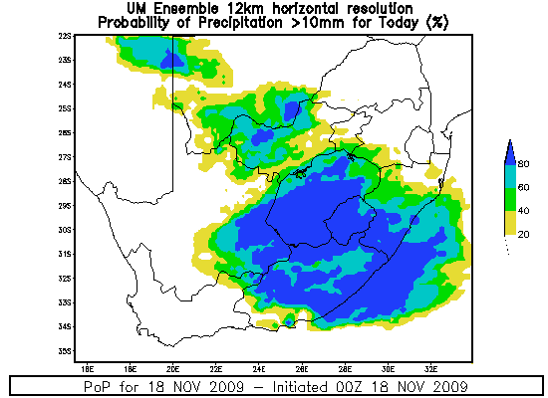
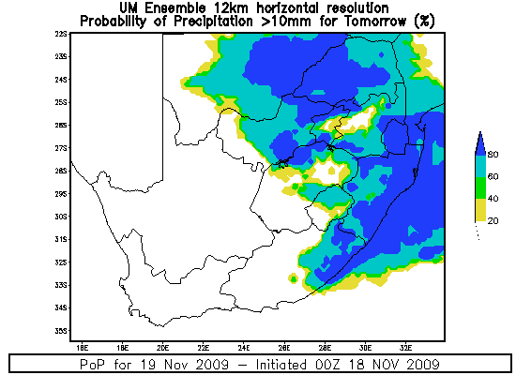
Probability Maps: Multi-models
Day 1
Day2
>5mm
>10mm

Slide 9
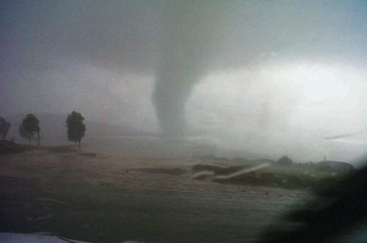
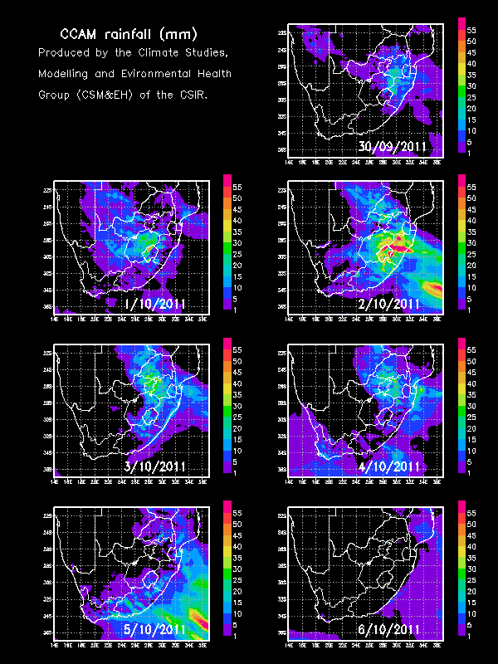
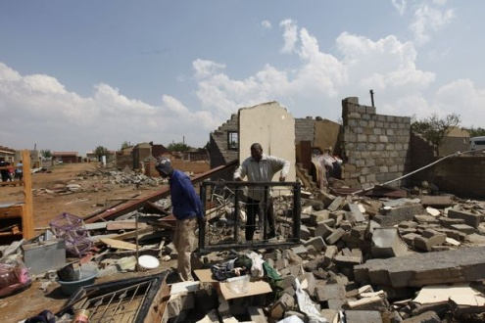
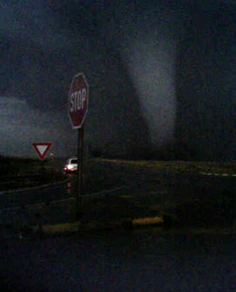
Tornado Sunday
Hundreds of homes were destroyed in Ficksburg in the Free State. Another tornado hit the East Rand and caused extensive damage to Duduza, near Nigel. Two children died.

Slide 10
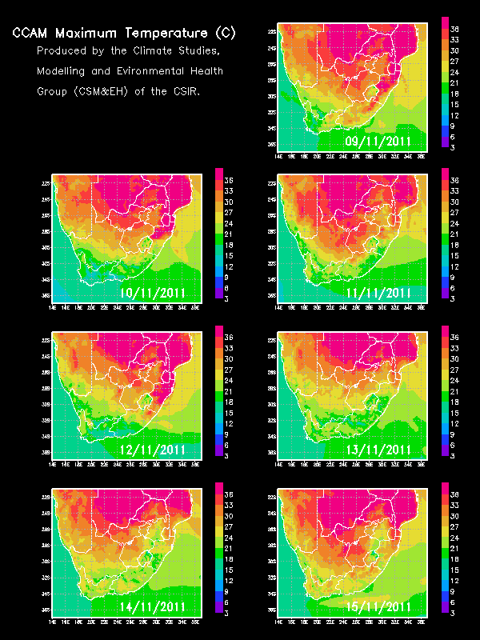
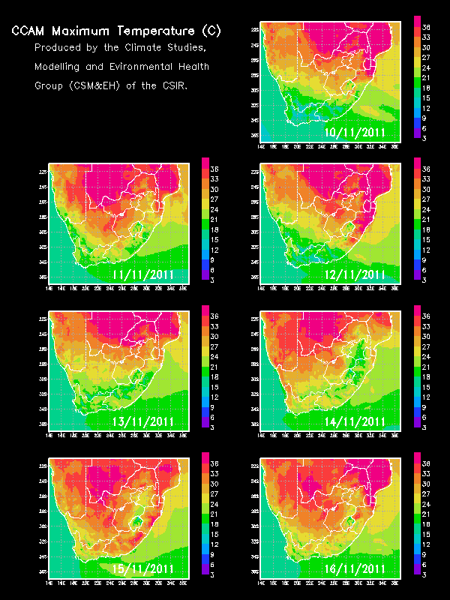
Heat wave: 9-13 November 2011
(at my house: 33; 33.5; 31; 32.5; 33.5°C)

Slide 11
Limits of Longer Range Forecasts
Great progress has been made to predict the day-to-day state of the atmosphere (e.g., frontal movement, winds, pressure)
However, day-to-day fluctuations in weather are not predictable beyond two weeks
Beyond that time, errors in the data defining the state of the atmosphere at the start of a forecast period grow and overwhelm valid forecast information
This so called “chaotic” behaviour is an inherent property of the atmosphere

Slide 12
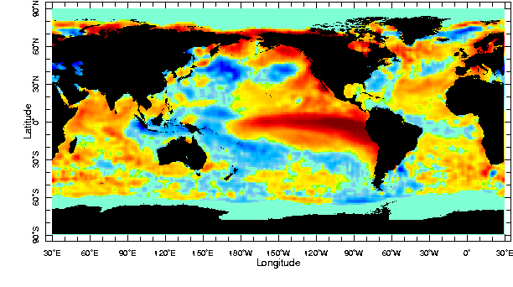
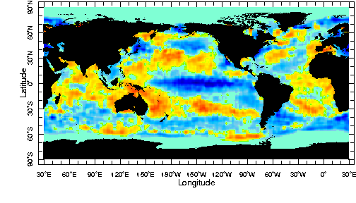
How is it then possible to predict seasonal climate anomalies?
Predictions of rainfall, frontal passages, etc. for a particular day at a certain location several months ahead has no usable skill. However, there is some skill in predicting anomalies in the seasonal average of the weather. The predictability of seasonal climate anomalies results primarily from the influence of slowly evolving boundary conditions, and most notably SSTs (i.e., El Niño and La Niña), on the atmospheric circulation.
Sea-surface temperature (SST) anomalies of September 1997 (El Niño of 1997/98)
Anomaly: departure from the mean or average
Sea-surface temperature (SST) anomalies of November 1988 (La Niña of 1988/89)

Slide 13
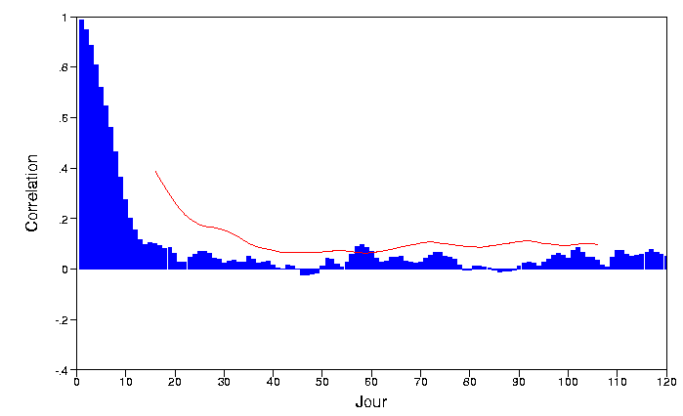
Dynamical Forecasts: Seasonal Forecasts
Daily Scores
+
Monthly running mean Scores

Slide 14
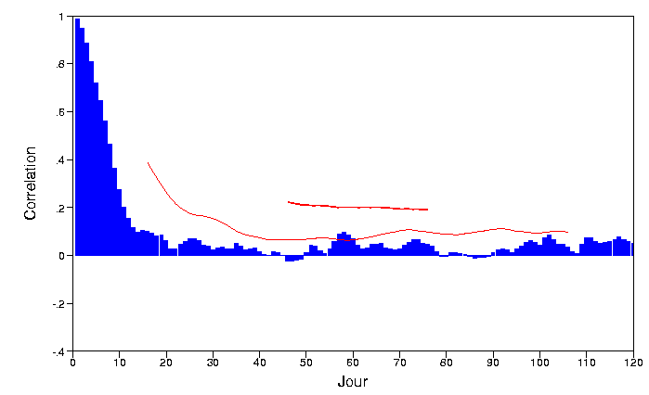
Dynamical Forecasts: Seasonal Forecasts
Daily Scores
+
Seasonal running mean Scores

Slide 15
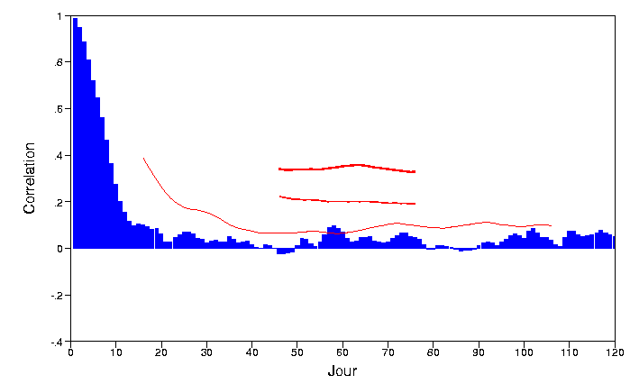
Dynamical Forecasts: Seasonal Forecasts
Daily Scores
+
Ensemble forecast, Seasonal running mean and SST forecast

Slide 16
Dynamical Forecasts: Seasonal Forecasts
Daily Scores
+
Ensemble forecast, Seasonal running mean and SST forecast
+
MOS

Slide 17
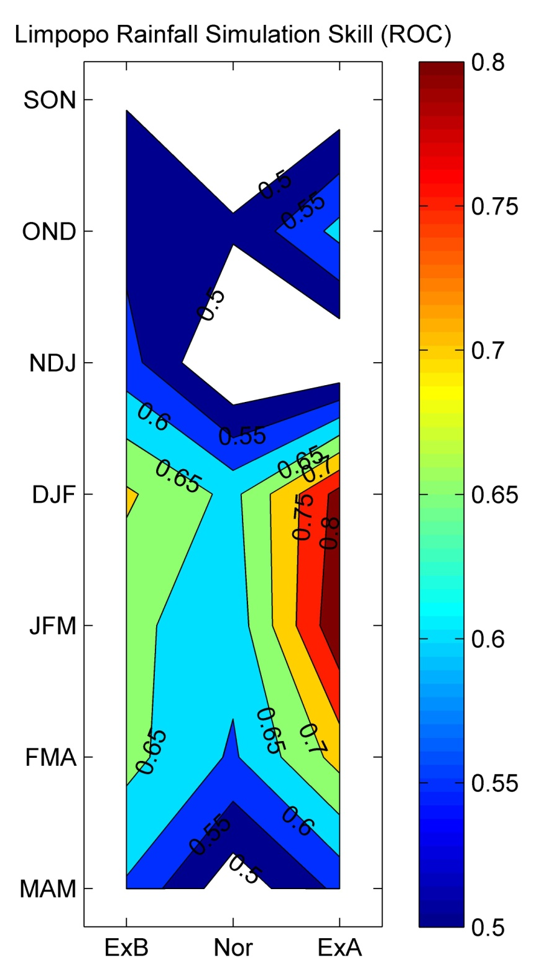
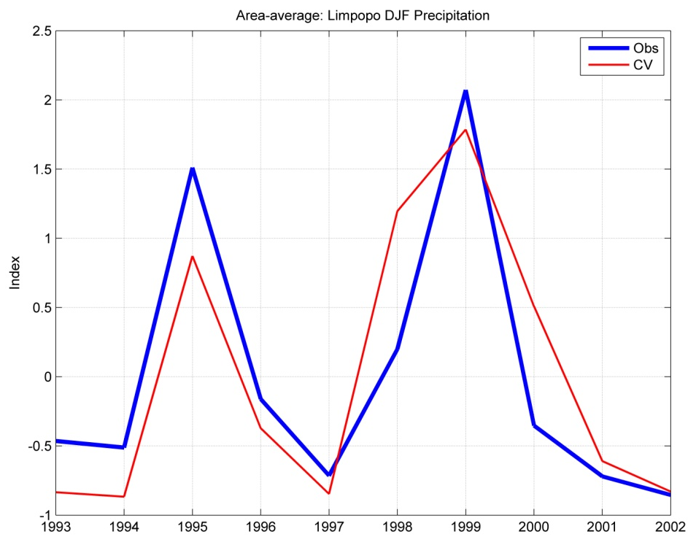
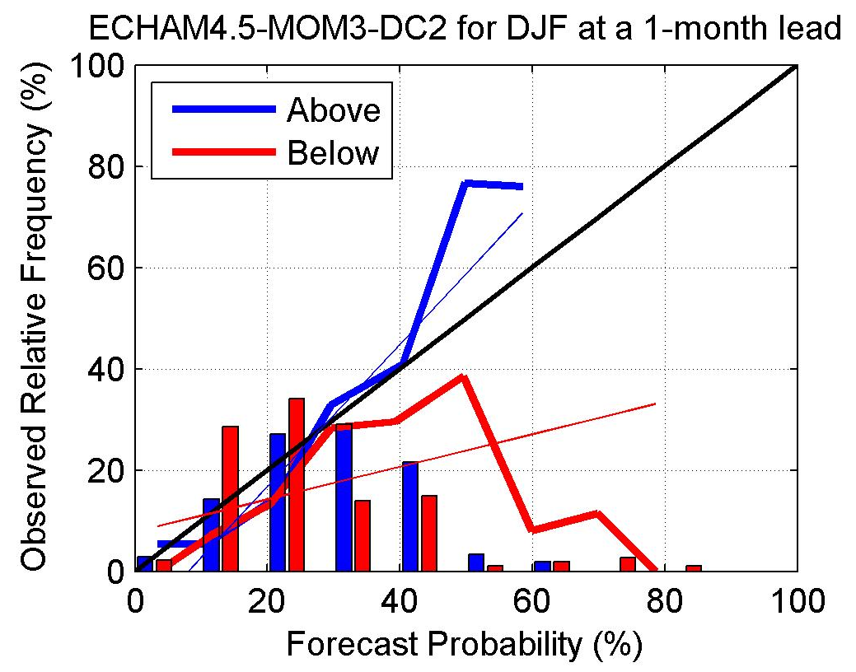
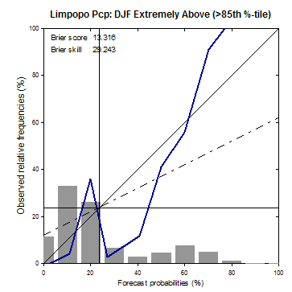
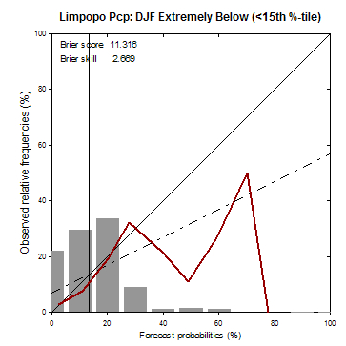
Verification of CCAM AMIP: Limpopo

Slide 18
“11/14” ~3/4

Slide 19
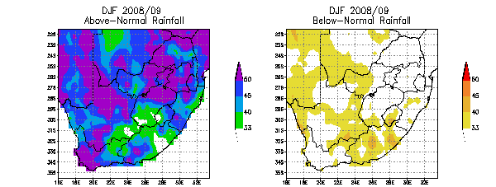
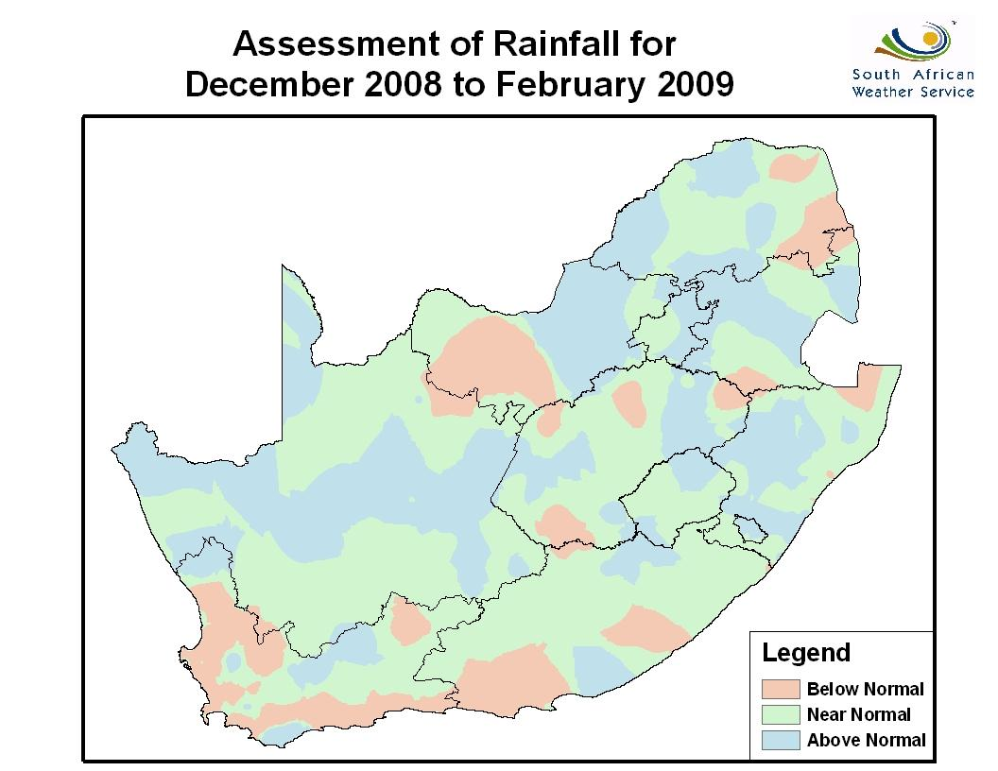
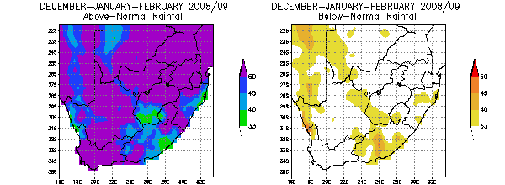
December-January-February 2008/09 “verification”
SEP
NOV

Slide 20
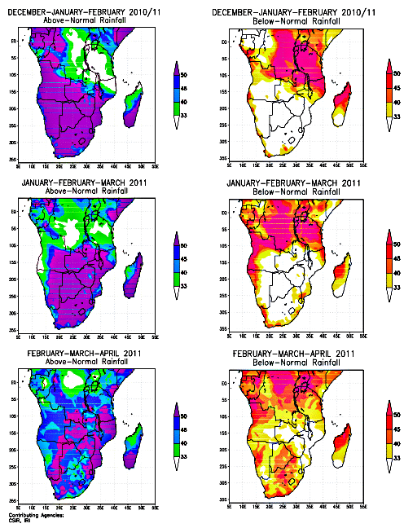
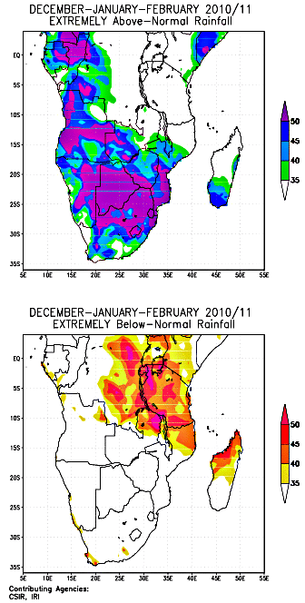
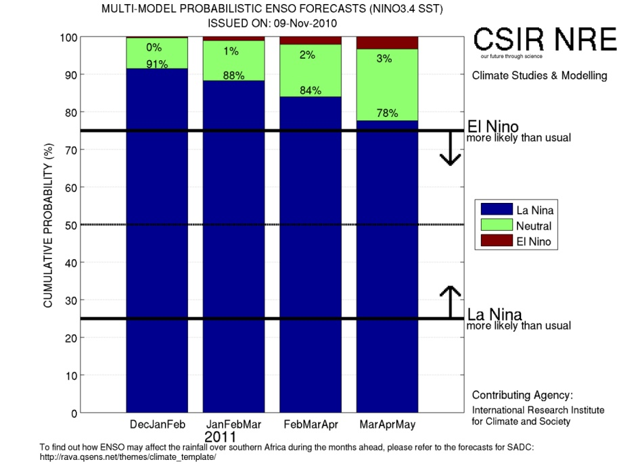
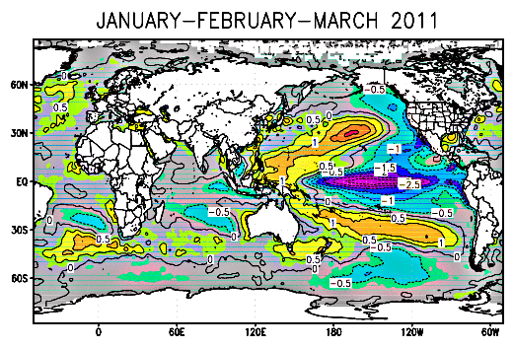
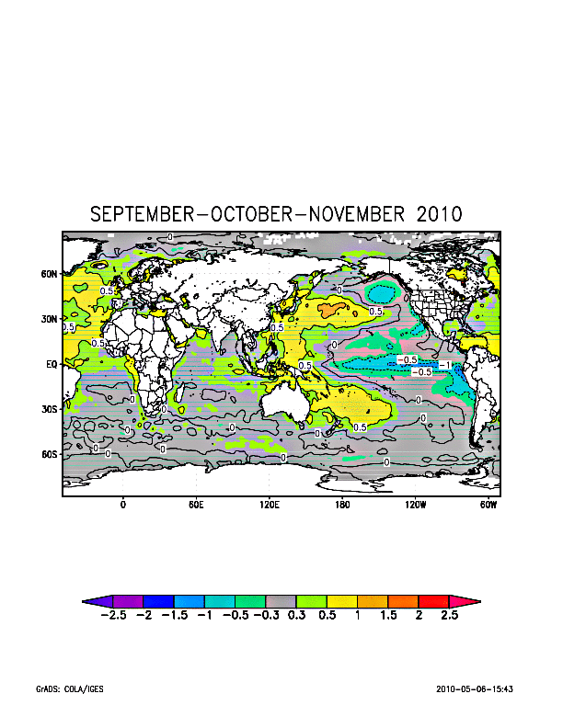
Seasonal forecast examples: Issued Nov 2010

Slide 21
ROC Scores: Coupled vs. 2-tiered systems

Slide 22
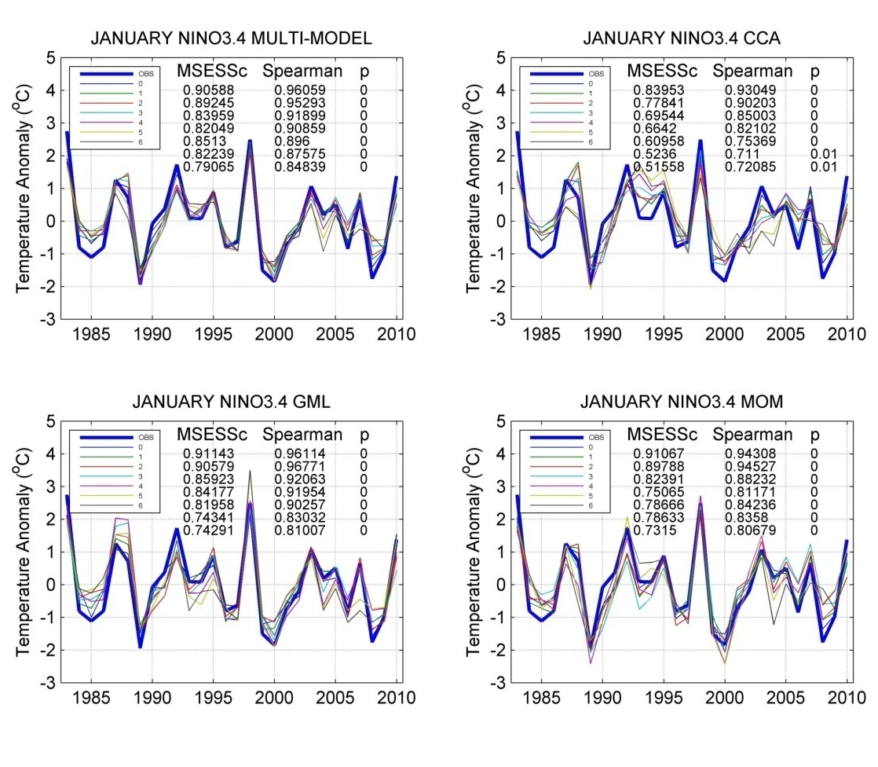
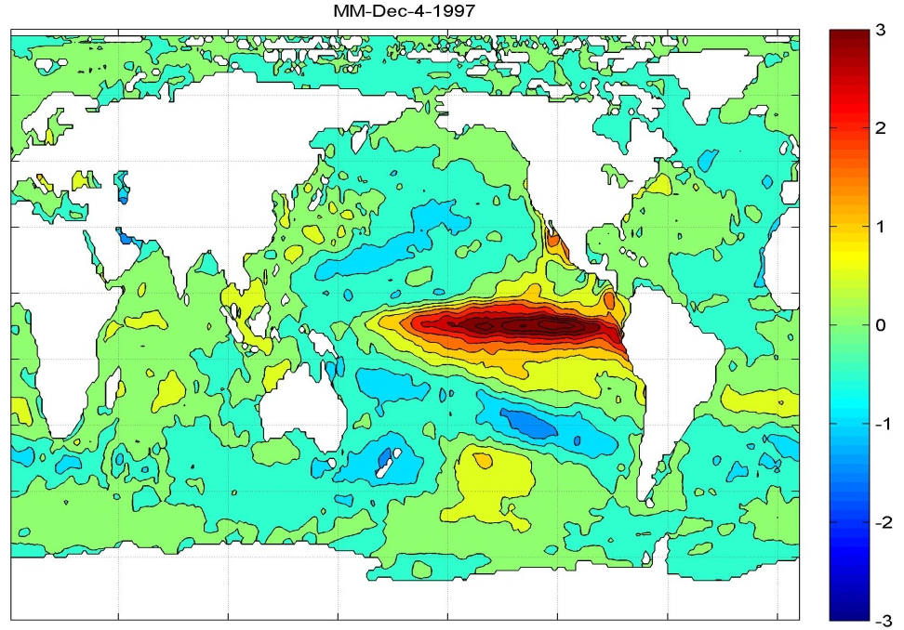
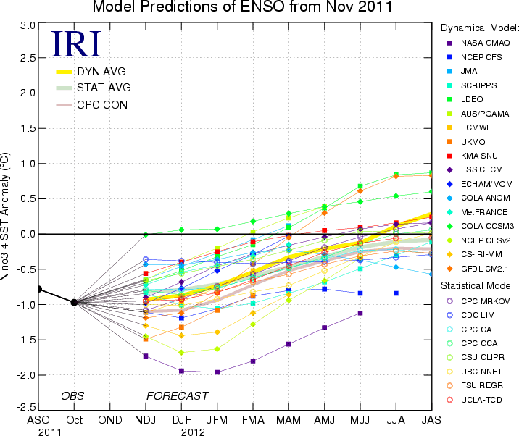
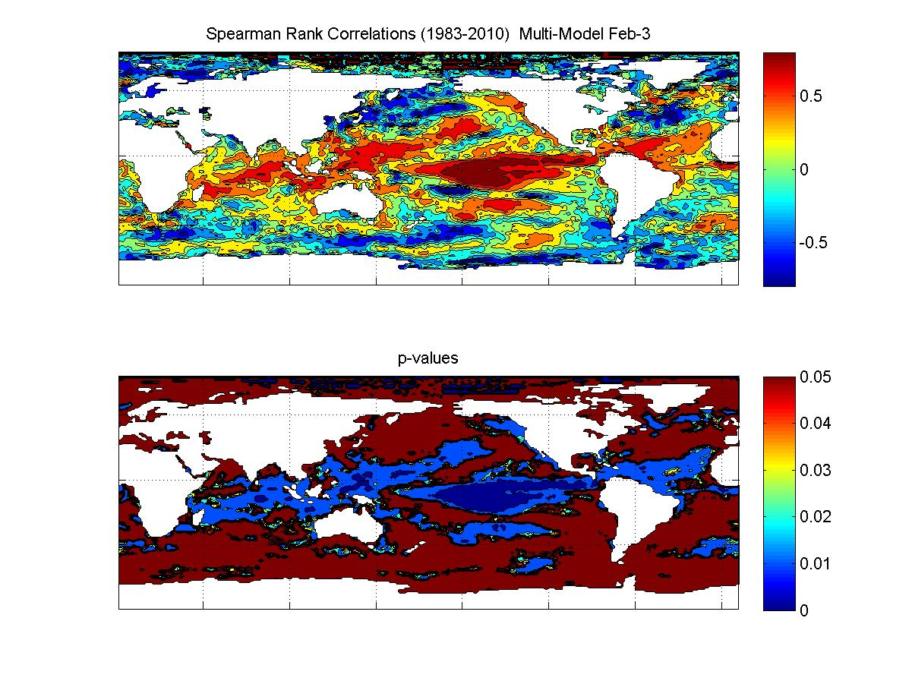

Slide 23
Final thoughts
Forecasts for various time-ranges are subject to different forcings and have different skill levels
Models can provide useful operational forecasts
Model/system development has resulted in improved forecasts, also of extreme events
The South African modelling community, in partnership with international modellers, are constantly improving on operational forecast models/systems

