Slide 1


THE IMPACT OF DIFFERENT SEA-SURFACE TEMPERATURE PREDICTION SCENARIOS
ON SOUTHERN AFRICAN SEASONAL CLIMATE FORECAST SKILL
Willem A. Landman
Asmerom Beraki
Dave DeWitt

Slide 2
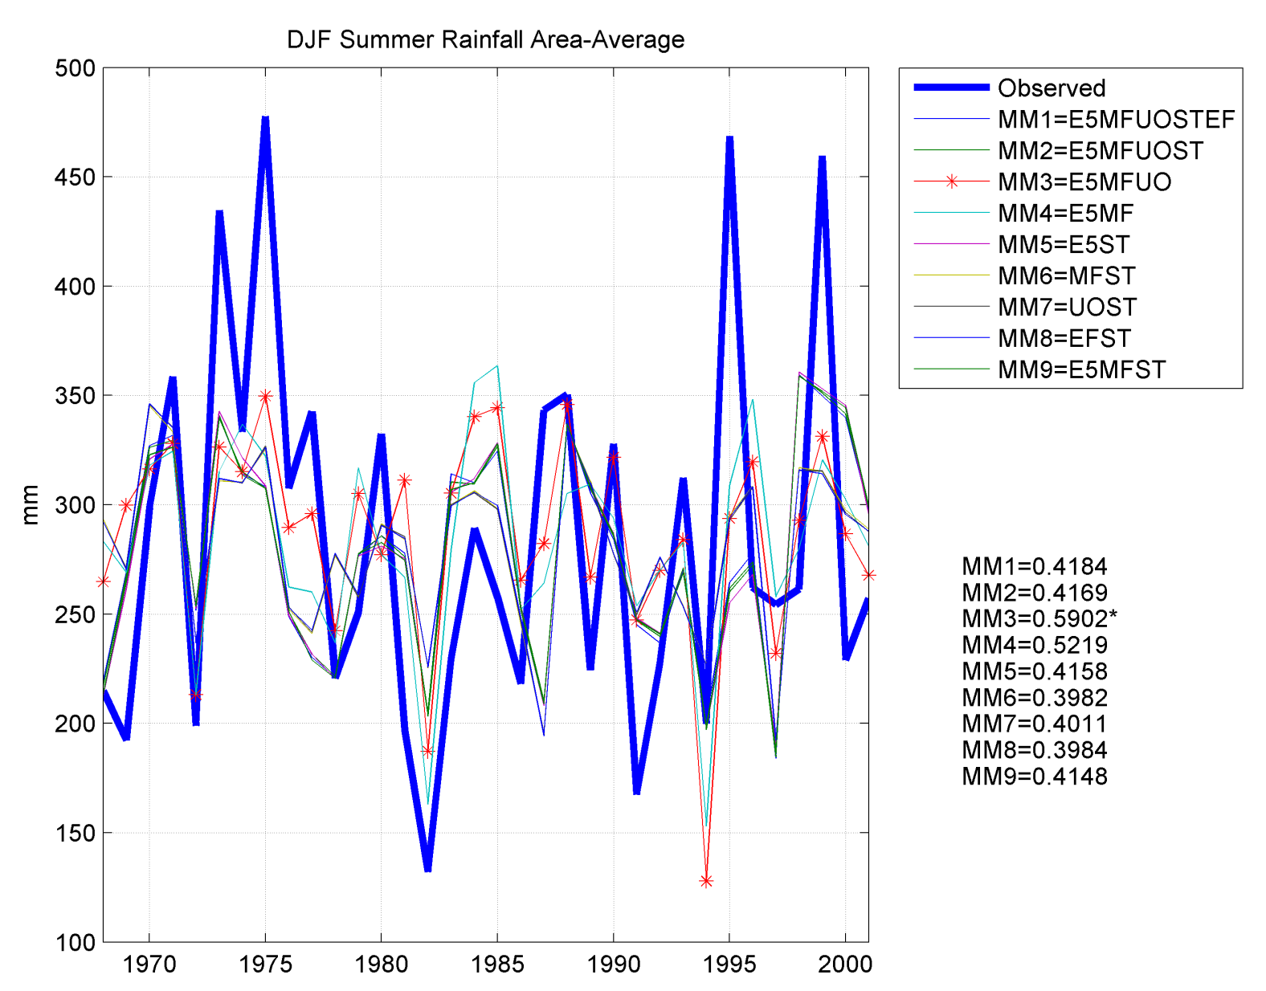
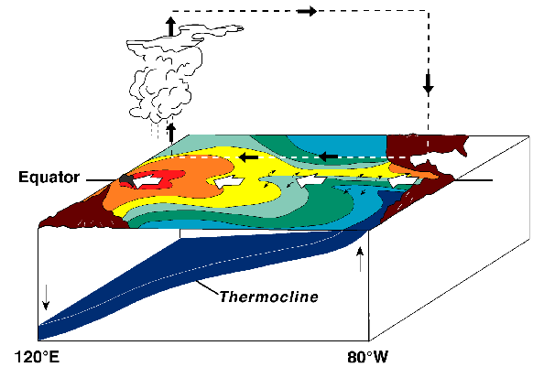
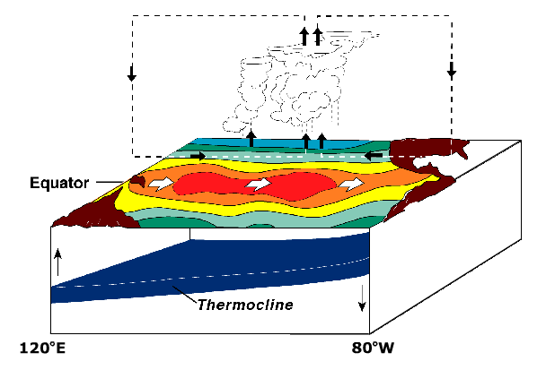
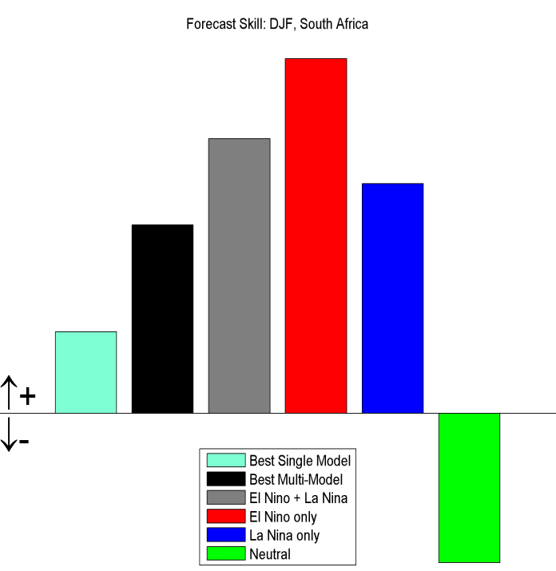
Are AGCMs useful? (1)
Test period
The best model is the ECHAM4.5 AGCM
“trend” hits=27/33=82%
for test period hits=12/14=86%

Slide 3
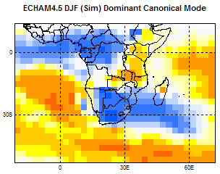
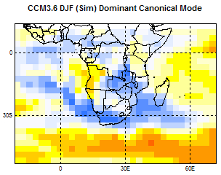
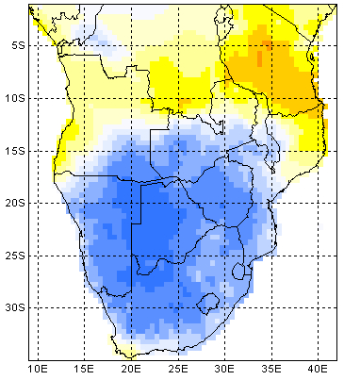
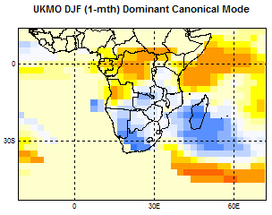
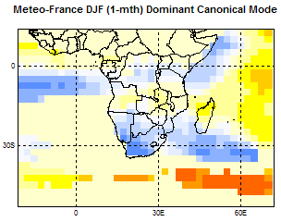
Are AGCMs useful? (2)
Dominant mode of GCM prediction performance
DJF rainfall association with ENSO

Slide 4
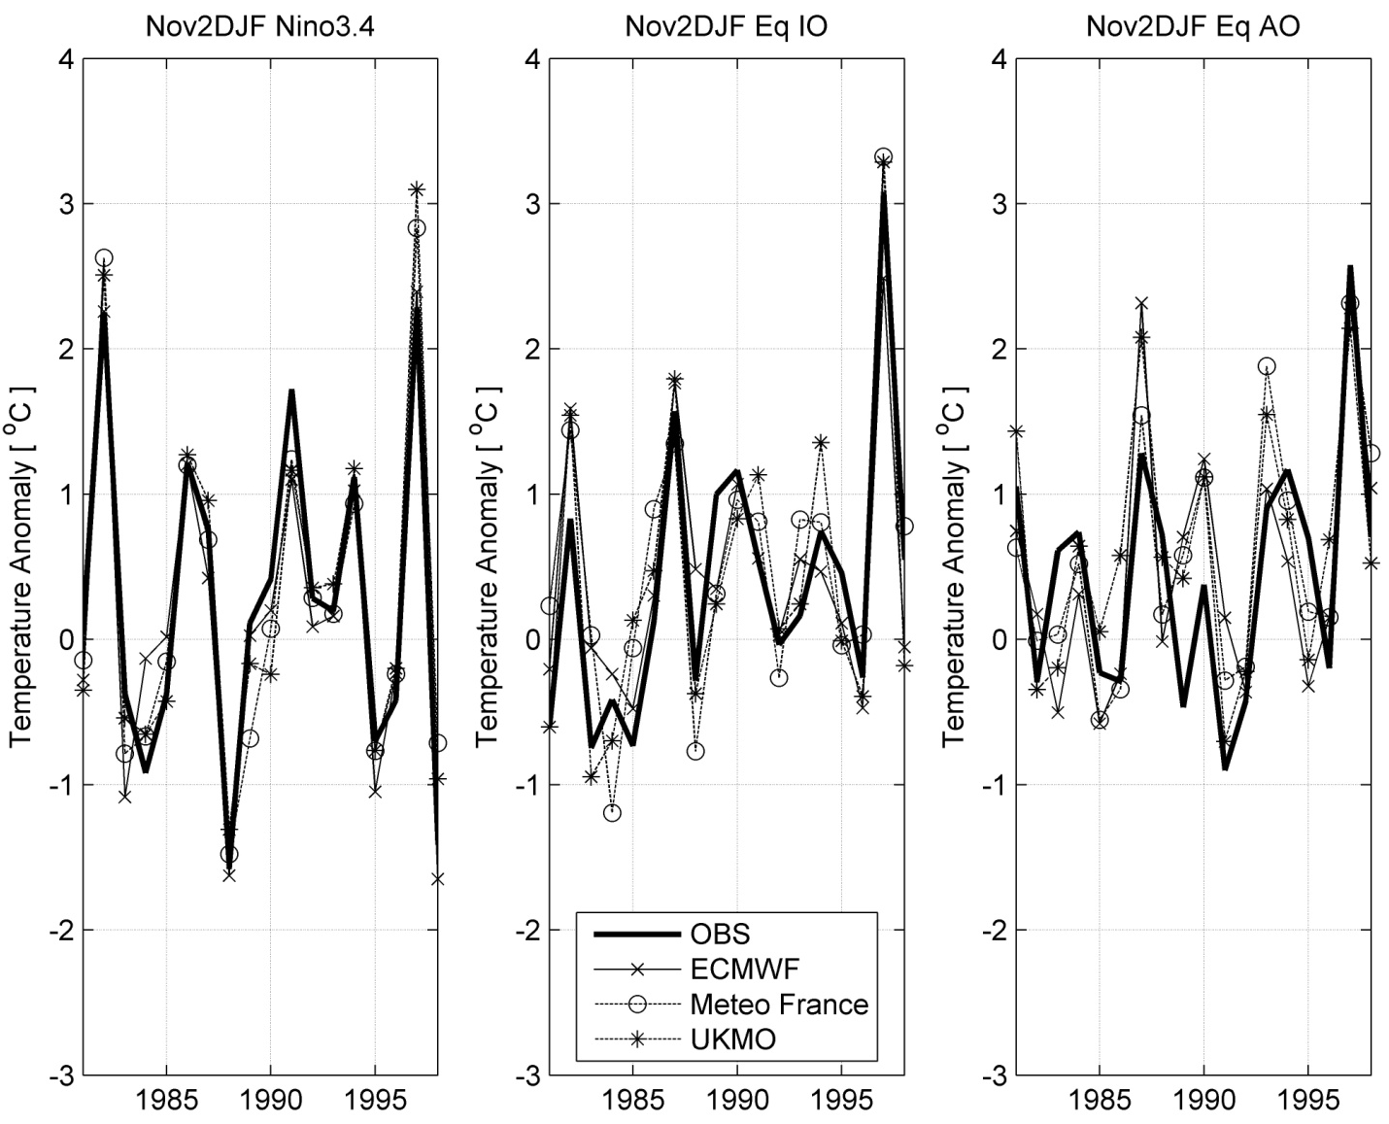
SST Predictability
SST scenarios:
DEMETER SST forecasts (9 members or scenarios)
24 ECHAM4.5 ensemble members each used one of these 9 DEMETER members / scenarios
Some DEMETER SST got used 3 times and some only 2 times
Forcing the ECHAM4.5 with the SST ensemble mean
Research questions:
What is the best SST forcing scenario for SA seasonal rainfall prediction?
Will forecast skill of seasonal rainfall be improved by including the uncertainties associated with skillfully predicted SST anomaly fields?

Slide 5
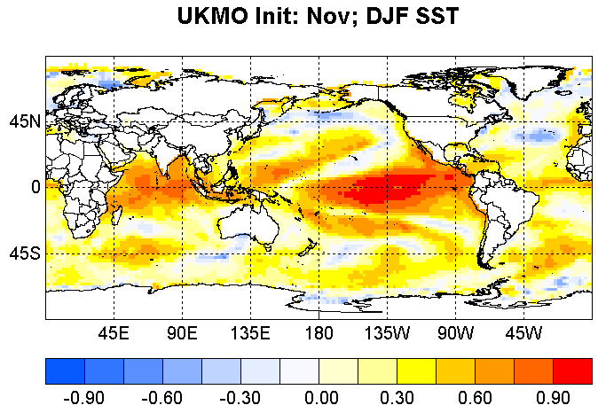
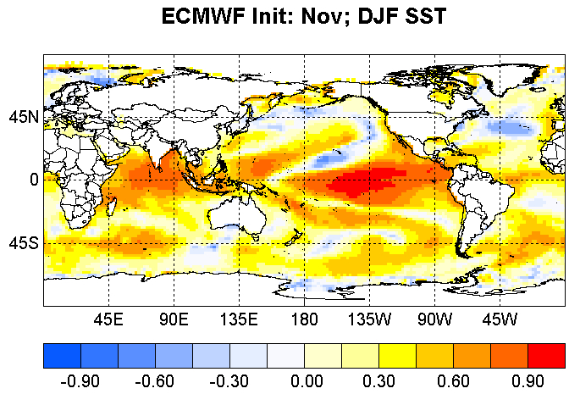
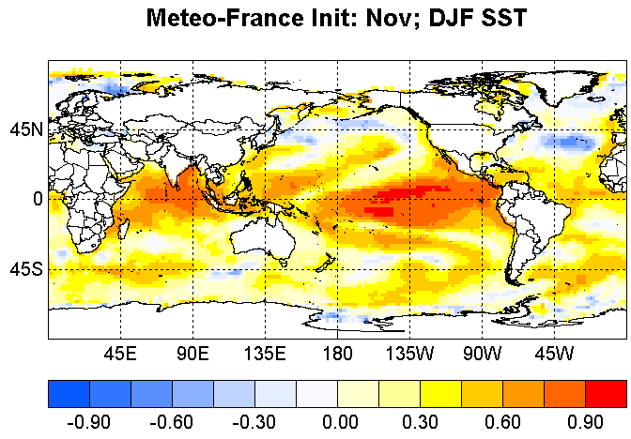
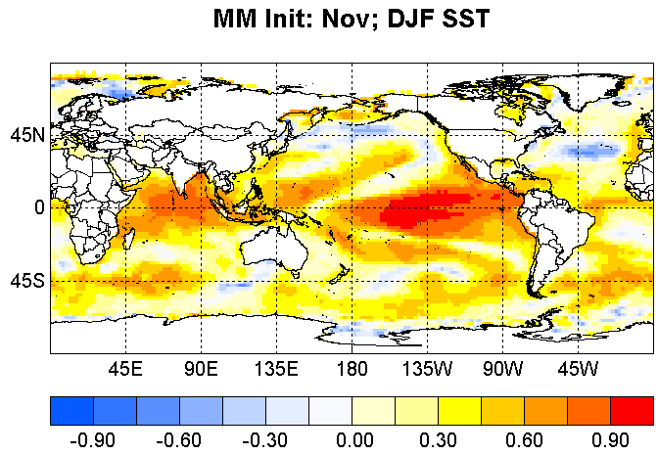
Question 1: Should the AGCM be forced with various SST forecast fields, or with an ensemble mean SST forecast field?
Skill maps (Spearman correlation)
or:

Slide 6
Question 2:Will uncertainties in forcing SST fields better estimate the probability of each outcome?
Ensemble forecast from model 1 explores
part of the future uncertainty
Ensemble forecast from model 2, run from (even
the) same set of initial states, typically explores
additional future uncertainties
Uncertainty in
initial atmospheric
state
Uncertainty in
future atmospheric
state
???
Ensemble forecast from model 3, run from
different ocean states may explore
additional future uncertainties
Uncertainty in
SST state

Slide 7
Experimental design:
ECHAM4.5 AGCM 850 hPa geopotential height field forecasts (forced with various SST scenarios) are downscaled (MOS) to 0.5° x 0.5° resolution for SADC (south of 10°S) DJF rainfall totals
Rainfall forecasts are produced retro-actively from 1987/88 to 2001/02, with an initial training period of 1958/59 to 1986/87 and an update interval of 1 year
Forecast lead-time is 1 month, i.e., DJF forecasts issued in November

Slide 8

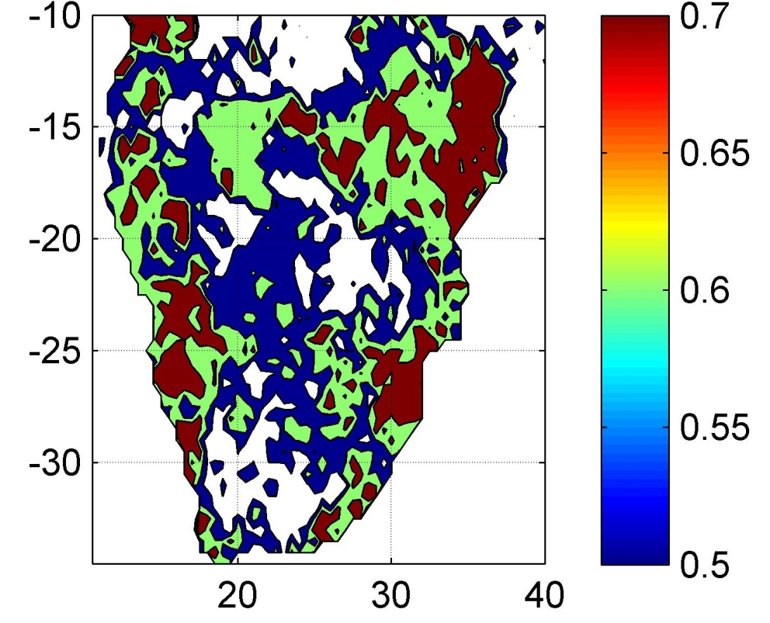
“Jackson Pollock maps”
Studies by Taylor, Micolich and Jonas have examined Pollock's technique and have determined that some works display the properties of mathematical fractals. The authors even speculate that Pollock may have had an intuition of the nature of chaotic motion, and attempted to form a representation of mathematical chaos, more than ten years before “Chaos Theory” itself was proposed.

Slide 9
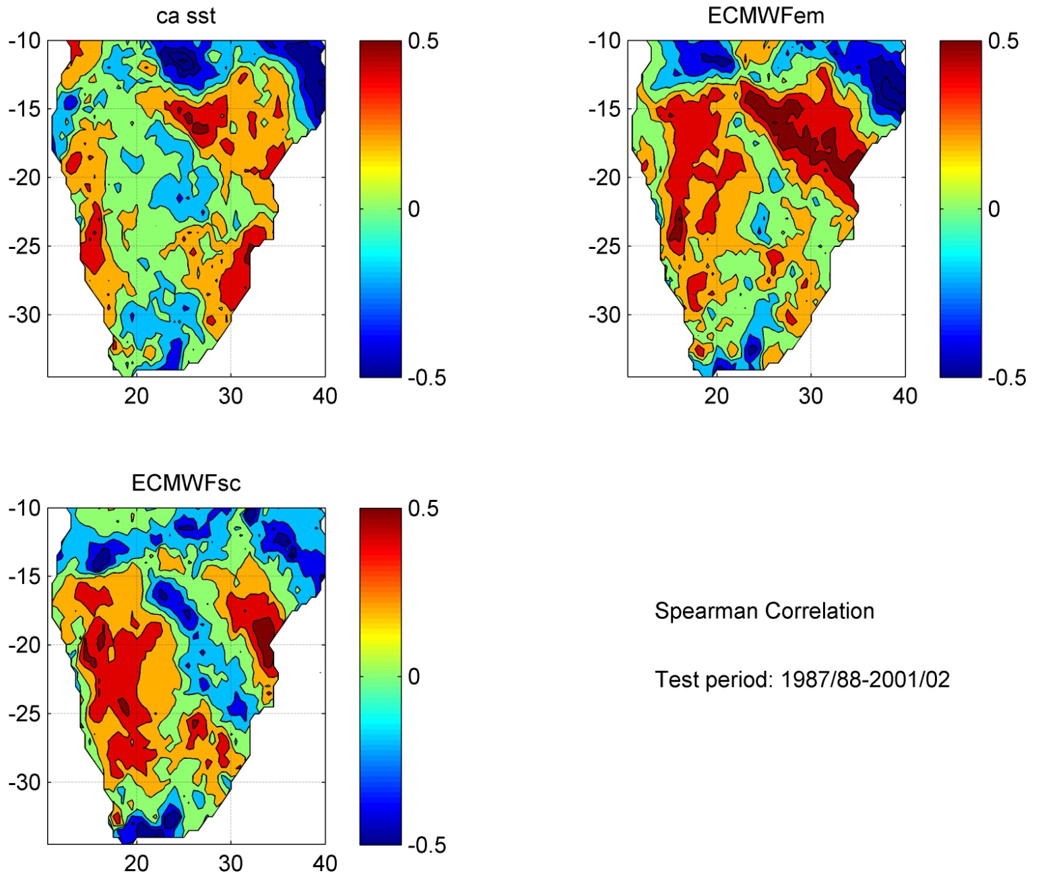
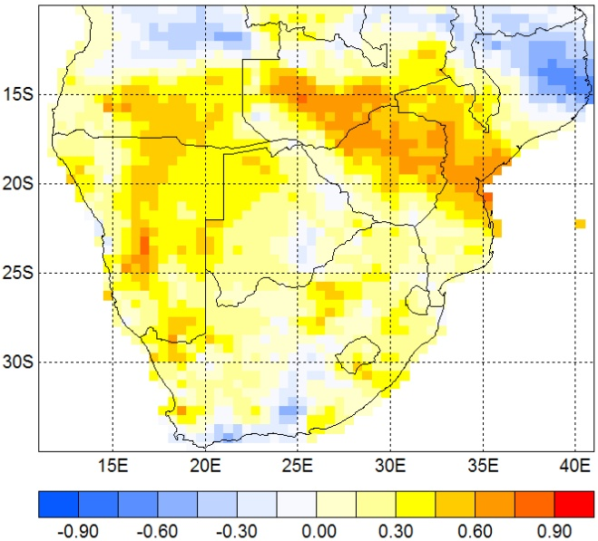
Deterministic Skill:
Spearman Correlations

Slide 10
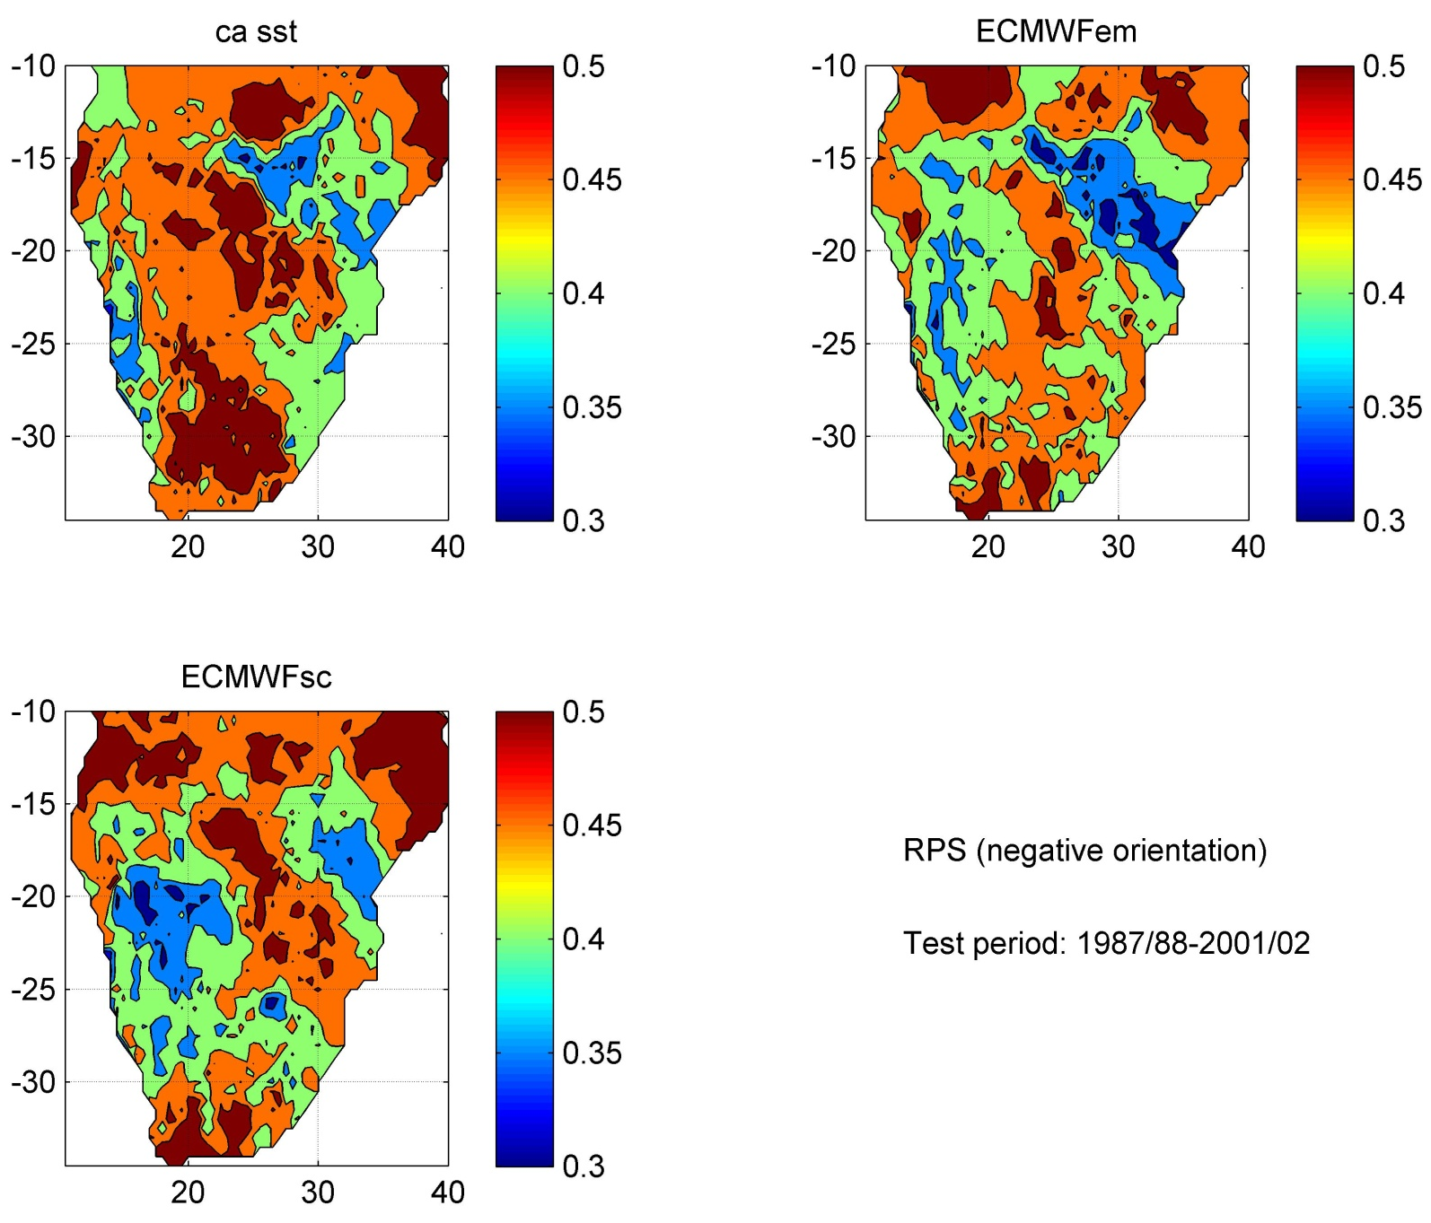
Probabilistic Skill:
Ranked Probability Score (RPS)

Slide 11
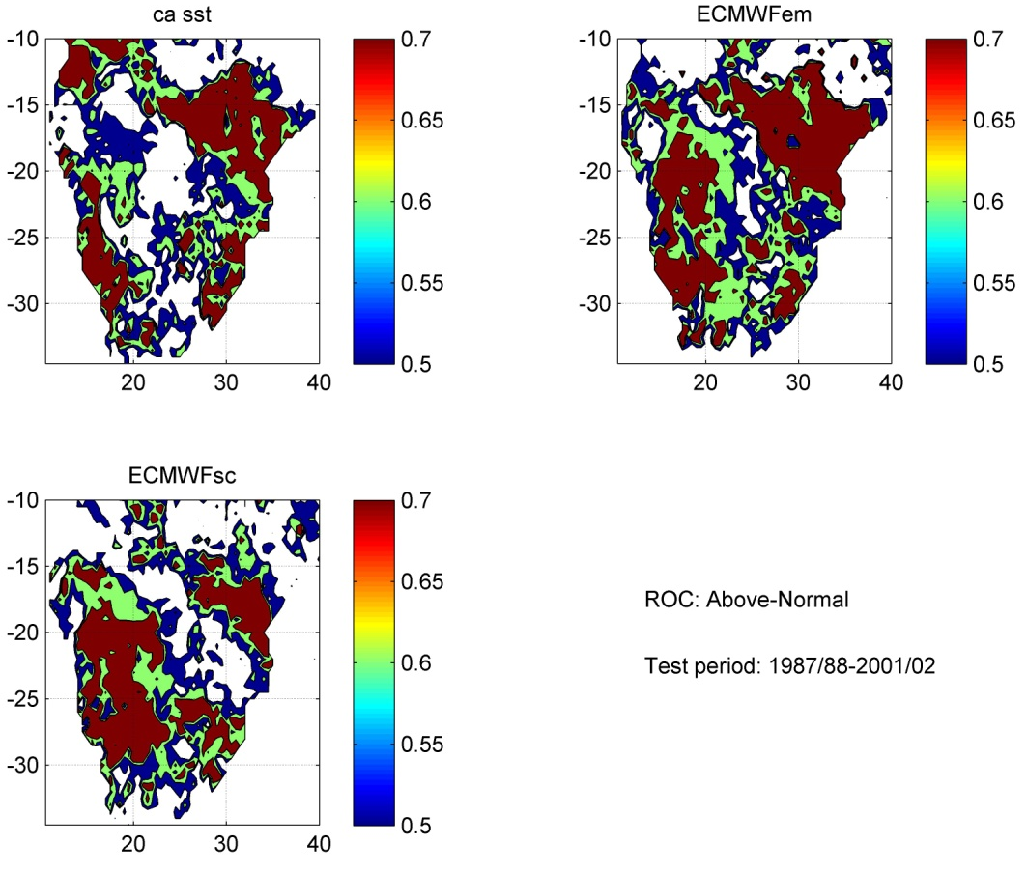

Probabilistic Skill per Category:
Relative Operating Characteristics (ROC)

Slide 12
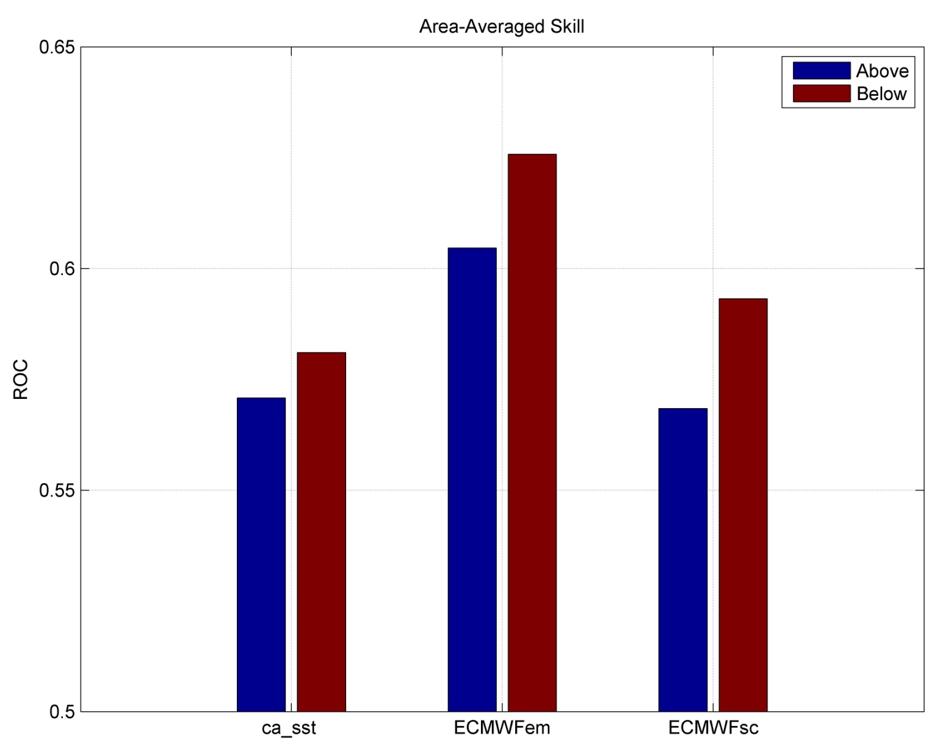
Best Probabilistic Skill
Answer 1: The AGCM should be forced by an ensemble mean SST forecast field in order to produce the best single-model forecast

Slide 13
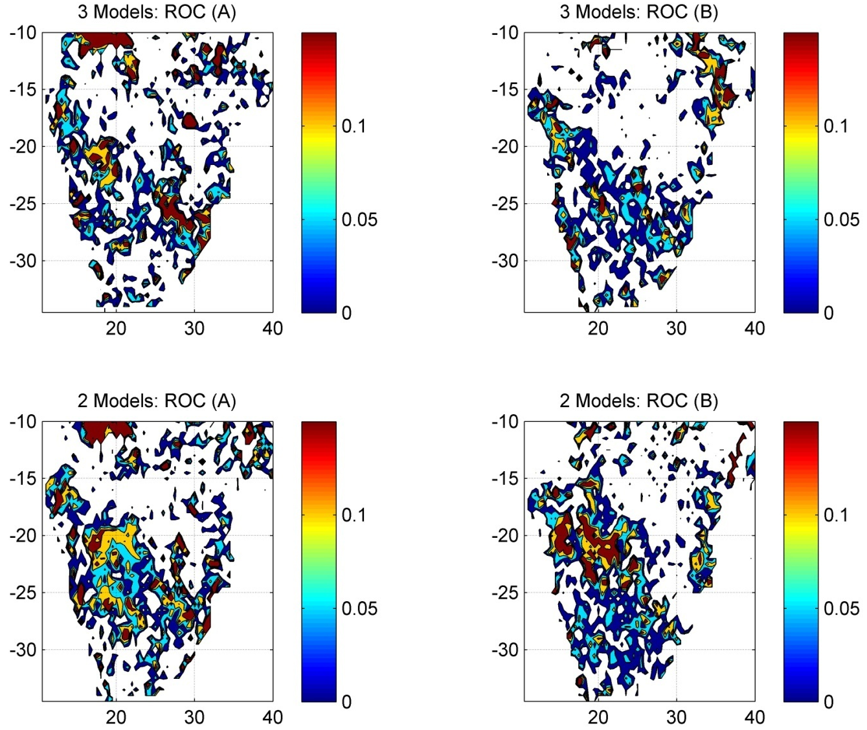
The multi-models: Skill Differences
3 AGCM configurations:
  Forced with ca_sst, ECMWFem and ECMWFsc
2 AGCM configurations
  Forced with ECMWFem and ECMWFsc
Positive values where MM is better than best single model (ECMWFem)
Answer 2: By considering (some of) the certainties in forcing SST fields the probability of forecast outcomes is better estimated (over some areas)

Slide 14
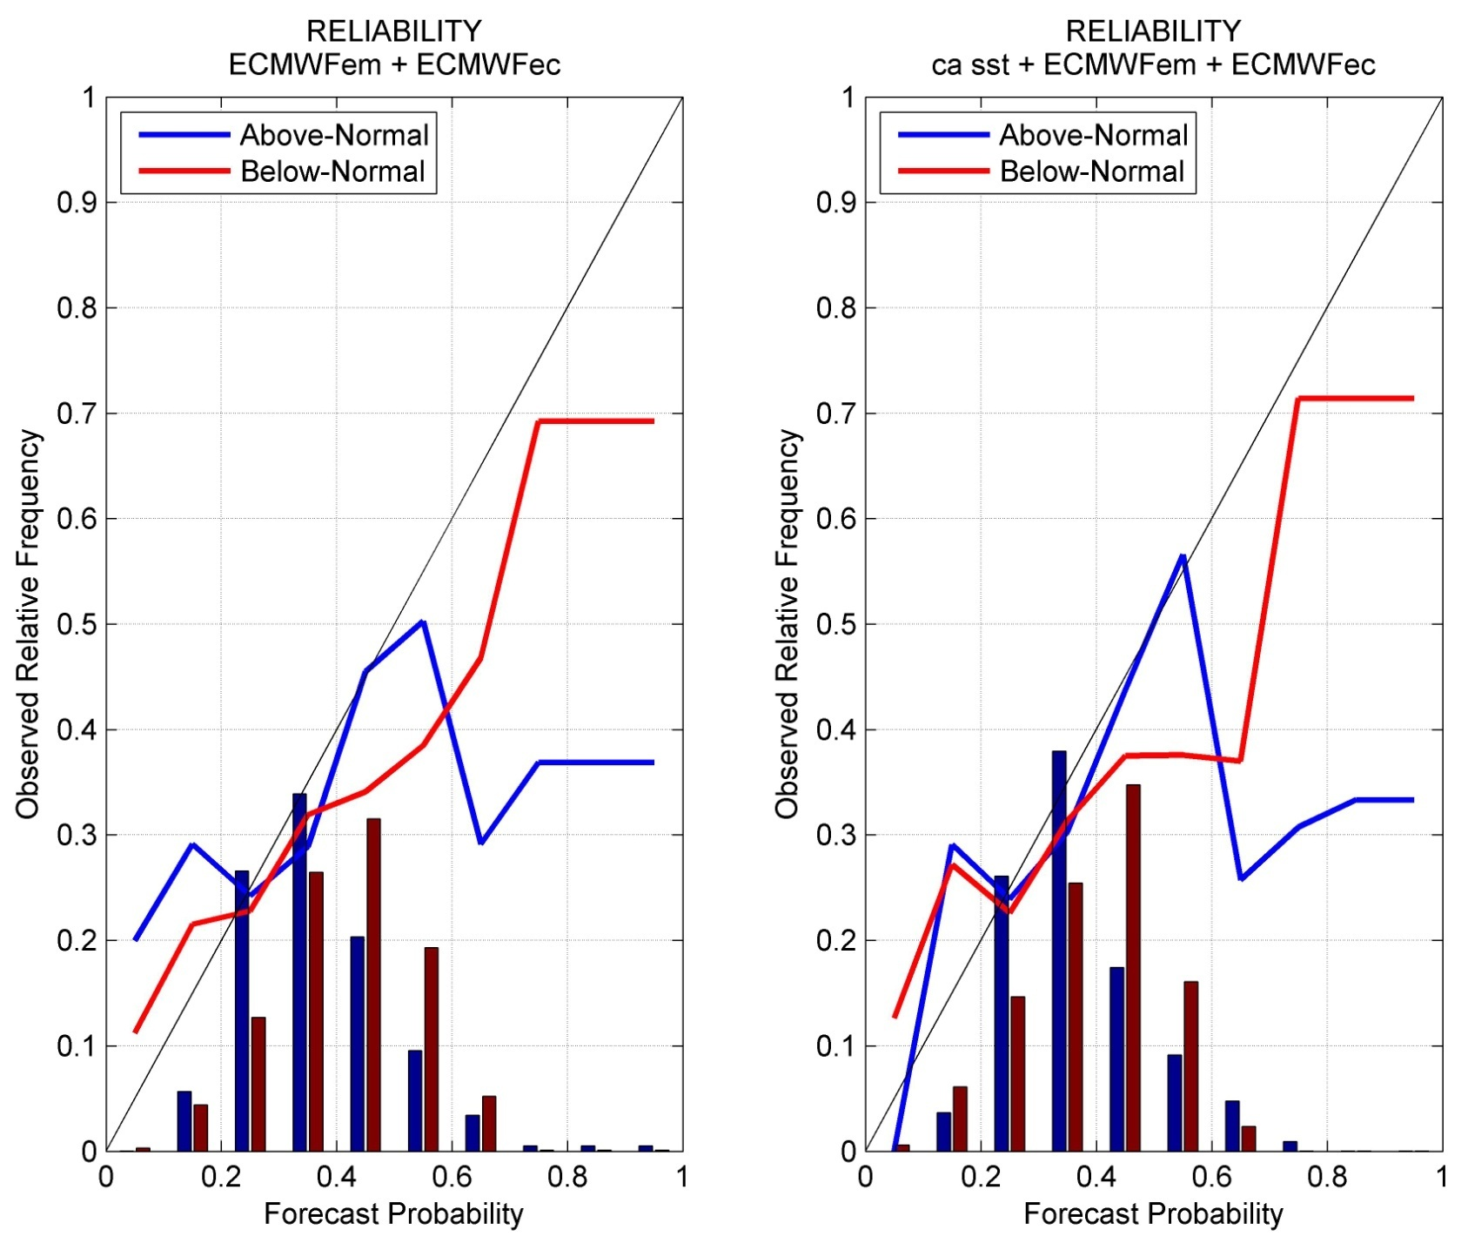
Reliability

Slide 15
Conclusions
AGCMs are useful tools to produce seasonal forecasts
To produce the best single-model forecasts, the AGCM should be forced by an ensemble mean SST forecast field
By considering the uncertainties in forcing SST fields the probability of forecast outcomes may be better estimated
Forecasts are reliable, especially forecasts for drought… and so El Niño 2009/10…?

Slide 16
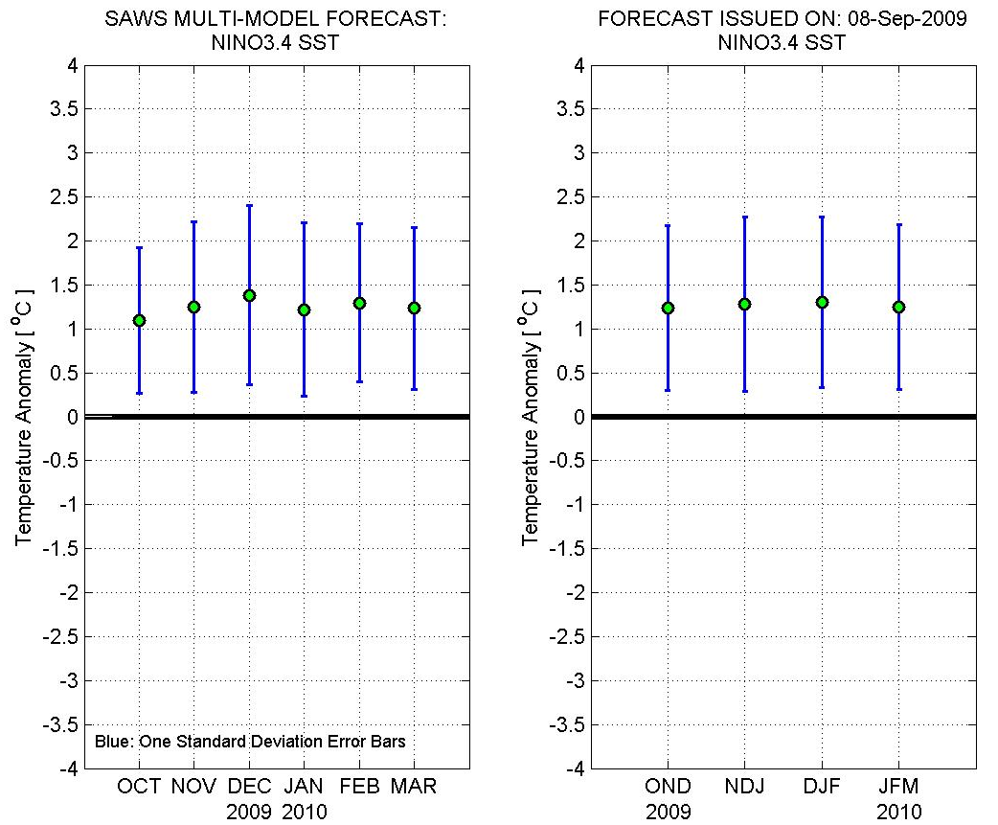
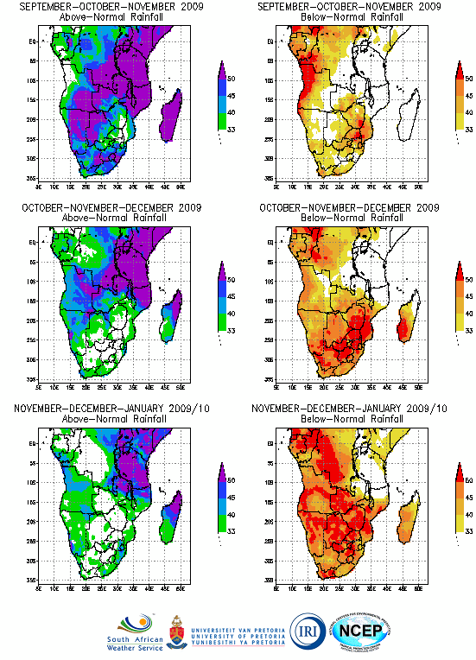
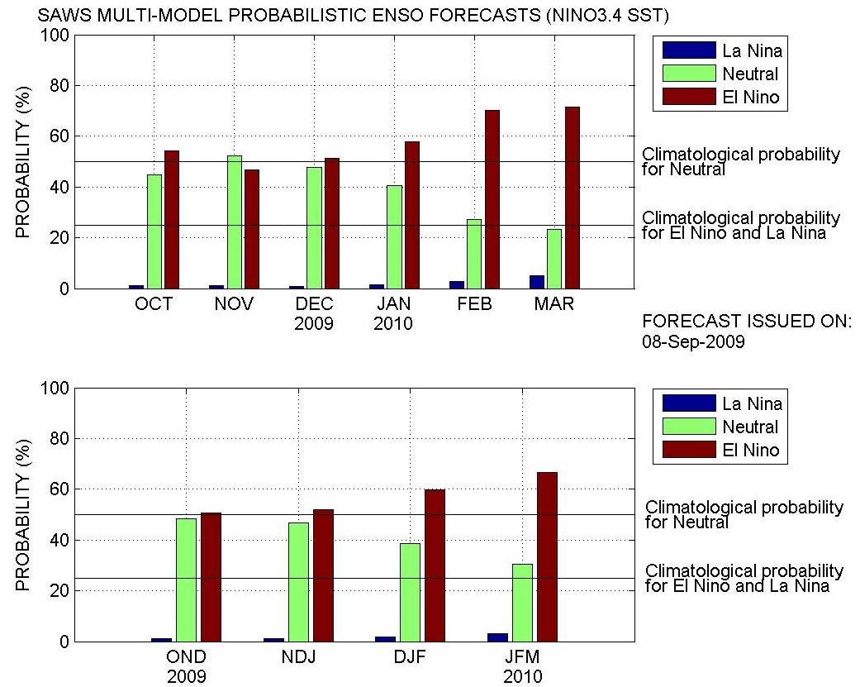
SAWS forecasts produced recently:

