Slide 1
An overview of models to support spatial planning and land use management processes
Engaging our future –
Alize le Roux
14 November 2018
Presented to: National Spatial Planning and Land Use Management Forum
Authors: Alize le Roux, Gerbrand Mans, Quintin van Heerden & Chantel Ludick

Slide 2
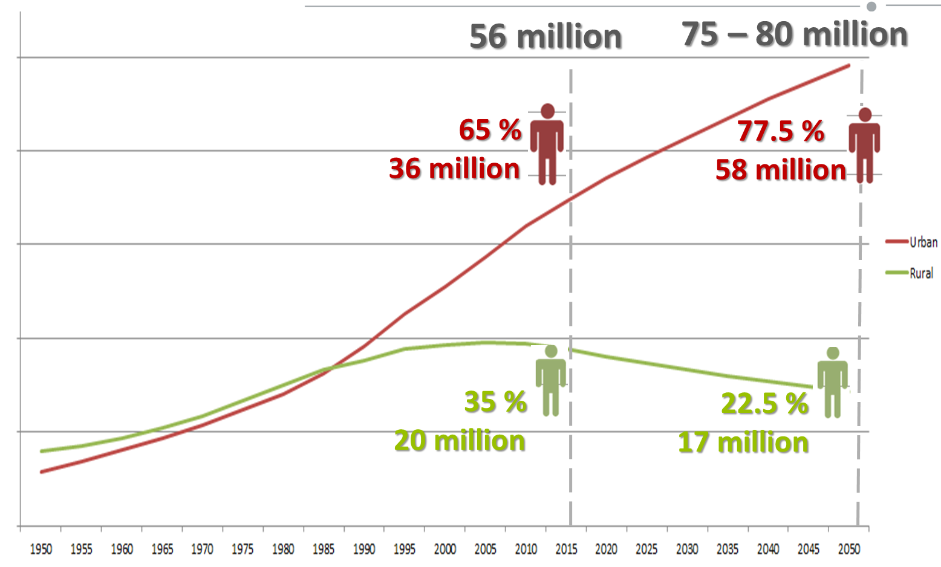
The spatial planning challenge
Notes:
World’s urban population 52% - 67% (2050)
It is expected that South Africa will follow the worldwide trend to experience high population growth and urbanisation.
Current projections indicate an additional 19-24 million people to be added to the country by 2015, the vast majority of this growth to be added to cities and towns (le Roux et al., 2018).

Slide 3
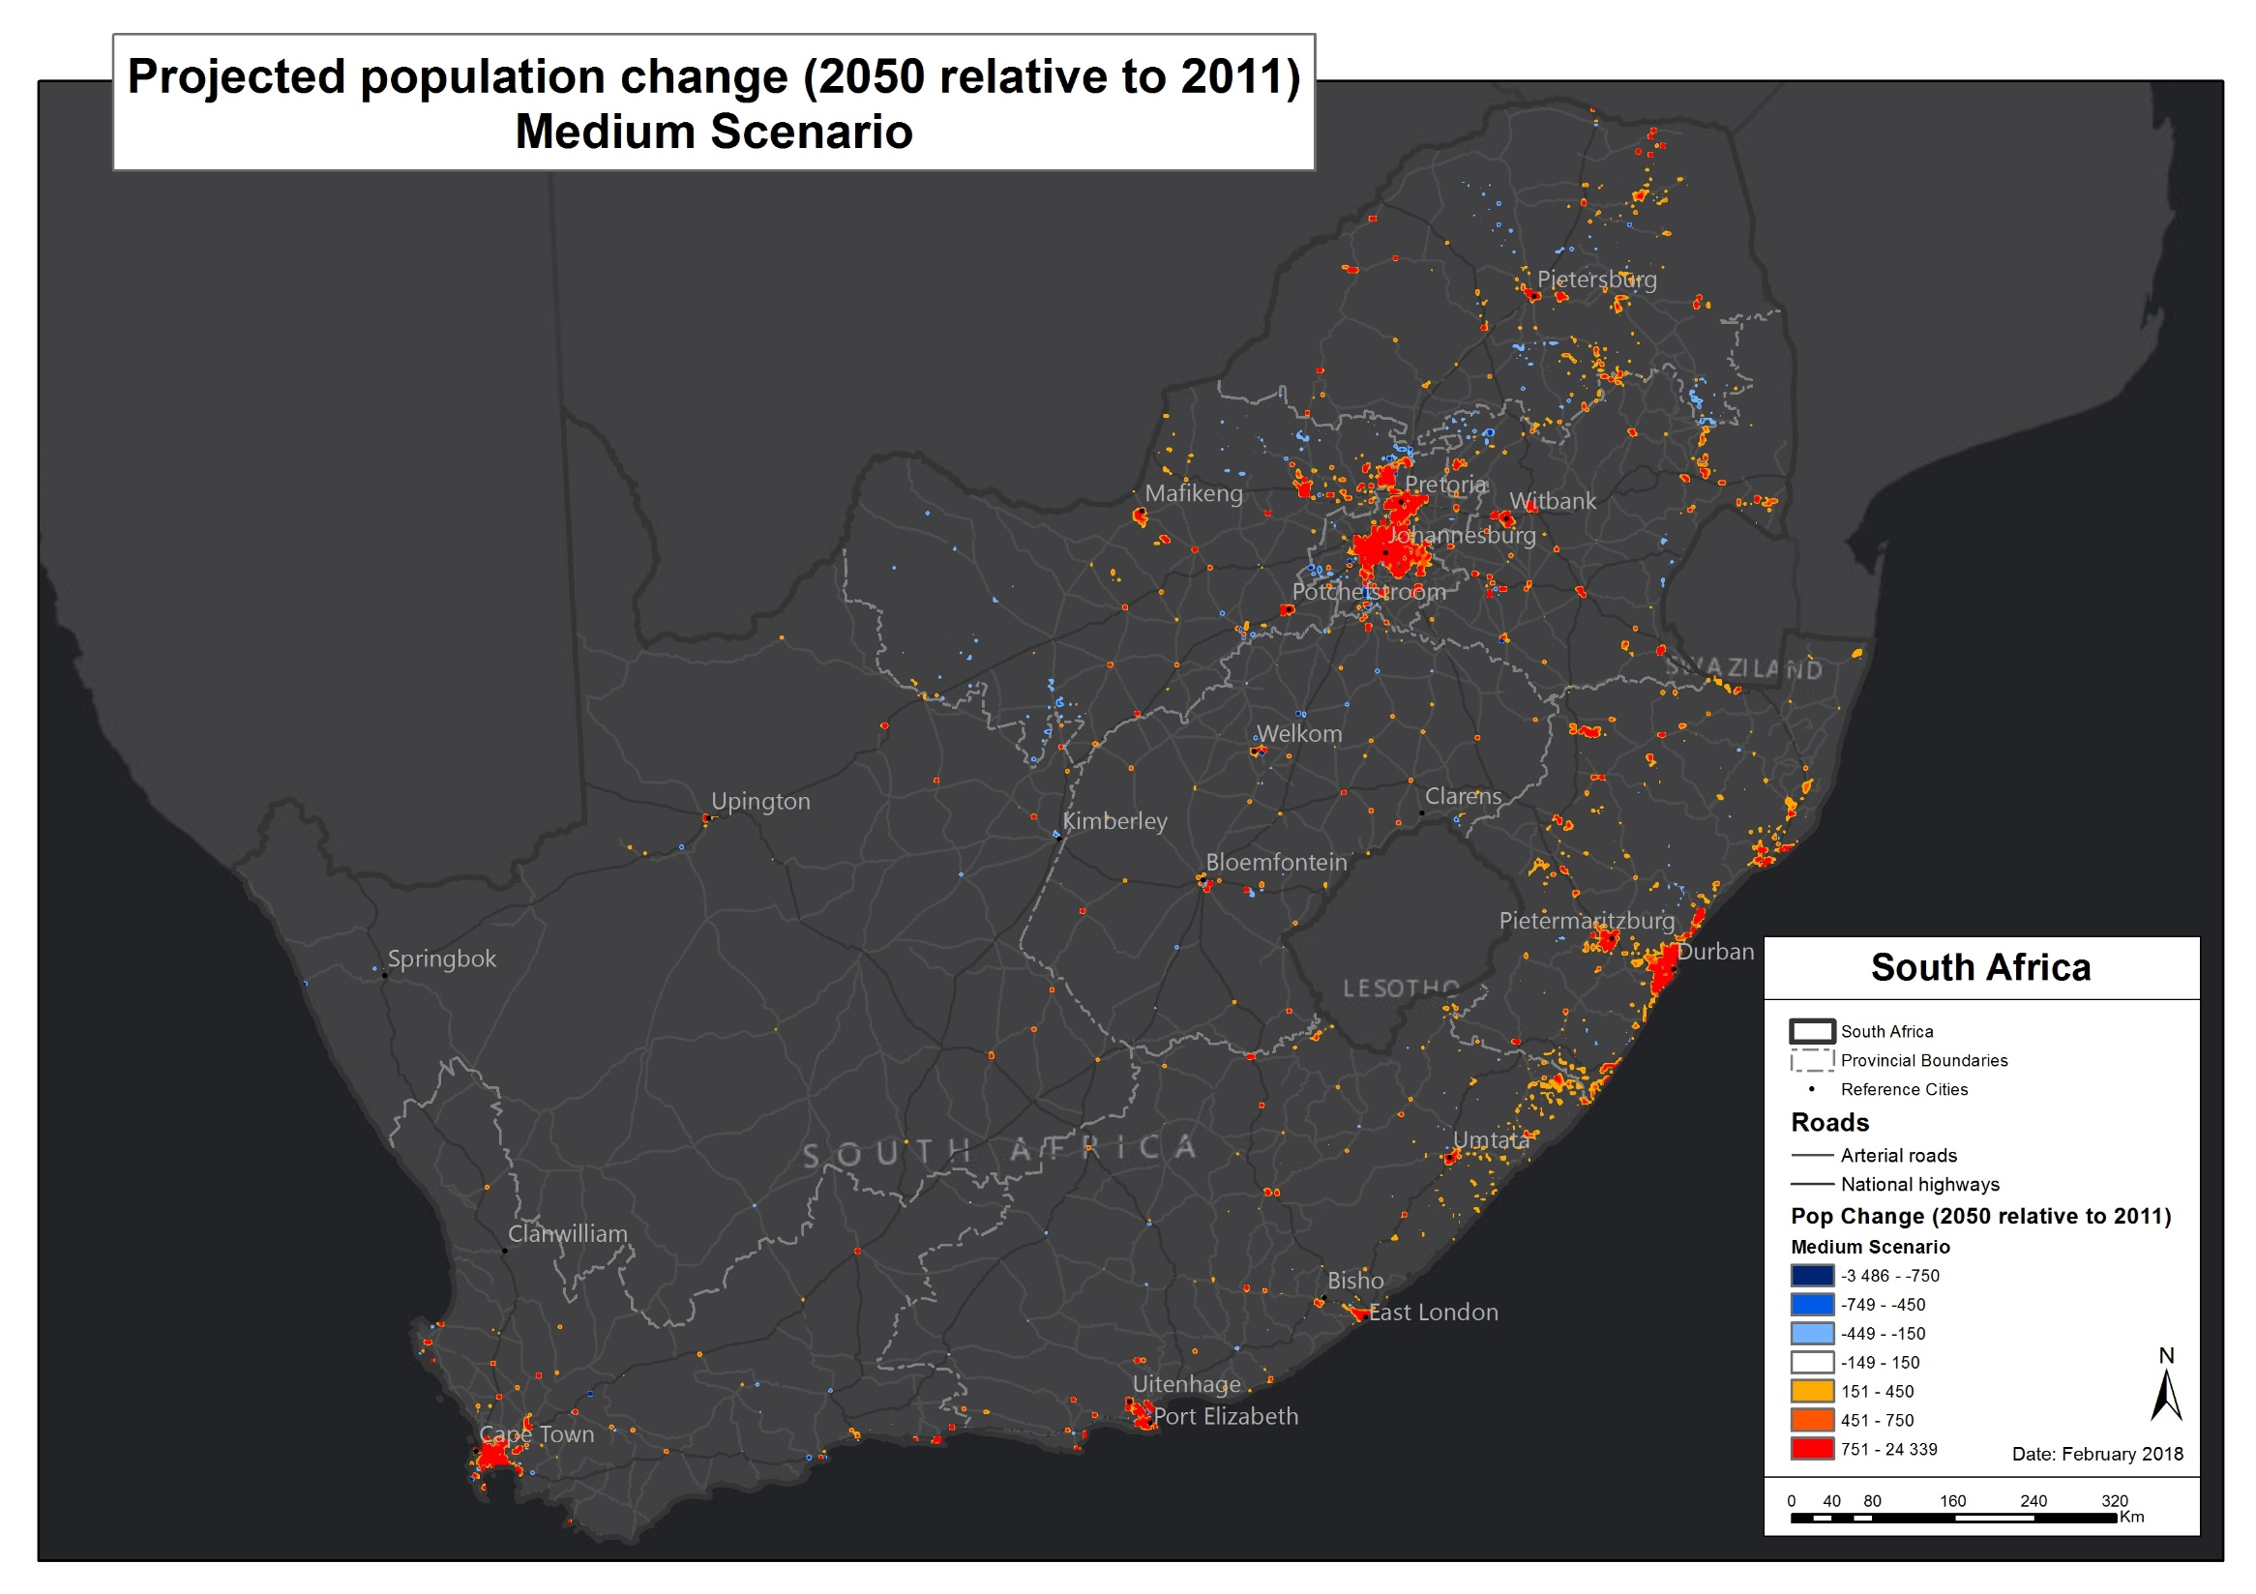
Effective planning and policy interventions
  “We need to fundamentally reshape human settlements by 2030” NDP
  “Bold measures are needed to reshape our settlements” NDP
Test our policies and interventions
  “Cities can be irreversible changed as most of the planning consequences will only be observed and quantified well into the future” Bertaud
Notes:
This growth, if not managed and planned for effectively, will place an enormous amount of pressure on bulk infrastructure delivery and will have critical implications for national and regional policies and inter-governmental prioritisation efforts.
Growth is also a catalyst economic growth, This growth however also opens up the possibilities of designing principles of resilience into our cities, principles that can open up pathways to change.
Effective planning & policy intervention to handle and manage the growth

Slide 4
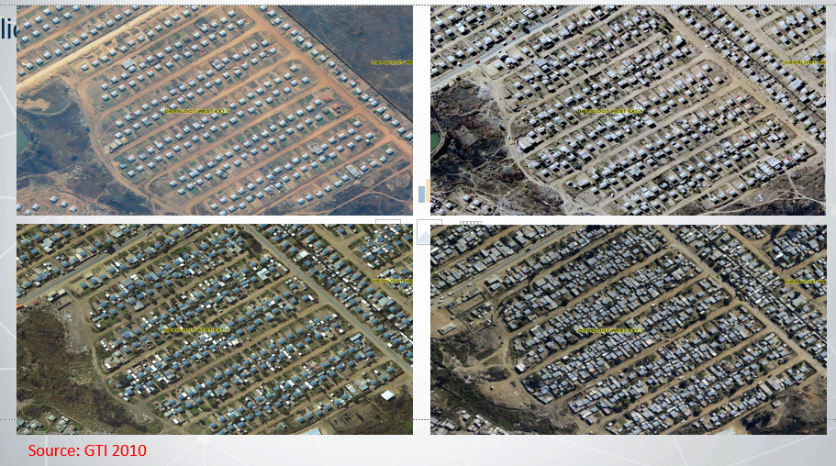

The spatial planning challenge
Policies can have unintended consequences
Consequences that can irreversible change the landscape
Even with well-designed planning policies there is still a great uncertainty to how areas will develop and what the impact thereof will be on the environment and our livelihoods
Example
1990 – 2013 WC significant decrease in forest plantations & marginal increase in urban/built-up areas, mines & quarries, woodlands & scrublands and fynbos
2001 the cabinet decommissioned 45 000ha forest plantations for agriculture, human settlements
2008 decision partially reversed
Notes:
. The rationale behind this was that the plantations were not economically viable at that time; accompanied with concerns of plantations invasion of protected areas and catchments. Government however partially reversed 22 402ha back to plantation forestry following studies and recommendations by the Department of Water Affairs and Forestry in 2008 (Wilgen, 2015). There has been no significant increase in plantations since no initiatives were implemented following the reversal by Cabinet in 2008 (De Beer et al., 2014). An indication of the actual losses of forest plantations to other LULC classes between 1990 and 2014 is illustrated in Figure 4.

Slide 5
What are the drivers of LULC change
Political Factors: Play a significant role in land use change in South Africa – Past & Current
  Legislations that control land use: Constitution of South Africa No 108 of 1996, Municipal Systems Act No 32 of 2000, Development Facilitation Act No 67 of 1995, National Environment Management Act No 107 of 1998, Spatial Planning and Land Use Management Act no 16 of 2013 (SPLUMA)
Economic Factors: land markets, access to capital, investments, subsidies and cost of production and transportation.
Demographic factors: Pressure on land use is caused by aspects of population composition and distribution e.g Migration, Urbanization, Household size
Cultural Factors: Encompass people’s beliefs, values and attitudes towards lands use
Biophysical Factors: Climate, Soils, Topography, Relief, Vegetation
Technological: Decrease in number of farms & farm consolidations or Increased mechanization

Slide 6
There is a need for models and tools
Need
tool for testing policy interventions but..
Complex, intricate and complicated to model with many interconnecting parts
There's multiple role-players and decision makers involved
Changes continuously
Current condition of the system depends on its past
Cross-scale connections (vertical/horisontal)
Elements adapt and change to stimuli from their environment
Self-organization emergent behavior ‘more than sum of its parts’
Why
We want to Engage in our future
Better understand/explore the impacts of future policies on land use
To predict behaviour under specific scenarios, inputs & pressures
To study, understand & explore links & phenomena’s (get a better understanding of reality)
Land Use Land Cover change models (Urban growth modes) have proven to be effective decision support tools to determine the possible effects that planning policies could have.

Slide 7
Review of current international LULC Models
LUCM applied internationally
What if? 2.0 | GEM | Plurel
Sleuth | UrbanSim | Moland/EUCS100
Delta | CUF | Metronamica
LUCAS | LTM | Dinamica
SAMBA | NELUP | ILUTE
Geomod2 | FASOM | PUMA
Dyna-Clue/Clue-S | CURBA | Ilumass
Agarwal et al. (2000), Verburg et al. (2004), Wainger et al. (2007), Pontius et al. (2008),
Haase and Schwarz (2009) &
Wray et al. (2015)
Notes:
The five most popular and comprehensive literature comparisons on land use models are the work of Agarwal et al. (2000), Verburg et al. (2004), Wainger et al. (2007), Pontius et al. (2008) and Haase and Schwarz (2009). From each one of these studies it is clear that various models exist that have been developed, applied and tested throughout various countries. It is also clear that each one of these models where designed for a very specific purpose, location and application in mind.

Slide 8
Considerations when developing a LULC model
All Models Are Wrong—Some Models Are Useful
Keep it as simple as possible
“The question isn’t whether a model is correct in some absolute sense, BUT rather whether it is useful for a particular purpose”
Real world processes (behavioral, spatial, temporal) needs to be represent in the model
Scale (National or Local changes)
Resolution (detail)
Temporal dynamics
Indicators to measure change
Loose coupling with models (National)
Unique SA circumstances (informal economy, policy interventions, land use management
Purpose of the model –what are you going to use it for??
  Prediction: very difficult (why?)
  Explaining: explain patterns but do not make predictions
  Exploring: develop intuitions or even theories, study alternative hypotheses

Slide 9
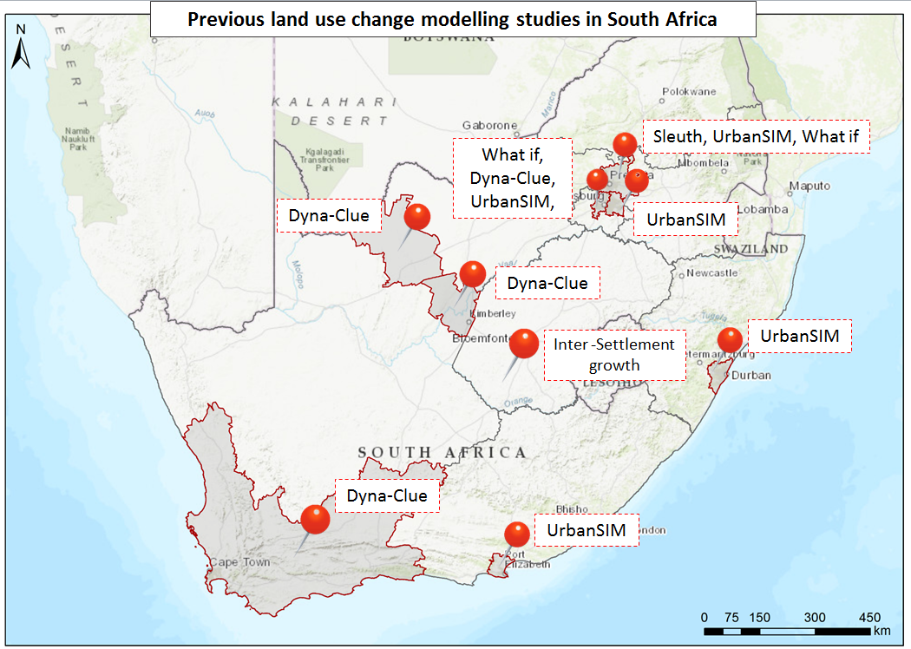
Applications in South Africa – decade of investment
CSIR developed, adapted & applied models
12 model case studies
Scales:
National, Provincial, District, Local, Metropolitan
Resolutions:
Erf level – 1x1sqkm
Models:
Inter settlement growth model, Dyna-Clue model, Sleuth, What-if & UrbanSim model
Different model techniques:
Gravity-based, hybrid models, ABM, CA, GIS based, etc.
Durban
Port Elizabeth
Notes:
9

Slide 10
Central to all LULC change models
Computer simulations
Underpinned by various theories (urban and regional economic theory, sociological and political economy theory, human-nature theories.)
Build on 3 key building blocks Space, time and human choice
Classes of models statistical and economic models, spatial interaction models, optimisation models, integrated models
Modelling techniques Equations, Statistics, Expert knowledge, CA, Hybrid, ABM
Statistically validated Accuracy/Uncertainty
Different models for different Scales , Resolutions and Questions
Examples include Sleuth, What-if, UrbanSim, Dyna-Clue , etc.

Slide 11
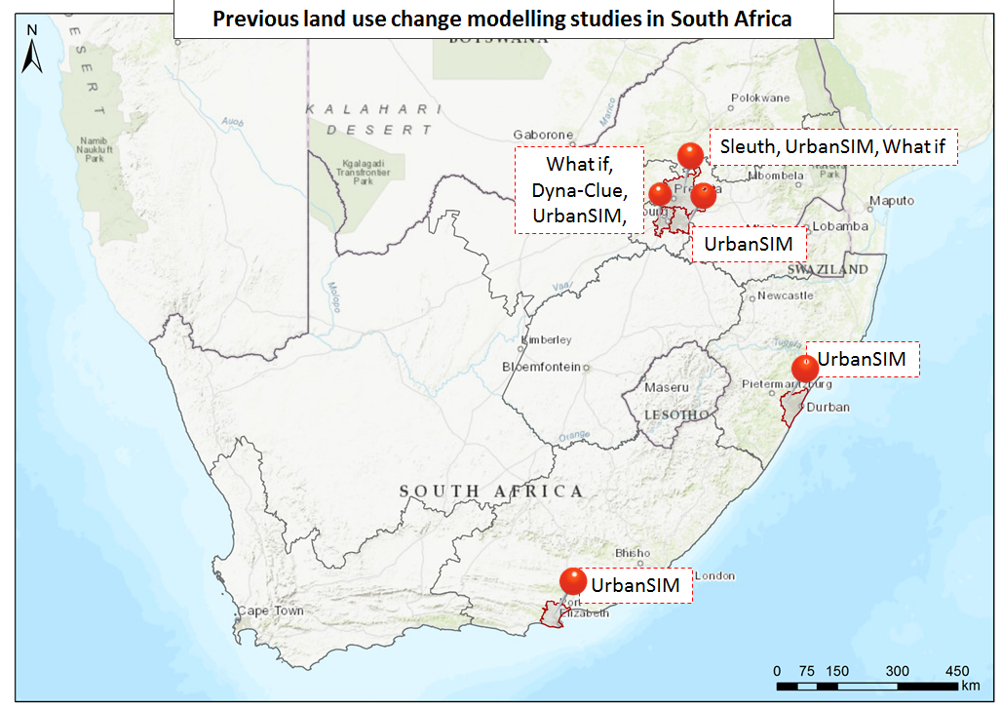
Models @ Local Municipal / Metro Scale
CSIR adapted & applied models
Scales:
Local, Metropolitan
Models:
Dyna-Clue model, Sleuth, What-if 2.0 & UrbanSim model
Resolution:
Erf level, 30m, 100m
Techniques:
GIS DSS, CA, AMB, Hybrid
Locations:
JHB, NMBM, Tshwane, Ekh
Durban
Port Elizabeth
Notes:
11
Nelson Mandela Bay, GP, Ethekwini Metropolitan Municipality (UrbanSIM)
Johannesburg Metropolitan Municipality (Dyna-Clue)
Cape Town (Watkiss) (Sleuth)
Cape Town (UGM) GIS-based
Cape Town (Soko & Smith) AMB informality
Potchefstroom Spatial MCA (Cilliers)

Slide 12

Models @ Local Municipal / Metro Scale
Case study: City of Tshwane
Model: What-if 2.0
Technique: GIS Based planning Support System
Resolution: Ward level
Temporal Scale: 2015 – 2030 (5 year intervals)
What was tested: City of Tshwane’s 2055 Vision – Compaction & Densification strategy
How was it measured: Indicators on building density & population density
How many scenarios: 2; As-IS & CDS Will the proposed policies aid densification & compaction

Slide 13
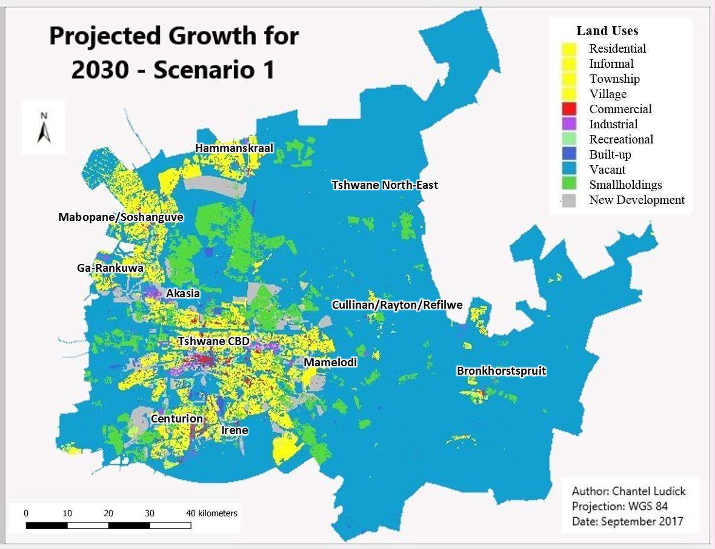
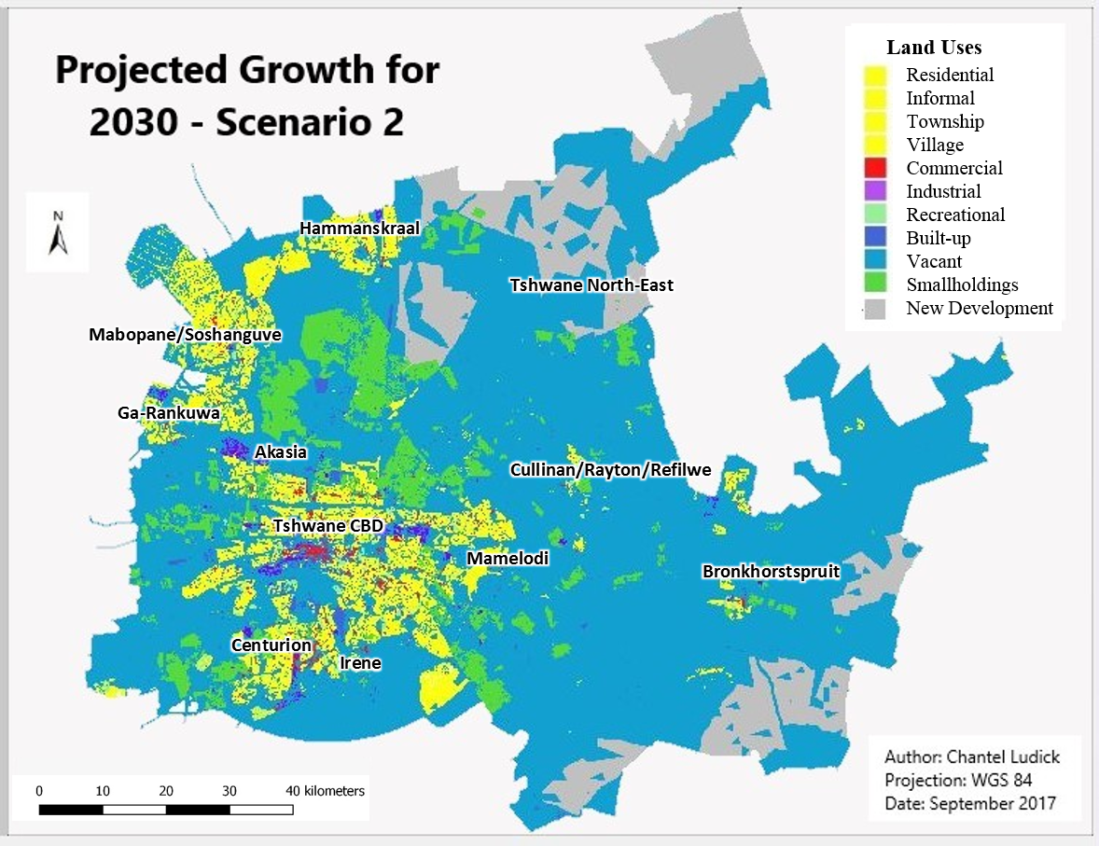
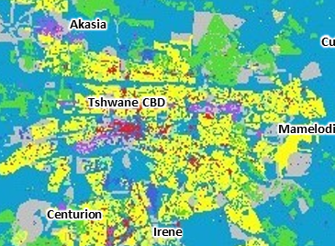
Projected growth
CDS Scenario
As-IS Scenario

Slide 14
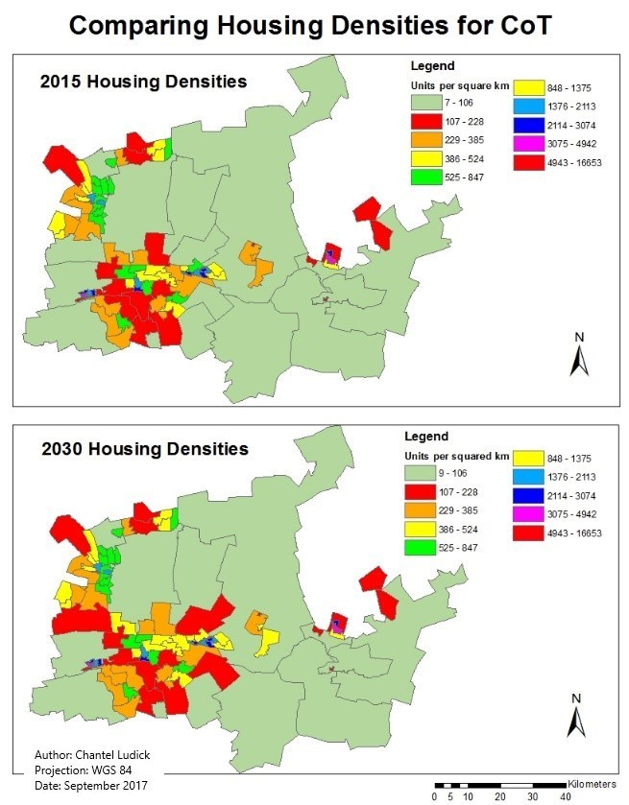
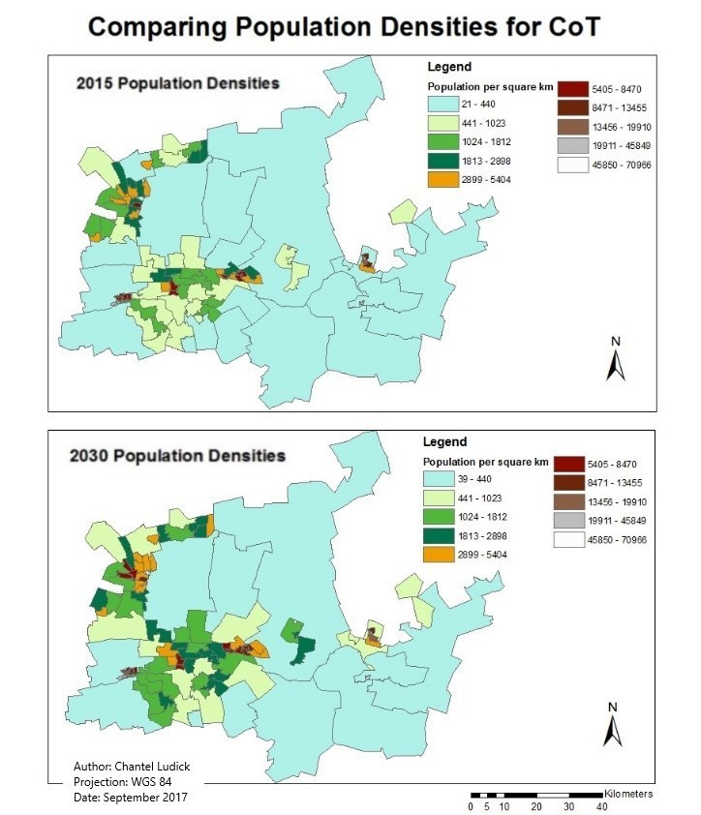
Indicators
Building density
Population density
Notes:
Out of the 107 wards located in CoT, 33 wards showed a significant increase in density for CDS. For Scenario 2 only 11 of the 107 wards showed a significant increase in density.

Slide 15
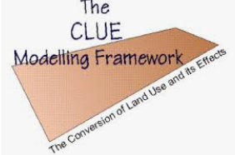
Models @ Local Municipal / Metro Scale
Case study: City of Johannesburg
Model: Dyna-Clue model
Technique: Hybrid model
Resolution: 100m
Temporal Scale: 2007– 2030 (year intervals)
What was tested: JHB growth management strategy
How was it measured: Indicators on commuting distances, spatial inequality & density patterns
How many scenarios: 2; As-IS & GMS Will the proposed policies restore the land use patterns of the city by 2030?

Slide 16
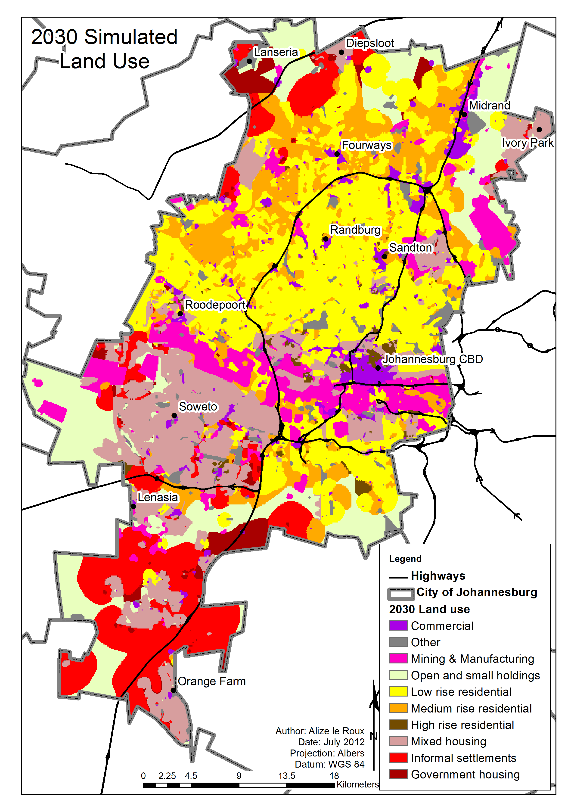
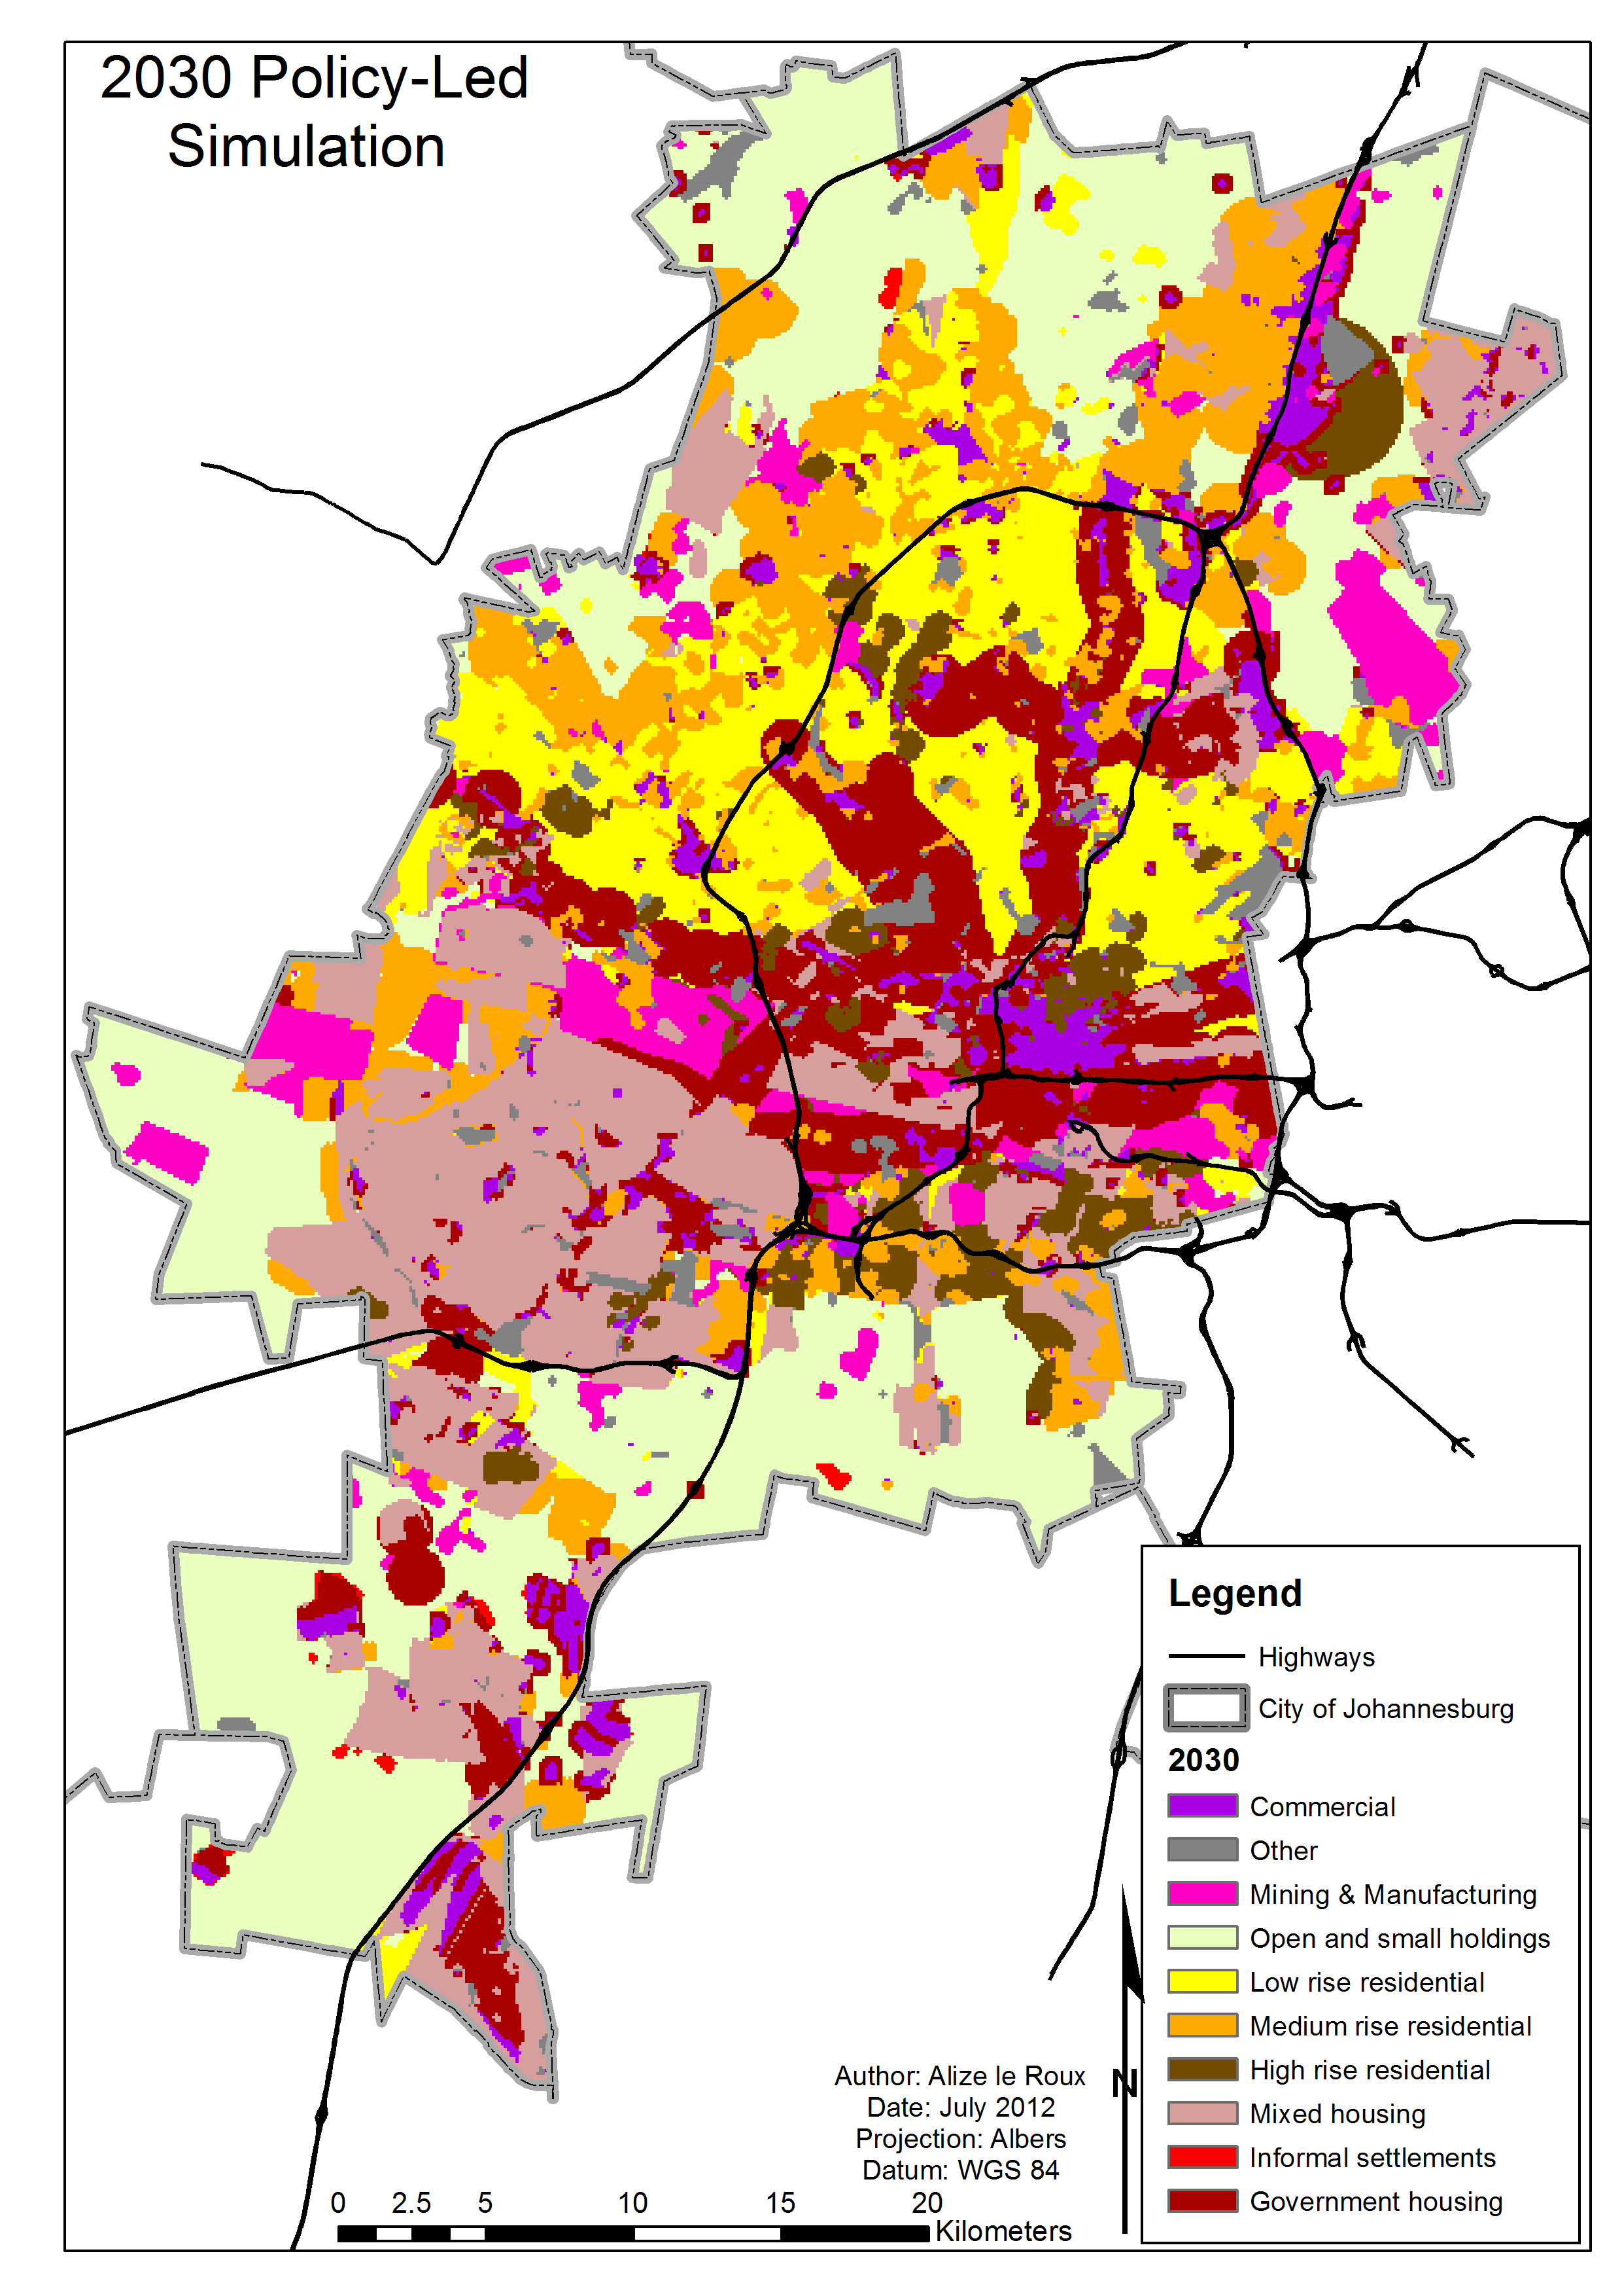
AS-IS Scenario Policy-Led Scenario

Slide 17
Quantifying results
1. Spatial inequality
  Wealth segregation
  Distribution and quantity of economic nodes and centres
  Spatial allocation of demand (Growth patterns and trends)
2. Density patterns
  Amount and location of change (Urban sprawl)
  Densification of transport management nodes (transport sustainability)
3. Commuting distances
  Access to public transport
Indicators | 2007 Base | AS-IS Scenario | Policy-Led Scenario
Wealth segregation | 61% pop South 91% Low-income | 60% pop South 90% Low-income | 52% pop South 78% Low-income
Distribution and quantity of economic nodes and centres | 82% com North 312 patches 127 HH/Ha 18% com South 143 patches 903 HH/HA | 80% com North 325 patches 191 HH/Ha 20% com South 144 patches 1152 HH/Ha | 67% com North 371 patches 221 HH/Ha 33% com South 221 patches 489 HH/Ha

Slide 18
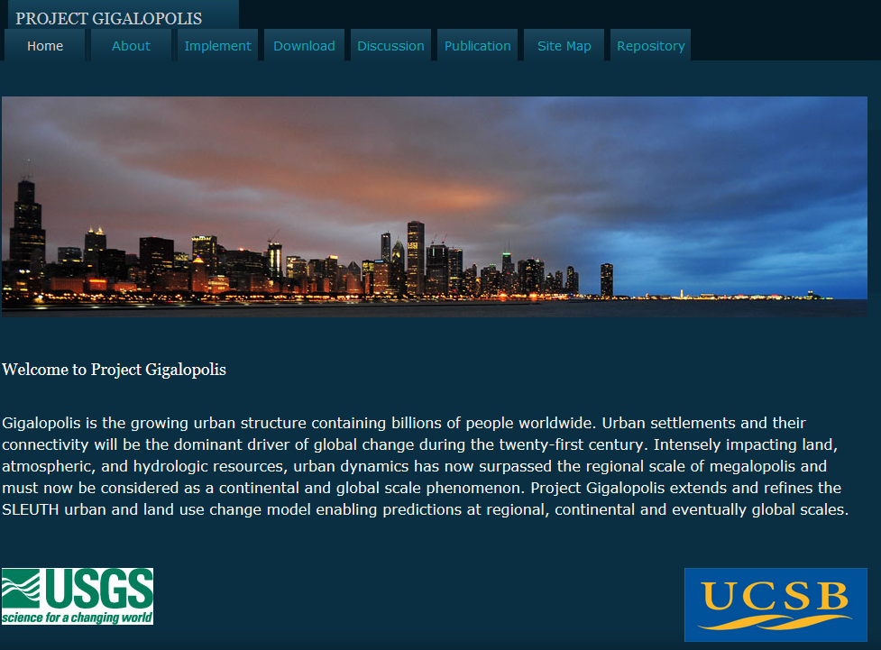
Models @ Local Municipal / Metro Scale
Case study: City of Tshwane
Model: Sleuth
Technique: Cellular Automata model (CA)
Resolution: 500m
Temporal Scale: 2015 – 2030 (year intervals)
What was tested: Urban growth/sprawl
How was it measured: Growth probability
How many scenarios: Not scenario based, Probability of growth based on decades of growth data

Slide 19
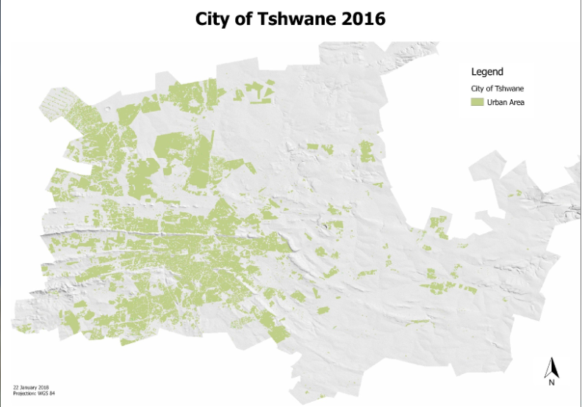
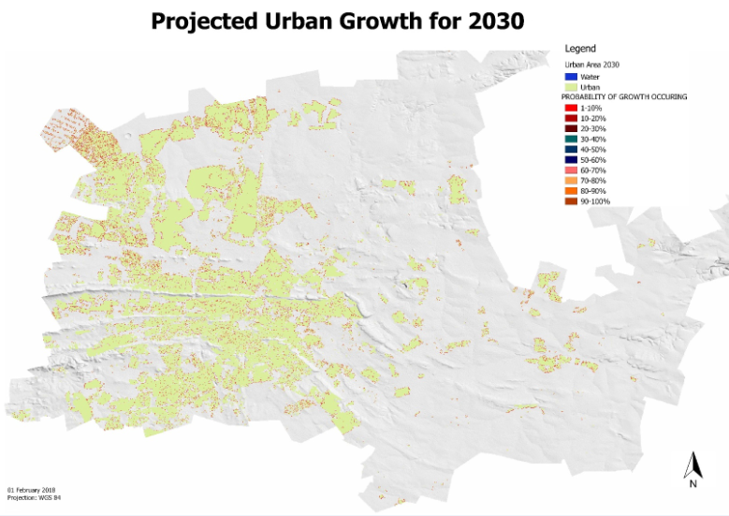
Sleuth growth probability through Machine Learning

Slide 20

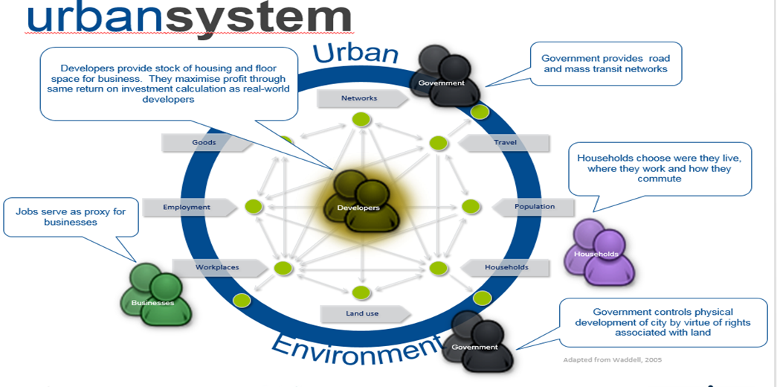
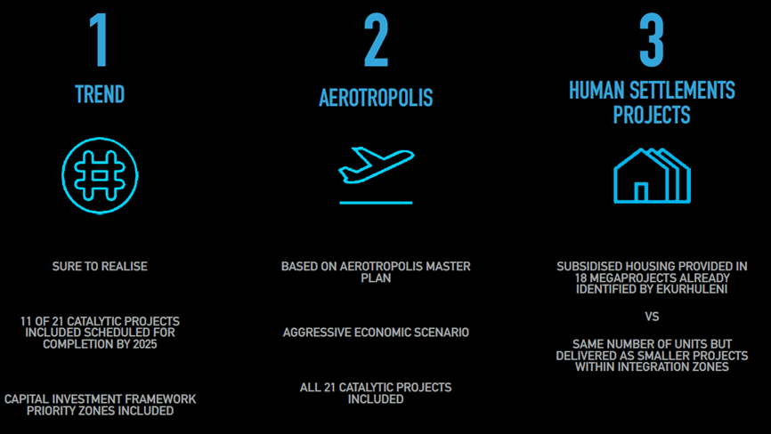
Models @ Local Municipal / Metro Scale
Case study: Ekurhuleni Metropolitan Municipality
Model: UrbanSim
Technique: Agent Based Model (ABM)
Resolution: Erf level
Temporal Scale: 2011 – 2030 (year intervals)
What was tested: Budget Implications & trade-offs
How was it measured: Indicators on access to job opportunities, transport costs, household growth & densification
How many scenarios:
Notes:
Our most advanced powerful urban growth model

Slide 21
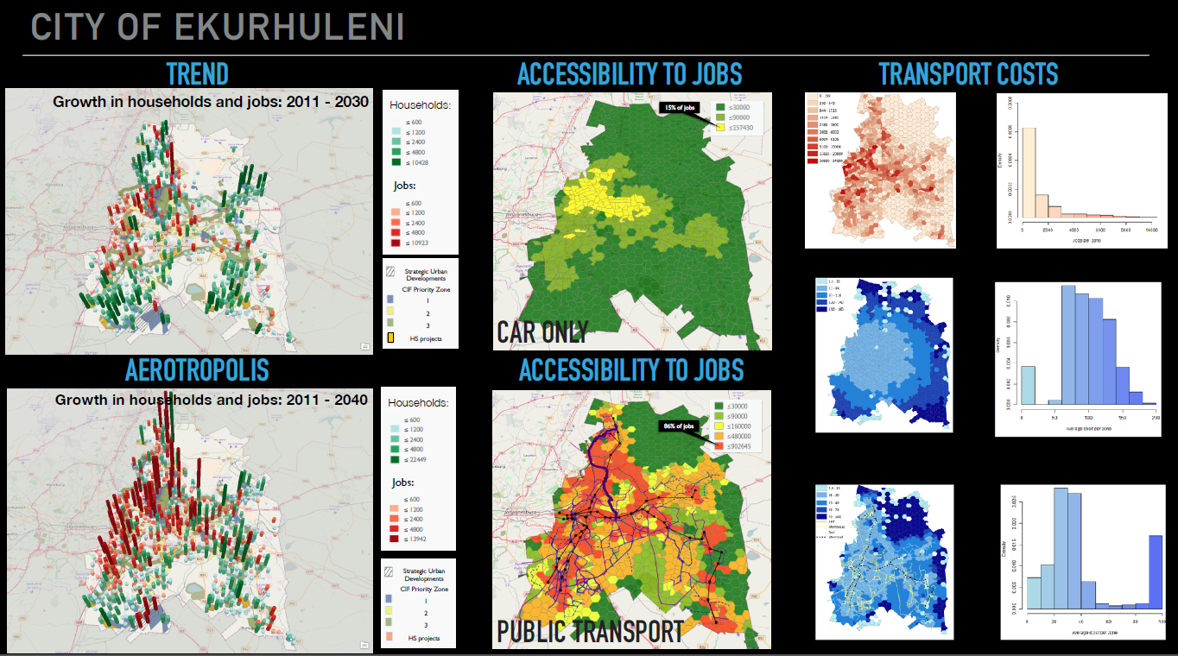
Most advanced modelling capability – ultimate “What-if” tool
Simulates choice behaviour
Successfully implemented in 3 metropolitan cities
We have informed and supported policy and planning processes through testing their spatial strategies, SDF’s, IDP’s etc.
E.g when & how much land should be released for development, the desired land use mix to obtain densities & low transport costs & budget implications of policies etc..

Slide 22
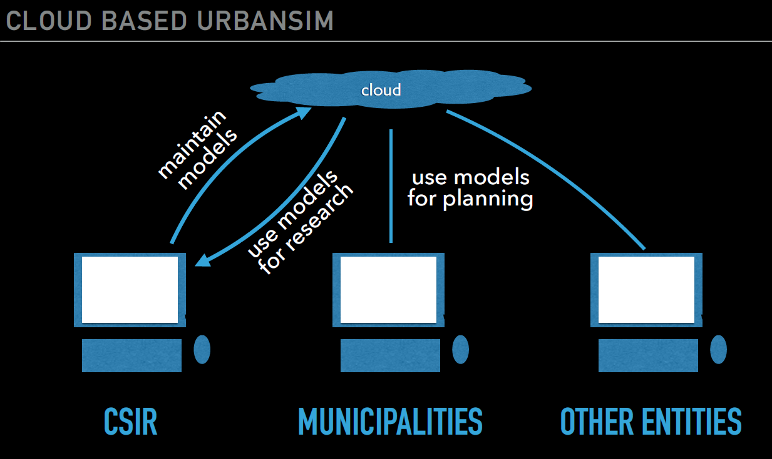
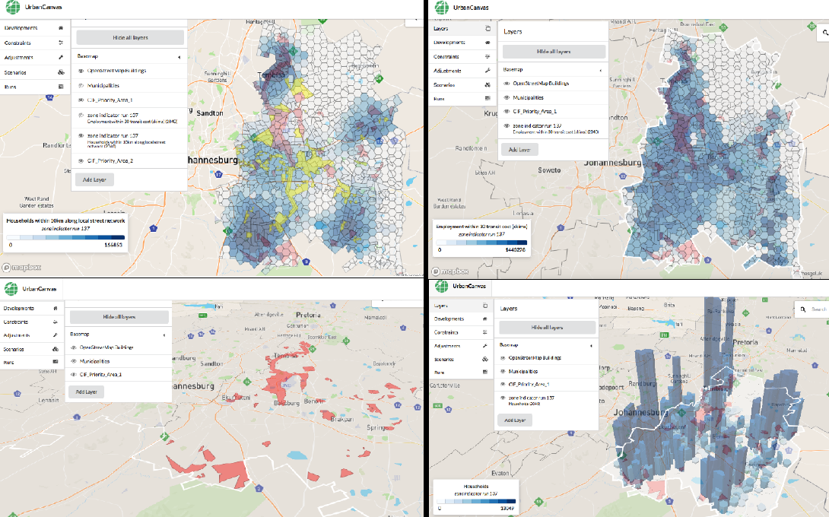
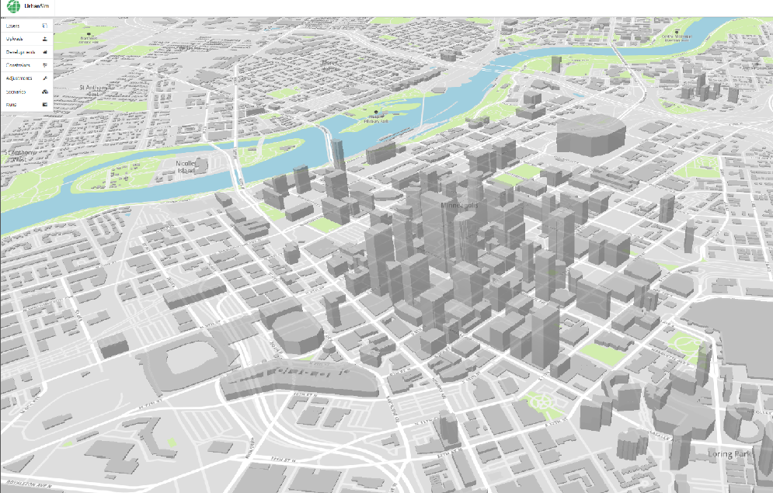
Current Investment: Cloud based UrbanSIM

Slide 23
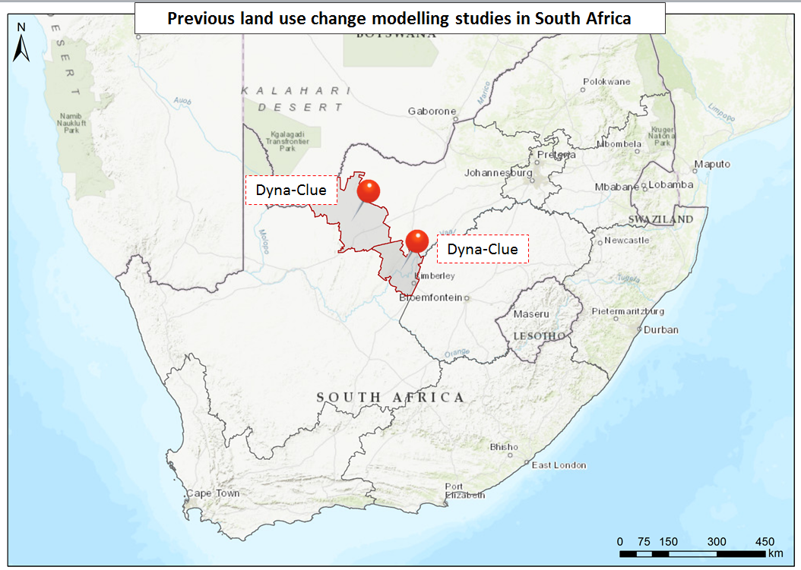
Models @ District Municipality level
CSIR adapted & applied models
Scales:
District Municipal
Models:
Dyna-Clue model
Techniques:
Hybrid
Resolution:
300m
Locations:
Frances Baard DM &
John Taolo Gaetsewe DM
Durban
Port Elizabeth
Notes:
23
Regional modelling initiative
Stakeholder: NC Spluma implementation forum, NC DRDLR, Provincial Government, DM & LM
Model used: Dyna-Clue model
Hybrid model
2 Scenarios
Regional plans & Spatial policies
- tested impact of policies on land use change & town growth/decline
- evidence was used for political engagements

Slide 24
Models @ District Municipality
Case study: John Taolo Gaetsewe DM
Model: Dyna-Clue model
Technique: Hybrid model
Resolution: 300m
Temporal Scale: 2001 – 2030 (year intervals)
What was tested: Regional plans & policies
  Stakeholders: NC Spluma implementation forum, NC DRDLR, Provincial Government, DM & LM representatives
How was it measured: Indicators on land use change & town growth/decline
How many scenarios: 2; Most likely; Most probable. Evidence was used for political engagements

Slide 25
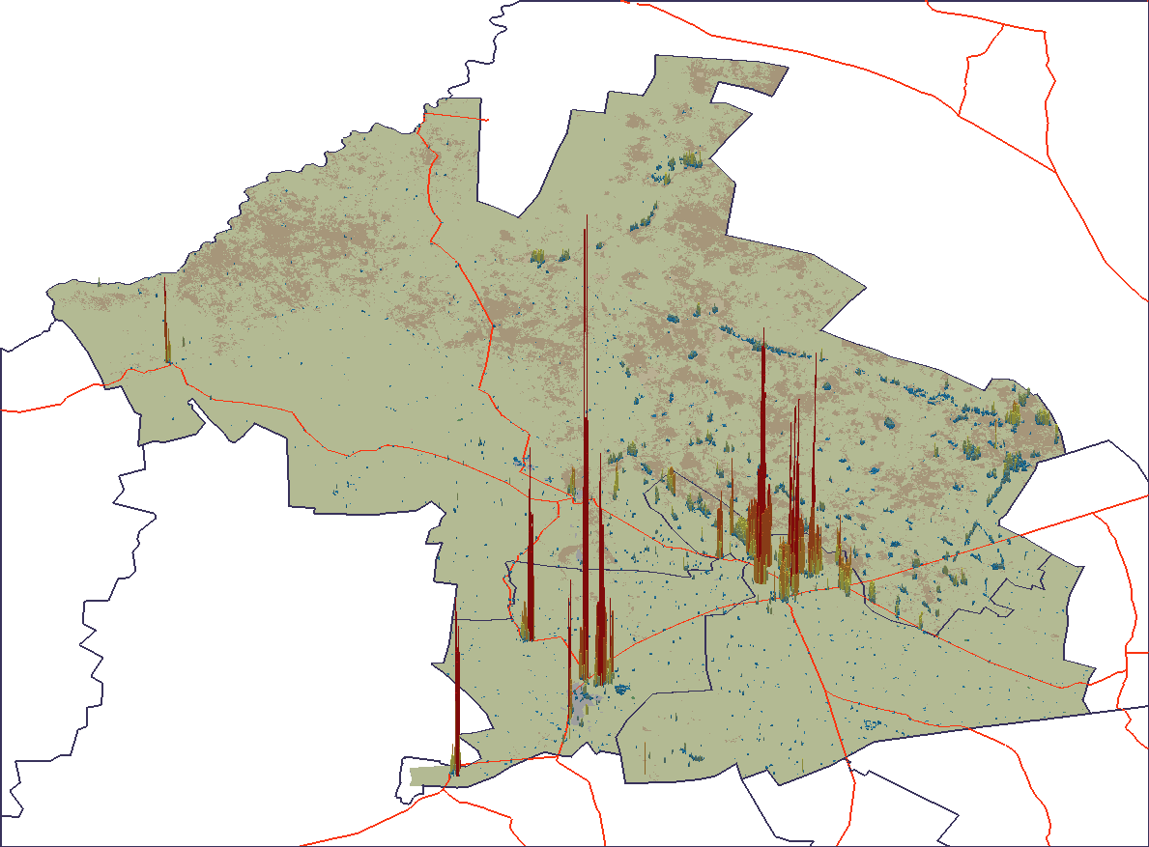
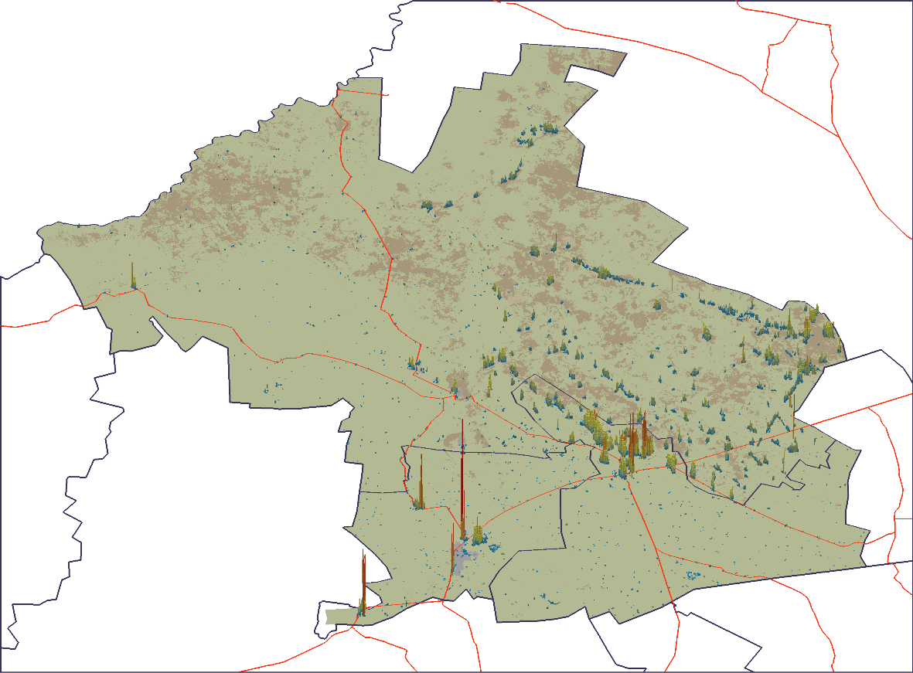

2030
JTG Extrapolated future
JTG Most probable future
15000
10000

Slide 26
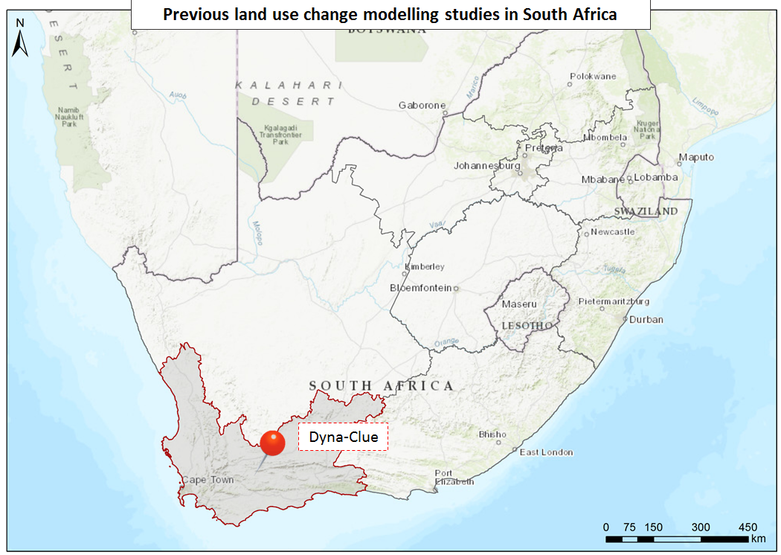
Models @ Provincial level
CSIR developed, adapted & applied models
Scales:
Provincial
Models:
Dyna-Clue model
Techniques:
Hybrid
Resolution:
800m
Locations:
Western Cape
Durban
Port Elizabeth
Notes:
26
Nelson Mandela Bay, GP, Ethekwini Metropolitan Municipality (UrbanSIM)
Johannesburg Metropolitan Municipality (Dyna-Clue)
Cape Town (Watkiss) (Sleuth)
Cape Town (UGM) GIS-based
Cape Town (Soko & Smith) AMB informality
Potchefstroom Spatial MCA (Cilliers)

Slide 27
Models @ District Municipality
Case study: Western Cape Province
Model: Dyna-Clue & Markov Chain
Technique: Hybrid model & Stochastic model
Resolution: 800m
Temporal Scale: 1990 – 2015 (year intervals)
What was tested: Regional plans & policies
  Stakeholders: Local and District Municipal planning officials
  How was it measured: Indicators on types and location of land use change
  How many scenarios: 2; As-IS; Strict policy scenario (NEMA, SDF’s)

Slide 28
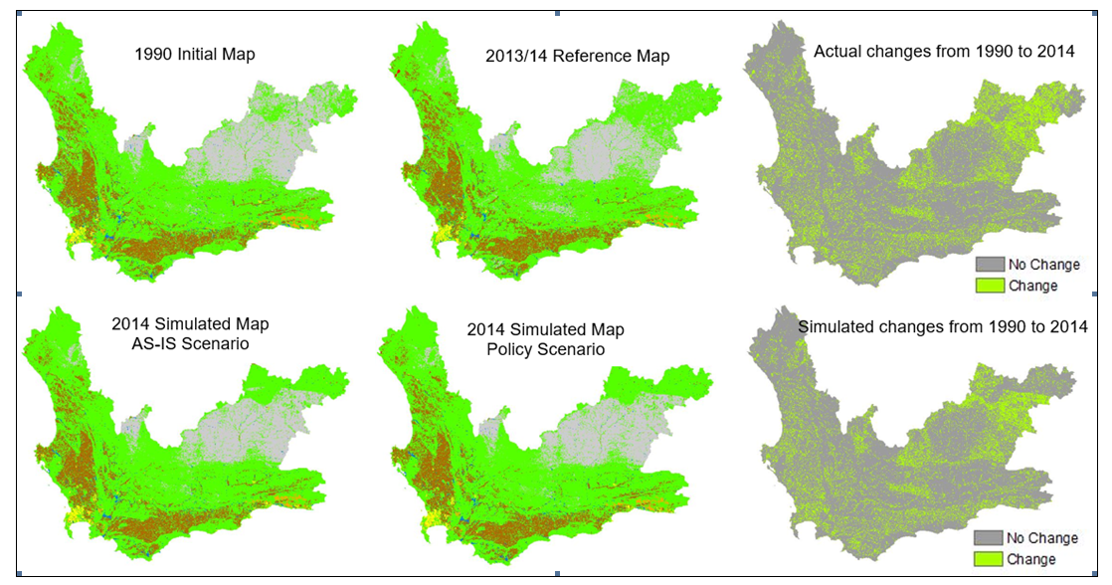
Notes:
quickly analyse spatial patterns which could otherwise be undetectable through statistical methods
Visual analysis was done using IDRISI crosstabulation with hard classification analysis. Hard classification analysis is used when pixels in maps belong to exactly one category without any partial membership to more than one category
The outputs of hard classification crosstabulation analysis of the two sets of maps were cross classification images which consisted of pixels that showed a combination of categories of the maps being compared
These images allowed visualisation of changes that occurred between each LULC category and every other LULC category/class
To simplify the visualisation analysis results, the output cross classification image from analysis of the 1990 LULC map and the 2013/14 LULC reference map was reclassified in ArcMap to show pixels where changes occurred and where there were no changes (top right of figure)
Similarly, the image at the bottom right of figure gives an indication of changes that occurred between the 1990 initial map and the 2014 AS-IS scenario simulated map
The 2014 Policy-Led scenario map was created using national parks as the restriction area and slightly different parameters
The maps of actual LULC changes and simulated changes display some similarities in changes in LULC throughout the province, though there are a few differences.

Slide 29
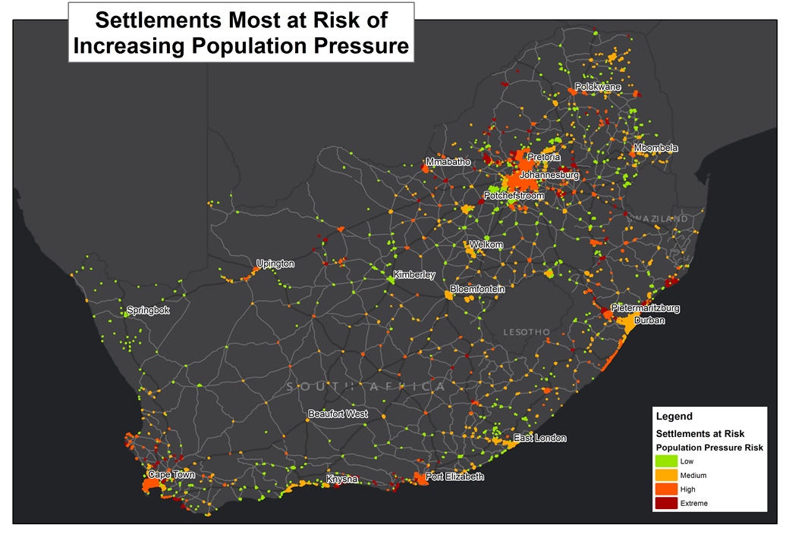
Typical questions @ National level
CSIR developed, adapted & applied models
Scales:
National
Models:
Inter settlement growth model
Resolution:
Settlement level (aggregated up from 1x1sqkm)
Techniques:
Gravity based spatial allocation model
Locations:
Entire South Africa
Durban
Port Elizabeth
Notes:
29

Slide 30
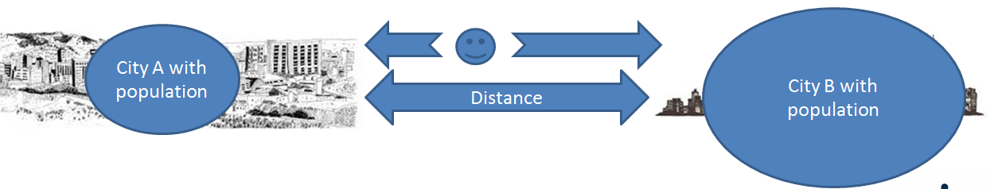
Models @ National level
Case study: Entire South Africa
Model: Inter-Settlement Growth Model (ISG-Model)
Technique: Gravity model with coupling to demographic models
Resolution: 1x1sqkm
Temporal Scale: 2011 – 2050 (year intervals)
What was tested: Growth/Decline of settlement across S.A/ Movement of people between settlements
  How was it measured: Settlements experiencing growth pressure
  How many scenarios: Medium & High Growth Scenario
  Envisioned use: Long-term planning for all sectors and spheres

Slide 31

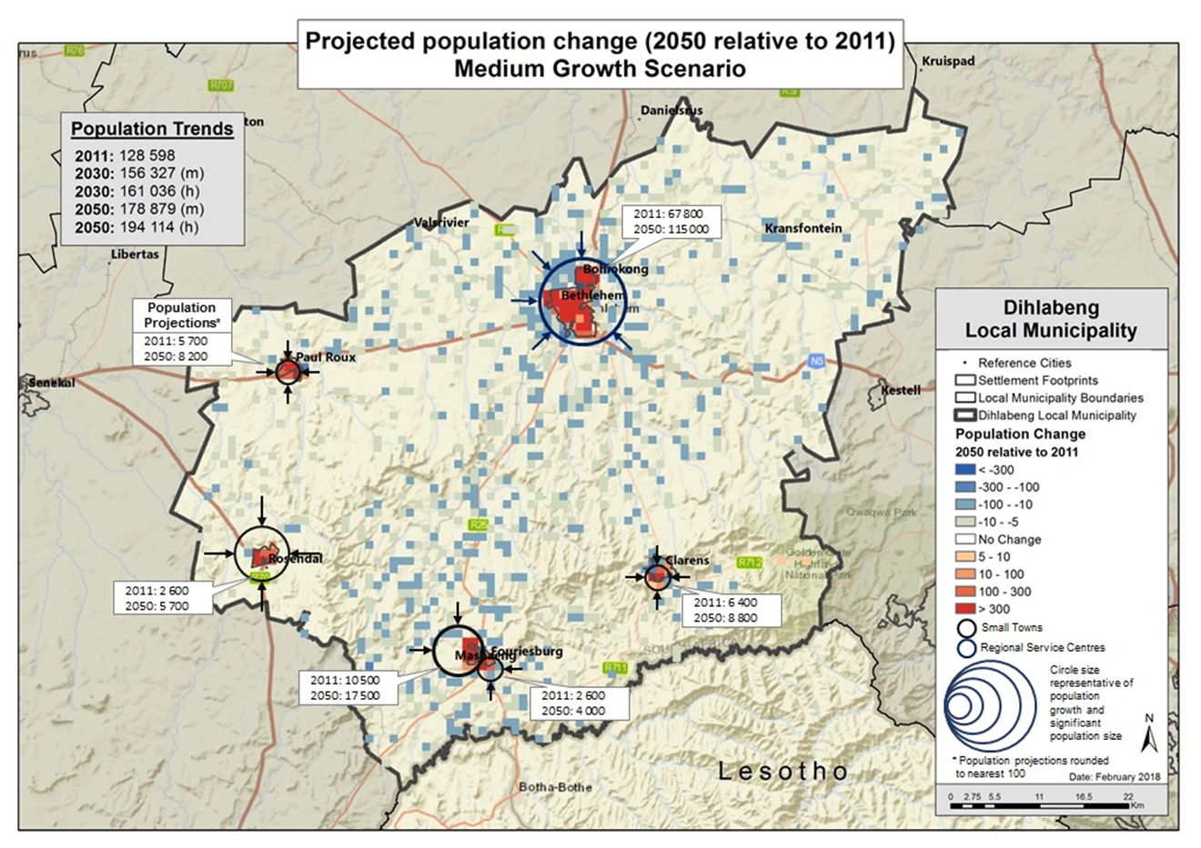

Slide 32
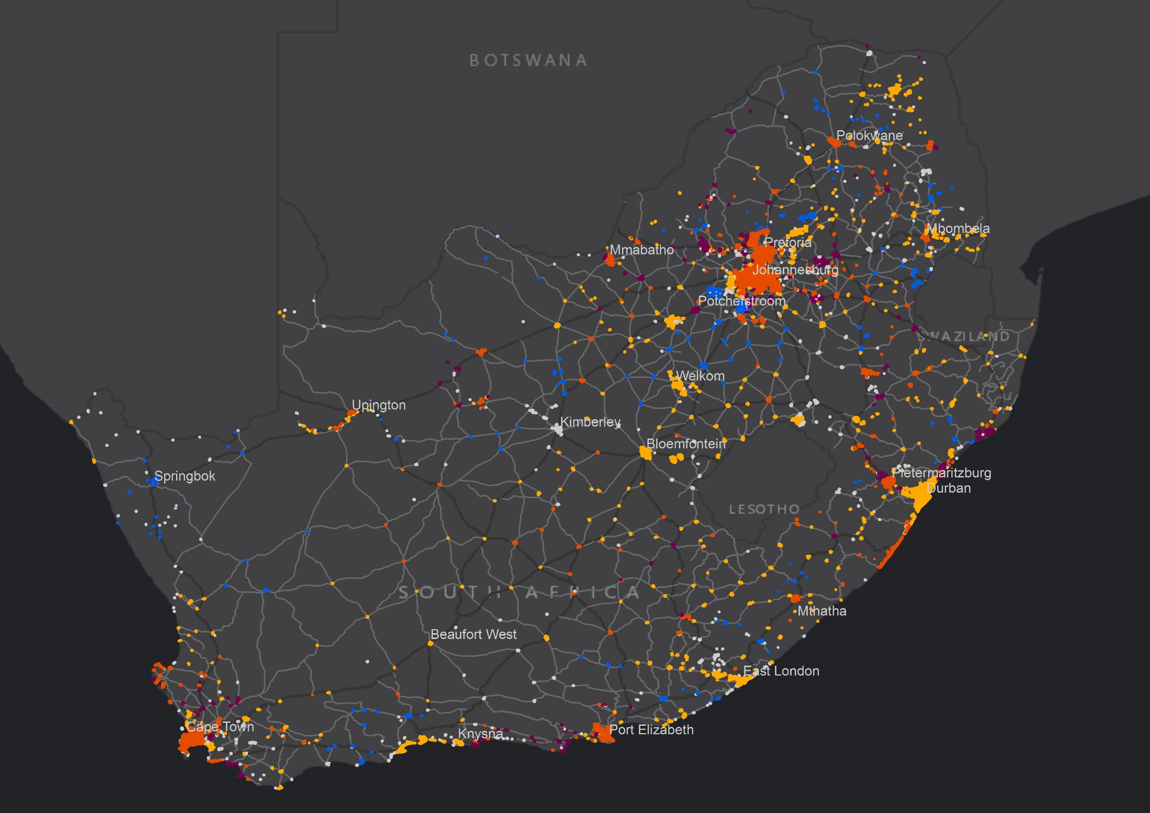
2030 Trend scenario
Population Growth Pressure
 | Declining
 | No Change
 | Medium
 | High
 | Extreme

Slide 33
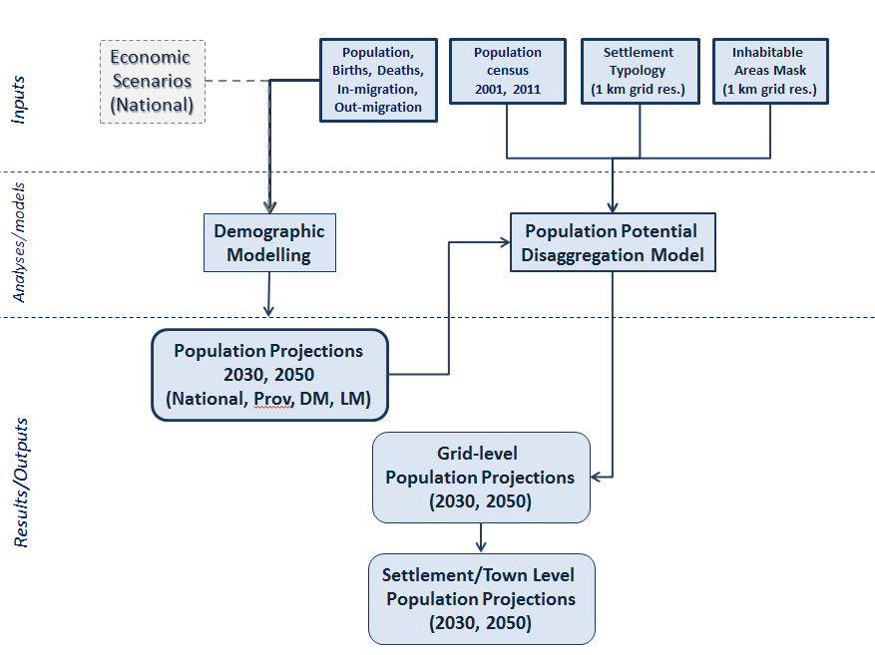
ISG model: Current investment
Economic Scenarios (National
Population Census (Births, Deaths, In/out-Migration)
Population (Census-EA, 2001, 2011)
Settlement Typology (1x1 km grid
Inhabitable Area Mask (1x1 km grid)
Current investment in making this an interactive web-based scenario testing platform that can simulate:
How policies (e.g IUDF) or major government interventions (DHS, SEZs etc.) impact the movement of people
How economic shifts impact movement
How a shifting climate and resource availability pushes/pulls people
Demographic models (Spectrum & Cohort-component)
Population potential model
Population projections 2030, 2050
(National, Prov, Dm, LM)
Population projections (2030, 2050) 1x1 km grid
Settlement level population projections (2030, 2050)

Slide 34
Success vs. Pitfalls
Envisioned
  War room with real time scenario development (not-yet)
  Municipalities will jump at the opportunity
Reality
    Getting buy-in and confidence in models takes a long time
    Significant investment
  Getting a shared vision (scenario) is the hardest part
  Evidence not always considered if in conflict with vision
  Well matured technology accepted
Notes:
scenario development is time consuming if done in an integrated cross collaboration way between departments in the municipalities. (planners, engineers, housing department, bulk water services etc. don’t share the same vision)
Investment. Even if not paying for development, municipal time is important.
Focus on multi-level approach
Economic growth
Investing in economic opportunities
Job creation of medium/small enterprises
Investment in human capital

Slide 35
Value of regional land use change models
Land use policies have a lasting impact spatial legacy
Policies have direct impact on livelihoods of people
Planners need to understand their ‘unintended’ consequences (Impact assessment of policies)
Quantify the effect of policies on land use patterns
The model can therefore be used to support future land use planning
LULC change models can be used to guide planners in making informed decisions
Used to create a balance between accommodating growth pressures & preservation the natural environment
Offer a unique opportunity to study the system
Produces scientific evidence to support policy debates
Doesn’t predict land use change but monitors and evaluates ‘What-if’ scenarios
Planning Support tool advising decision makers (Promoting discussion and awareness between stakeholders)

Slide 36
Thank you
ALeroux1@csir.co.za

Slide 37
List of publications
Tizora P, le Roux A, Mans G, Cooper A. Adapting the Dyna-Clue Model for simulating land use and land cover change in the Western Cape Province, South Africa. South Africa Journal of Geomagnetic
Le Roux A, Augustijn P.W.M. 2017. Quantifying the spatial implications of future land use policies in South Africa. Article in South African Geography Journal. Volume 99, Issue 1 (2017), page 29-51.
Ludick C & le Roux A. Simulating the impact of planning policies on the City of Tshwane. A geospatial modelling approach using the What-if planning support model. AfricaGEO conference 2018.
Tizora P, Le Roux A, Mans G & Cooper A. 2016. Land Use and Land Cover change in the Western Cape Province: Quantification of change & understanding of driving factors. Planning Africa 2016. P. 108-125
Coetzee M, Waldeck L, Le Roux A, Meiklejohn C, van Niekerk W, Leuta T. 2014. Spatial policy, planning and infrastructure investment: Lessons from urban simulations in three South African cities. Town and Regional Planning: Issue 64 (2014), page 1-9.
Waldeck, J.L. & Van Heerden, Q. 2016. Integrated land-use and transportation modelling in developing countries: using OpenTripPlanner to determine lowest-cost commute trips. Book Chapter in: Transportation, Land Use, and Integration: Applications in Developing Countries. Edited by: I.M. Schoeman. Published by: WIT Press. ISBN: 978-1-78466-233-2.
Van Heerden, Q., Ludick, C. le Roux, A., Mans, G., Veramoothea, P & Gxumisa, A. Predicting urban growth in the city of Tshwane using SLEUTH. Unpublished paper. 2018.
Le Roux, A., Makhanya-Khuluse, S., Mans, G., Wools, L., van Tonder, L., & Arnold, K. Intra-Settlement growth model. Constructing a model for predicting the growth and decline of settlements across South Africa. (Unpublished)
Le Roux, A., Mokilane, P., McKelly, D., van Huyssteen, E. & Mans, G. 2015. Technical input requirements to use the DYNA_CLUE model. The Frances Baard- Clue application. Unpublished technical Report. CSIR GWDMS No: 250223
Le Roux, A. 2013. Implementing land use change models in the developing world. Reshaping cities through urban land use modelling. Presentation at 2013 ESRI International user conference, San Dieg, California, USA.
Le Roux A.2016. 2 Part lecture series. ‘Modelling & Simulating to answer the ‘What-if’ questions’ presented to final year Geo-informatics students at UP.
2014. Mr P.G dos Santos & A. Le Roux. Simulating the growth of backyard shack formation in the Johannesburg Metropolitan Municipality.

